Slide 1
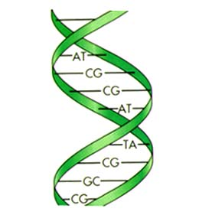
Sequence Similarity Searching 19th September, 2016
Ansuman Chattopadhyay, PhD,
Head, Molecular Biology Information Service
Health Sciences Library System
University of Pittsburgh
ansuman@pitt.edu
http://www.hsls.pitt.edu/guides/genetics

Slide 2
Objectives
science behind BLAST
basic BLAST search
advanced BLAST search
PSI BLAST
PHI BLAST
Delta Blast
pairwise BLAST
Multiple Sequence Alignments
http://www.hsls.pitt.edu/guides/genetics

Slide 3
you will be able to…..
find homologous sequence for a sequence of interest :
Nucleotide:
TTGGATTATTTGGGGATAATAATGAAGATAGCAA
TTATCTCAGGGAAAGGAGGAGTAGGAAAATCTTC
TA TTTCAACATCCTTAGCTAAGCTGTTTTCAAAAG
AGTTTAATATTGTAGCATTAGATTGTGATGTTGAT
Protein:
MSVMYKKILYPTDFSETAEIALKHVKAFKTLKAEEVILLHVIDER
EIKKRDIFSLLLGVAGLNKSVEEFE NELKNKLTEEAKNKMENIK
KELEDVGFKVKDIIVVGIPHEEIVKIAEDEGVDIIIMGSHGKTNLKEILLG
http://www.hsls.pitt.edu/guides/genetics

Slide 4
you will be able to…..
find statistically significant matches, based on sequence similarity, to a protein or nucleotide sequence of interest.
obtain information on inferred function of the gene or protein.
find conserved domains in your sequence of interest that are common to many sequences.
compare two known sequences for similarity.
http://www.hsls.pitt.edu/guides/genetics

Slide 5
Blast search
Jurassic park sequence
The Lost World sequence
http://www.hsls.pitt.edu/guides/genetics

Slide 6
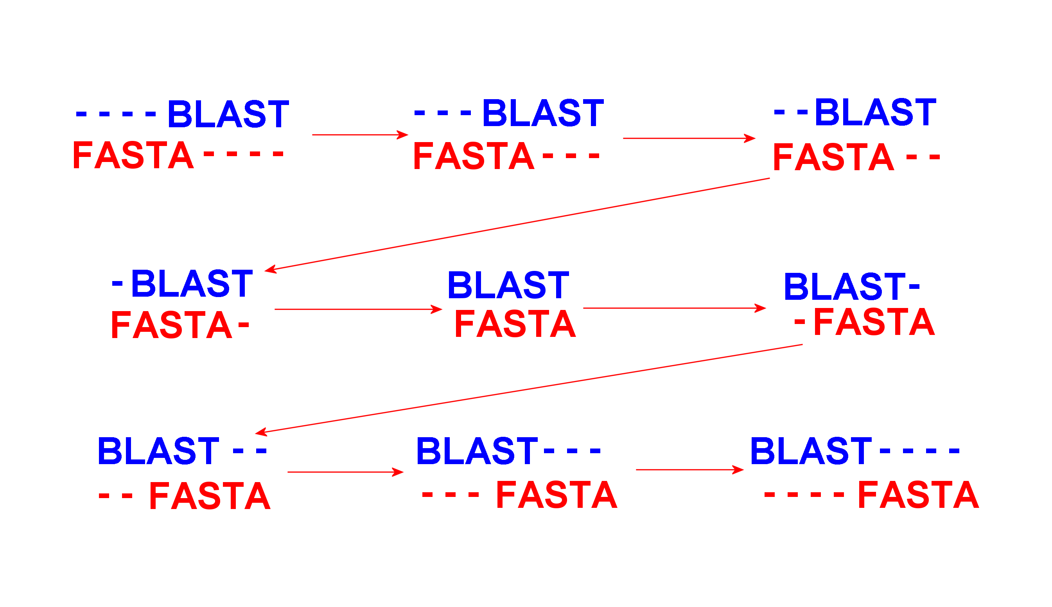
Sequence Alignment
“BLAST” and “FASTA”
What is the best alignment ?
http://www.hsls.pitt.edu/guides/genetics

Slide 7
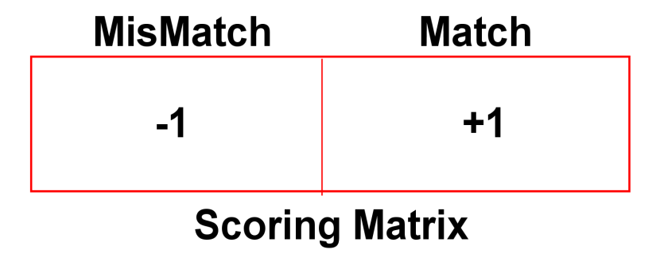
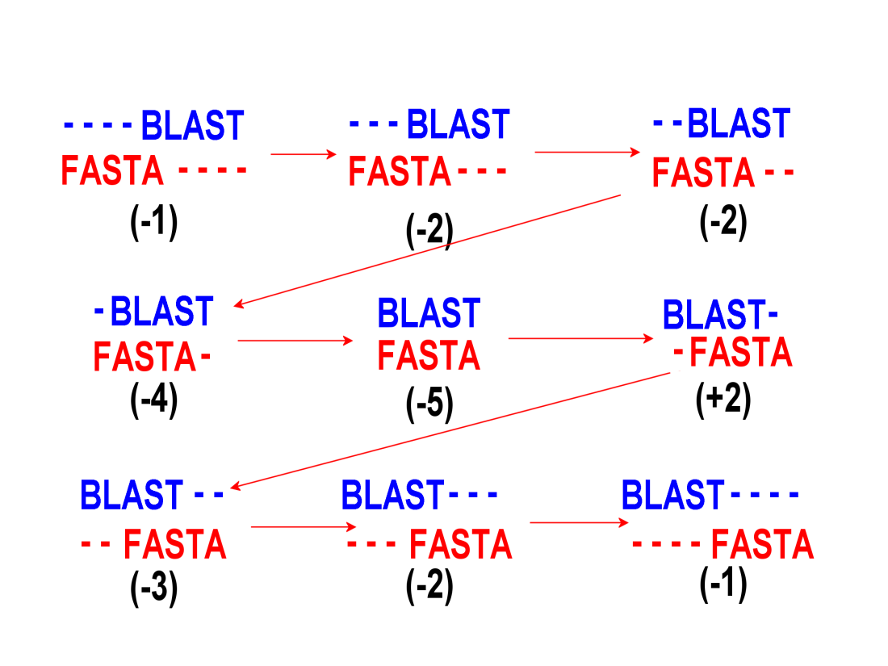
Sequence Alignment Score
Best Scoring Alignment
http://www.hsls.pitt.edu/guides/genetics

Slide 8
Growth of GenBank
Sequence Alignment etween….
TACATTAGTGTTTATTACATTGAGAAACTTTATAATTAAAAAAGATTCATGTAAATTTCTTATTTGTTTA
TTTAGAGGTTTTAAATTTAATTTCTAAGGGTTTGCTGGTTTGATTGTTTAGAATATTTAACTTAATCAAA
TTATTTGAATTTTTGAAAATTAGGATTAATTAGGTAAGTAAATAAAATTTCTCTAACAAATAAGTTAAAT T
TATTATGAAGTAGTTACTTACCCTTAGAAAAATATGGTATAGAAAAGCTTAAATATTAAGAGTGATGAAG
and
http://www.hsls.pitt.edu/guides/genetics

Slide 9
Sequence Alignment Algorithms
Dynamic Programming:
Needleman Wunsch Global Alignment (1970):
Smith-Waterman Local Alignment (1981):
mathematically rigorous, guaranteed to find the best scoring
Alignment between the pair of sequence being compared.
….. Slow, takes 20-25 minutes at our super computer center for a query of
470 amino acids against a database of 89,912 sequences.
FASTA : heuristic approximations to Smith-waterman ( Lipman and Pearson, 1985)
Basic Local Alignment Search Tools (1991)
BLAST: an approximation to a simplified version of Smith-Waterman
http://www.hsls.pitt.edu/guides/genetics

Slide 10
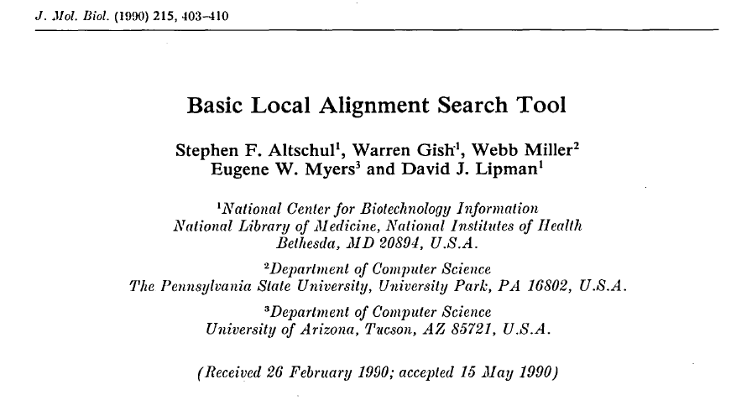
BLAST Paper
Cited by in Scopus (31720)
http://www.hsls.pitt.edu/guides/genetics

Slide 11
BLAST
Basic Local Alignment Search Tool. (Altschul et al. 1991) A sequence comparison algorithm optimized for speed used to search sequence databases for optimal local alignments to a query.
The initial search is done for a word of length "W" that scores at least "T" when compared to the query using a substitution matrix. Word hits are then extended in either direction in an attempt to generate an alignment with a score exceeding the threshold of "S". The "T" parameter dictates the speed and sensitivity of the search.
http://www.hsls.pitt.edu/guides/genetics

Slide 12
BLAST steps
Step 1 - Indexing
Step 2 – Initial Searching
Step 3 - Extension
Step 4 - Gap insertion
Step 5 - Score reporting
http://www.hsls.pitt.edu/guides/genetics

Slide 13
How BLAST Works….. Word Size
The initial search is done for a word of length "W" that scores at least "T" when compared to the query using a substitution matrix.
Word hits are then extended in either direction in an attempt to generate an alignment with a score exceeding the threshold of "S".
The "T" parameter dictates the speed and sensitivity of the search.
Word Size= 5
http://www.hsls.pitt.edu/guides/genetics

Slide 14
Step 1: BLAST Indexing
The initial search is done for a word of length "W" that scores at least "T" when compared to the query using a substitution matrix. Word hits are then extended in either direction in an attempt to generate an alignment with a score exceeding the threshold of "S". The "T" parameter dictates the speed and sensitivity of the search.
Query:
NKCKTPQGQRLVNQWIKQPLMD………
NKC
KCK
CKT
KTP
TPQ
PQG
QGQ
GQR……..
Protein:
Word Size= 3
Nucleotide
Word Size= 11
http://www.hsls.pitt.edu/guides/genetics

Slide 15
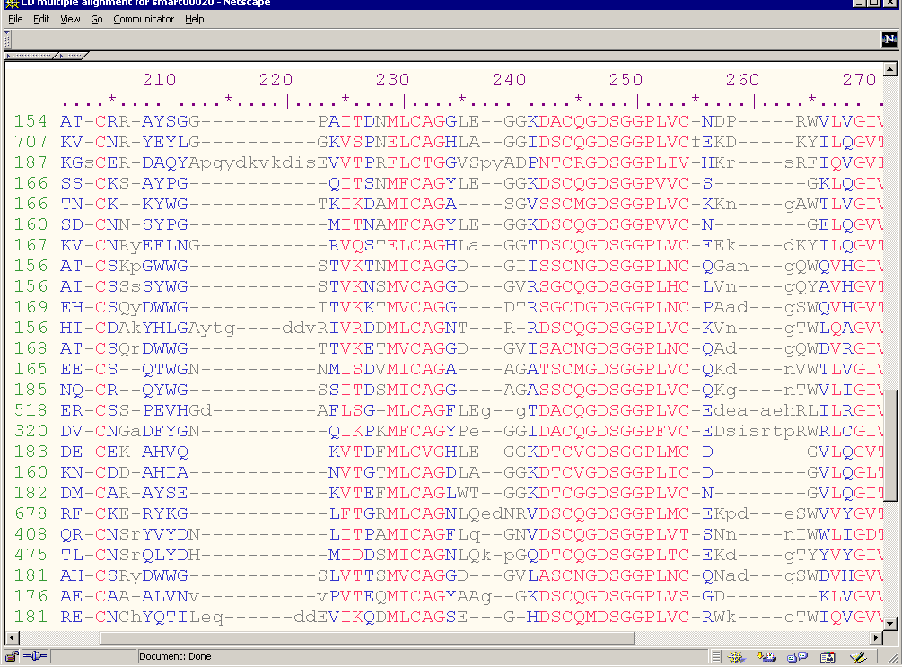
Score the alignment
Multiple sequence alignment of Homologous Proteins
I,V,L,F
A substitution matrix containing values proportional to the probability
that amino acid i mutates into amino acid j for all pairs of amino acids.
such matrices are constructed by assembling a large and diverse sample
of verified pair wise alignments of amino acids. If the sample is large enough to
be statistically significant, the resulting matrices should reflect the true
probabilities of mutations occurring through a period of evolution.

Slide 16
Substitution Matrix…a look up table
Percent Accepted Mutation (PAM)
Blocks Substitution Matrix (BLOSUM)
http://www.hsls.pitt.edu/guides/genetics

Slide 17
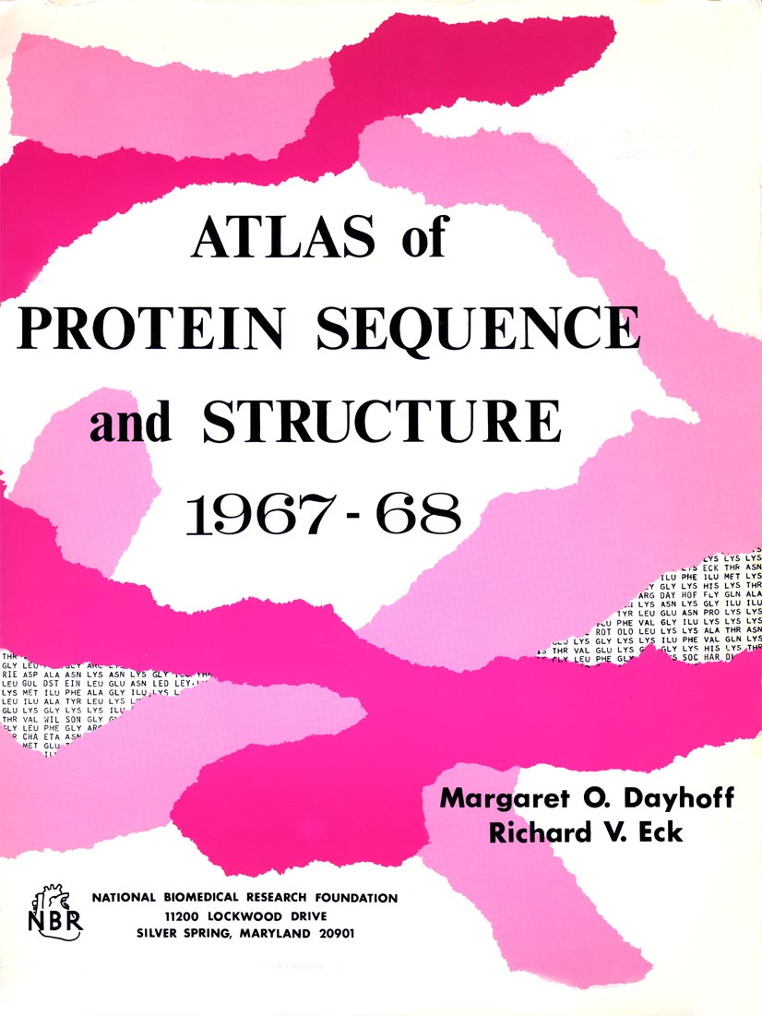
Percent Accepted Mutation (PAM)
A unit introduced by Dayhoff et al. to quantify the amount of evolutionary change in a protein sequence.
1.0 PAM unit, is the amount of evolution which will change, on average,
1% of amino acids in a protein sequence. A PAM(x) substitution matrix is a look-up table in which scores for each amino acid substitution have
been calculated based on the frequency of that substitution in closely related proteins that have experienced a certain amount (x) of evolutionary divergence.
Margaret Dayhoff
http://www.hsls.pitt.edu/guides/genetics

Slide 18
Blocks Substitution Matrix
A substitution matrix in which scores for each position are derived from observations of the frequencies of substitutions in blocks of local alignments in related proteins.
Each matrix is tailored to a particular evolutionary distance.
In the BLOSUM62 matrix, for example, the alignment from
which scores were derived was created using sequences
sharing no more than 62% identity. Sequences more identical
than 62% are represented by a single sequence in the alignment
so as to avoid over-weighting closely related family members.
(Henikoff and Henikoff)
http://www.hsls.pitt.edu/guides/genetics

Slide 19
BLOSUM62
A 4
R -1 5
N -2 0 6
D -2 -2 1 6
C 0 -3 -3 -3 9
Q -1 1 0 0 -3 5
E -1 0 0 2 -4 2 5
G 0 -2 0 -1 -3 -2 -2 6
H -2 0 1 -1 -3 0 0 -2 8
I -1 -3 -3 -3 -1 -3 -3 -4 -3 4
L -1 -2 -3 -4 -1 -2 -3 -4 -3 2 4
K -1 2 0 -1 -3 1 1 -2 -1 -3 -2 5
M -1 -1 -2 -3 -1 0 -2 -3 -2 1 2 -1 5
F -2 -3 -3 -3 -2 -3 -3 -3 -1 0 0 -3 0 6
P -1 -2 -2 -1 -3 -1 -1 -2 -2 -3 -3 -1 -2 -4 7
S 1 -1 1 0 -1 0 0 0 -1 -2 -2 0 -1 -2 -1 4
T 0 -1 0 -1 -1 -1 -1 -2 -2 -1 -1 -1 -1 -2 -1 1 5
W -3 -3 -4 -4 -2 -2 -3 -2 -2 -3 -2 -3 -1 1 -4 -3 -2 11
Y -2 -2 -2 -3 -2 -1 -2 -3 2 -1 -1 -2 -1 3 -3 -2 -2 2 7
V 0 -3 -3 -3 -1 -2 -2 -3 -3 3 1 -2 1 -1 -2 -2 0 -3 -1 4
X 0 -1 -1 -1 -2 -1 -1 -1 -1 -1 -1 -1 -1 -1 -2 0 0 -2 -1 -1 -1
A R N D C Q E G H I L K M F P S T W Y V X
Common amino acids have low weights
Rare amino acids have high weights

Slide 20
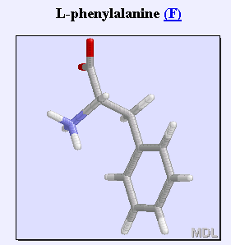
BLOSUM62
A 4
R -1 5
N -2 0 6
D -2 -2 1 6
C 0 -3 -3 -3 9
Q -1 1 0 0 -3 5
E -1 0 0 2 -4 2 5
G 0 -2 0 -1 -3 -2 -2 6
H -2 0 1 -1 -3 0 0 -2 8
I -1 -3 -3 -3 -1 -3 -3 -4 -3 4
L -1 -2 -3 -4 -1 -2 -3 -4 -3 2 4
K -1 2 0 -1 -3 1 1 -2 -1 -3 -2 5
M -1 -1 -2 -3 -1 0 -2 -3 -2 1 2 -1 5
F -2 -3 -3 -3 -2 -3 -3 -3 -1 0 0 -3 0 6
P -1 -2 -2 -1 -3 -1 -1 -2 -2 -3 -3 -1 -2 -4 7
S 1 -1 1 0 -1 0 0 0 -1 -2 -2 0 -1 -2 -1 4
T 0 -1 0 -1 -1 -1 -1 -2 -2 -1 -1 -1 -1 -2 -1 1 5
W -3 -3 -4 -4 -2 -2 -3 -2 -2 -3 -2 -3 -1 1 -4 -3 -2 11
Y -2 -2 -2 -3 -2 -1 -2 -3 2 -1 -1 -2 -1 3 -3 -2 -2 2 7
V 0 -3 -3 -3 -1 -2 -2 -3 -3 3 1 -2 1 -1 -2 -2 0 -3 -1 4
X 0 -1 -1 -1 -2 -1 -1 -1 -1 -1 -1 -1 -1 -1 -2 0 0 -2 -1 -1 -1
A R N D C Q E G H I L K M F P S T W Y V X
Positive for more likely substitution

Slide 21
BLOSUM62
A 4
R -1 5
N -2 0 6
D -2 -2 1 6
C 0 -3 -3 -3 9
Q -1 1 0 0 -3 5
E -1 0 0 2 -4 2 5
G 0 -2 0 -1 -3 -2 -2 6
H -2 0 1 -1 -3 0 0 -2 8
I -1 -3 -3 -3 -1 -3 -3 -4 -3 4
L -1 -2 -3 -4 -1 -2 -3 -4 -3 2 4
K -1 2 0 -1 -3 1 1 -2 -1 -3 -2 5
M -1 -1 -2 -3 -1 0 -2 -3 -2 1 2 -1 5
F -2 -3 -3 -3 -2 -3 -3 -3 -1 0 0 -3 0 6
P -1 -2 -2 -1 -3 -1 -1 -2 -2 -3 -3 -1 -2 -4 7
S 1 -1 1 0 -1 0 0 0 -1 -2 -2 0 -1 -2 -1 4
T 0 -1 0 -1 -1 -1 -1 -2 -2 -1 -1 -1 -1 -2 -1 1 5
W -3 -3 -4 -4 -2 -2 -3 -2 -2 -3 -2 -3 -1 1 -4 -3 -2 11
Y -2 -2 -2 -3 -2 -1 -2 -3 2 -1 -1 -2 -1 3 -3 -2 -2 2 7
V 0 -3 -3 -3 -1 -2 -2 -3 -3 3 1 -2 1 -1 -2 -2 0 -3 -1 4
X 0 -1 -1 -1 -2 -1 -1 -1 -1 -1 -1 -1 -1 -1 -2 0 0 -2 -1 -1 -1
A R N D C Q E G H I L K M F P S T W Y V X
Negative for less likely substitution
Source NCBI

Slide 22
Scoring Matrix
A G C T
A +1 –3 –3 -3
G –3 +1 –3 -3
C –3 –3 +1 -3
T –3 –3 –3 +1
Nucleotide :
Protein:
Position Independent Matrices
PAM Matrices (Percent Accepted Mutation)
BLOSUM Matrices (Block Substitution Matrices)
Position Specific Score Matrices (PSSMs)
PSI and RPS BLAST
http://www.hsls.pitt.edu/guides/genetics

Slide 23
Alignment Score
Query:
NKCKTPQGQRLVNQWIKQPLMD………
NKC
KCK
CKT
KTP
TPQ
PQG
QGQ
GQR……..
…PQG…
…PQA…
..PQG..
..PEG..
…PQG…
…PQG…
Query
Database
http://www.hsls.pitt.edu/guides/genetics

Slide 24
Alignment Score
Step 2: Initial Searching
A 4
R -1 5
N -2 0 6
D -2 -2 1 6
C 0 -3 -3 -3 9
Q -1 1 0 0 -3 5
E -1 0 0 2 -4 2 5
G 0 -2 0 -1 -3 -2 -2 6
H -2 0 1 -1 -3 0 0 -2 8
I -1 -3 -3 -3 -1 -3 -3 -4 -3 4
L -1 -2 -3 -4 -1 -2 -3 -4 -3 2 4
K -1 2 0 -1 -3 1 1 -2 -1 -3 -2 5
M -1 -1 -2 -3 -1 0 -2 -3 -2 1 2 -1 5
F -2 -3 -3 -3 -2 -3 -3 -3 -1 0 0 -3 0 6
P -1 -2 -2 -1 -3 -1 -1 -2 -2 -3 -3 -1 -2 -4 7
S 1 -1 1 0 -1 0 0 0 -1 -2 -2 0 -1 -2 -1 4
T 0 -1 0 -1 -1 -1 -1 -2 -2 -1 -1 -1 -1 -2 -1 1 5
W -3 -3 -4 -4 -2 -2 -3 -2 -2 -3 -2 -3 -1 1 -4 -3 -2 11
Y -2 -2 -2 -3 -2 -1 -2 -3 2 -1 -1 -2 -1 3 -3 -2 -2 2 7
V 0 -3 -3 -3 -1 -2 -2 -3 -3 3 1 -2 1 -1 -2 -2 0 -3 -1 4
X 0 -1 -1 -1 -2 -1 -1 -1 -1 -1 -1 -1 -1 -1 -2 0 0 -2 -1 -1 -1
A R N D C Q E G H I L K M F P S T W Y V X
Query
Database
…PQG…
…PQG…
7+5+6
=18
..PQG..
..PEG..
7+2+6
=15
…PQG…
…PQA…
7+5+0
=12

Slide 25
Alignment Score
The initial search is done for a word of length "W" that scores at least "T" when compared to the query using a substitution matrix. Word hits are then extended in either direction in an attempt to generate an alignment with a score exceeding the threshold of "S". The "T" parameter dictates the speed and sensitivity of the search.
Database
PQG= 18
PEG=15
PRG=14
PKG=14
PNG=13
PDG=13
PHG=13
PMG=13
PSG=13
PQA=12
PQN=12
….. Etc.
Query:
NKCKTPQGQRLVNQWIKQPLMD………
NKC
KCK
CKT
KTP
TPQ
PQG
QGQ
GQR……..
T=13
Query
Database
…PQG…
…PQG…
7+5+6
=18
..PQG..
..PEG..
7+2+6
=15
…PQG…
…PQA…
7+5+0
=12

Slide 26
High Scoring Pair (HSP)
Database
PQG= 18
PEG=15
PRG=14
PKG=14
PNG=13
PDG=13
PHG=13
PMG=13
PSG=13
PQA=12
PQN=12
….. Etc.
Step 3: Extension
The initial search is done for a word of length "W" that scores at least "T" when compared to the query using a substitution matrix. Word hits are then extended in either direction in an attempt to generate an alignment with a score exceeding the threshold of "S". The "T" parameter dictates the speed and sensitivity of the search.
High Scoring Pair (HSP) :
…..SLAALLNKCKTPQGQRLVNQWIKQPLMDKNR IEERLNLVEA…
+LA++L+ TP G R++ +W+ P+ D + ER +A
…..TLASVLDCTVTPMGSRMLKRWLHMPVRDTRVLLERQQTIGA….
words of length W that score at least T are extended in both directions to derive the High-scoring Segment Pairs.

Slide 27
alignment score
The initial search is done for a word of length "W" that scores at least "T" when compared to the query using a substitution matrix. Word hits are then extended in either direction in an attempt to generate an alignment with a score exceeding the threshold of "S". The "T" parameter dictates the speed and sensitivity of the search.
Raw Score
The score of an alignment, S, calculated as the sum of substitution and
gap scores. Substitution scores are given by a look-up table
(see PAM, BLOSUM). Gap scores are typically calculated as
the sum of G, the gap opening penalty and L, the gap extension penalty.
For a gap of length n, the gap cost would be G+Ln.
The choice of gap costs, G and L is empirical,
but it is customary to choose a high value for
G (10-15)and a low value for L (1-2).

Slide 28
GAP Score
GAP
Step 4: GAP Insertion
Gap scores are typically calculated as the sum of G,
the gap opening penalty and L, the gap extension penalty.
For a gap of length n, the gap cost would be G+Ln.
The choice of gap costs, G and L is empirical,
but it is customary to choose a high value for
G (10-15)and a low value for L (1-2).

Slide 29
Expect Value
E=The number of matches expected to occur randomly with a given score.
The number of different alignments with scores equivalent to or better
than S that are expected to occur in a database search by chance.
The lower the E value, more significant the match.
k= A variable with a value dependent upon the substitution matrix used and adjusted
for search base size.
m = length of query (in nucleotides or amino acids)
n = size of database (in nucleotides or amino acids)
mn = size of the search space – (more on this later)
λ = A statistical parameter used as a natural scale for the scoring system.
S = Raw Score = sum of substitution scores (ungapped BLAST)or substitution + gap scores.
Source NCBI

Slide 30
Nucleotide BLAST
It is better to use protein BLAST rather than nucleic acid BLAST searches if at all possible
Scoring Matrix
A 4
R -1 5
N -2 0 6
D -2 -2 1 6
C 0 -3 -3 -3 9
Q -1 1 0 0 -3 5
E -1 0 0 2 -4 2 5
G 0 -2 0 -1 -3 -2 -2 6
H -2 0 1 -1 -3 0 0 -2 8
I -1 -3 -3 -3 -1 -3 -3 -4 -3 4
L -1 -2 -3 -4 -1 -2 -3 -4 -3 2 4
K -1 2 0 -1 -3 1 1 -2 -1 -3 -2 5
M -1 -1 -2 -3 -1 0 -2 -3 -2 1 2 -1 5
F -2 -3 -3 -3 -2 -3 -3 -3 -1 0 0 -3 0 6
P -1 -2 -2 -1 -3 -1 -1 -2 -2 -3 -3 -1 -2 -4 7
S 1 -1 1 0 -1 0 0 0 -1 -2 -2 0 -1 -2 -1 4
T 0 -1 0 -1 -1 -1 -1 -2 -2 -1 -1 -1 -1 -2 -1 1 5
W -3 -3 -4 -4 -2 -2 -3 -2 -2 -3 -2 -3 -1 1 -4 -3 -2 11
Y -2 -2 -2 -3 -2 -1 -2 -3 2 -1 -1 -2 -1 3 -3 -2 -2 2 7
V 0 -3 -3 -3 -1 -2 -2 -3 -3 3 1 -2 1 -1 -2 -2 0 -3 -1 4
X 0 -1 -1 -1 -2 -1 -1 -1 -1 -1 -1 -1 -1 -1 -2 0 0 -2 -1 -1 -1
A R N D C Q E G H I L K M F P S T W Y V X
BLOSUM X
/ PAM X
A G C T
A +1 –3 –3 -3
G –3 +1 –3 -3
C –3 –3 +1 -3
T –3 –3 –3 +1
The assumption that all point mutations occur at equal frequencies is not true.
The rate of transition mutations (purine to purine or pyrimidine to pyrimidine)
is approximately 1.5-5X that of transversion mutations (purine to pyrimidine or vice-versa)
in all genomes where it has been measured (see e.g. Wakely, Mol Biol Evol 11(3):436-42, 1994).
SOURCE NCBI

Slide 31
What you can do with BLAST
Find homologous sequence in all combinations
(DNA/Protein) of query and database.
DNA Vs DNA
DNA translation Vs Protein
Protein Vs Protein
Protein Vs DNA translation
DNA translation Vs DNA translation
http://www.hsls.pitt.edu/guides/genetics

Slide 32
Protein scoring matrix
Current Protocol in Bioinformatics:
UNIT 3.5 Selecting the Right Protein-Scoring Matrix
http://www.mrw.interscience.wiley.com/emrw
/9780471250951/cp/cpbi/article/bi0305/current/html
1. PAM 250 is equivalent to BLOSUM45.
2. PAM 160 is equivalent to BLOSUM62.
3. PAM 120 is equivalent to BLOSUM80.
http://www.hsls.pitt.edu/guides/genetics

Slide 33
Choosing a BLOSUM Matrix
Locating all Potential Similarities: BLOSUM62
If the goal is to know the widest possible range of proteins
similar to the protein of interest,
It is the best to use when the protein is
unknown or may be a fragment of a larger protein. It would also
be used when building a phylogenetic tree of the protein and
examining its relationship to other proteins.
http://www.hsls.pitt.edu/guides/genetics

Slide 34
Choosing a BLOSUM Matrix
Determining if a Protein Sequence is a Member of a Particular
Protein Family: BLOSUM80
Assume a protein is a known member of the serine protease family.
Using the protein as a query against protein databases with
BLOSUM62 will detect virtually all serine proteases,
but it is also likely that a sizable number of other matches irrelevant
to the researcher's purpose will be located.
In this case, the BLOSUM80 matrix should be used,
as it detects identities at the 50% level.
In effect, it reduces potentially irrelevant matches.
http://www.hsls.pitt.edu/guides/genetics

Slide 35
Choosing a BLOSUM Matrix
Determining the Most Highly Similar Proteins to the
Query Protein Sequence: BLOSUM90
To reduce irrelevant matches even further,
using a high-numbered BLOSUM matrix will find only
those proteins most similar to the query protein sequence.
http://www.hsls.pitt.edu/guides/genetics

Slide 36
Find homologous sequences for an uncharacterized
archaebacterial protein, NP_247556, from
Methanococcus jannaschii
Resources
NCBI BLAST: http://blast.ncbi.nlm.nih.gov/Blast.cgi
Link to the video tutorial:
http://media.hsls.pitt.edu/media/clres2705/blast.swf
http://media.hsls.pitt.edu/media/clres2705/blast2.swf
http://www.hsls.pitt.edu/molbio

Slide 37
BLAST Search
Find homologous sequences for uncharacterized
archaebacterial protein, NP_247556, from
Methanococcus jannaschii
Perform Protein-Protein Blast Search
http://www.hsls.pitt.edu/guides/genetics

Slide 38
BLAST Search..
pairwise - Default BLAST alignment in pairs
of query sequence and database match.
http://www.hsls.pitt.edu/guides/genetics

Slide 39
BLAST Search
Query-anchored with identities –
The databases alignments are anchored
(shown in relation to) to the query sequence. Identities are displayed
as dots, with mismatches displayed as single letter
amino acid abbreviations.
http://www.hsls.pitt.edu/guides/genetics

Slide 40
BLAST Search
Flat Query-anchored with identities –
The 'flat' display shows inserts as deletions on the query.
Identities are displayed as dashes, with mismatches displayed
as single letter amino acid abbreviations.
http://www.hsls.pitt.edu/guides/genetics

Slide 41
BLAST Search
Program, query and database information
http://www.hsls.pitt.edu/guides/genetics

Slide 42
BLAST Search
Orthologs from closely related species will
have the highest scores and lowest E values
Often E = 10⁻³⁰ to 10⁻¹⁰⁰
Closely related homologs with highly
conserved function and structure will
have high scores
Often E = 10⁻¹⁵ to 10⁻⁵⁰
Distantly related homologs may be
hard to identify
Less than E = 10⁻⁴
http://www.hsls.pitt.edu/guides/genetics

Slide 43
PSI BLAST
Position Specific Iterative Blast provides increased sensitivity in searching and finds weak homologies to annotated entries in the database.
It is a powerful tool for predicting both biochemical activities and function from sequence relationships
http://www.hsls.pitt.edu/guides/genetics

Slide 44
PSI BLAST
The first step is a gapped BLAST search
Hits scoring above a user defined threshold are used for a multiple alignment
A position specific substitution matrix (PSSM) for the multiple alignment is constructed
Another BLAST search is performed using this newly build matrix instead of Blosum 62
New hits can be added to the alignment and the process repeated
http://www.hsls.pitt.edu/guides/genetics

Slide 45
PSSM
Weakly conserved serine
Active site serine

Slide 46
PSSM
A R N D C Q E G H I L K M F P S T W Y V
206 D 0 -2 0 2 -4 2 4 -4 -3 -5 -4 0 -2 -6 1 0 -1 -6 -4 -1
207 G -2 -1 0 -2 -4 -3 -3 6 -4 -5 -5 0 -2 -3 -2 -2 -1 0 -6 -5
208 V -1 1 -3 -3 -5 -1 -2 6 -1 -4 -5 1 -5 -6 -4 0 -2 -6 -4 -2
209 I -3 3 -3 -4 -6 0 -1 -4 -1 2 -4 6 -2 -5 -5 -3 0 -1 -4 0
210 S -2 -5 0 8 -5 -3 -2 -1 -4 -7 -6 -4 -6 -7 -5 1 -3 -7 -5 -6
211 S 4 -4 -4 -4 -4 -1 -4 -2 -3 -3 -5 -4 -4 -5 -1 4 3 -6 -5 -3
212 C -4 -7 -6 -7 12 -7 -7 -5 -6 -5 -5 -7 -5 0 -7 -4 -4 -5 0 -4
213 N -2 0 2 -1 -6 7 0 -2 0 -6 -4 2 0 -2 -5 -1 -3 -3 -4 -3
214 G -2 -3 -3 -4 -4 -4 -5 7 -4 -7 -7 -5 -4 -4 -6 -3 -5 -6 -6 -6
215 D -5 -5 -2 9 -7 -4 -1 -5 -5 -7 -7 -4 -7 -7 -5 -4 -4 -8 -7 -7
216 S -2 -4 -2 -4 -4 -3 -3 -3 -4 -6 -6 -3 -5 -6 -4 7 -2 -6 -5 -5
217 G -3 -6 -4 -5 -6 -5 -6 8 -6 -8 -7 -5 -6 -7 -6 -4 -5 -6 -7 -7
218 G -3 -6 -4 -5 -6 -5 -6 8 -6 -7 -7 -5 -6 -7 -6 -2 -4 -6 -7 -7
219 P -2 -6 -6 -5 -6 -5 -5 -6 -6 -6 -7 -4 -6 -7 9 -4 -4 -7 -7 -6
220 L -4 -6 -7 -7 -5 -5 -6 -7 0 -1 6 -6 1 0 -6 -6 -5 -5 -4 0
221 N -1 -6 0 -6 -4 -4 -6 -6 -1 3 0 -5 4 -3 -6 -2 -1 -6 -1 6
222 C 0 -4 -5 -5 10 -2 -5 -5 1 -1 -1 -5 0 -1 -4 -1 0 -5 0 0
223 Q 0 1 4 2 -5 2 0 0 0 -4 -2 1 0 0 0 -1 -1 -3 -3 -4
224 A -1 -1 1 3 -4 -1 1 4 -3 -4 -3 -1 -2 -2 -3 0 -2 -2 -2 -3
Serine scored differently
in these two positions
Active site

Slide 47
PSI BLAST
Iteration 1
Iteration 2
BLOSUM62
PSSM

Slide 48
PSI BLAST
Iteration 3
Iteration 2
PSSM
PSSM

Slide 49
PSI BLAST
MJ0577 is probably a member of the Universal Stress Protein Family.
The final set of significant annotated hits are to a set of
proteins with similarity to the Universal
stress protein (Usp) of E. coli. This similarity between individual members of
the Usp family and MJ0577 is weak but the alignments are respectable.
A BLAST search with the aa sequence of E. coli UspA reveals
a small set of UspA homologs as the sole significant hits.
In the first PSI-BLAST iteration using UspA as a query,
MJ0577 and some of its closest relatives emerge as significant hits.
http://www.hsls.pitt.edu/guides/genetics

Slide 50
PHI BLAST
PHI-BLAST follows the rules for pattern syntax used by Prosite.
[LIVMF]-G-E-x-[GAS]-[LIVM]-x(5,11)-R-[STAQ]-A-x-[LIVMA]-x-[STACV]
A short explanation of the syntax rules is available from NCBI.
A good explanation of the syntax rules is also available
from the Prosite Tools Manual.
Hands-On :
Try using this Sequence and its pattern.
http://www.hsls.pitt.edu/guides/genetics

Slide 51
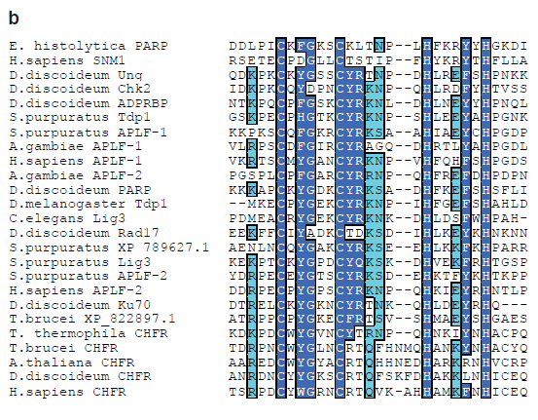
Pattern Search

Slide 52
BLAST 2 Sequence
http://www.hsls.pitt.edu/guides/genetics

Slide 53
BLAST 2 Sequence
Compare two protein sequences
with gi AAA28372 and gi AAA 28615
http://www.hsls.pitt.edu/guides/genetics

Slide 54
Nucleotide BLAST
It is better to use protein BLAST rather than nucleic acid BLAST searches if at all possible
Scoring Matrix
A 4
R -1 5
N -2 0 6
D -2 -2 1 6
C 0 -3 -3 -3 9
Q -1 1 0 0 -3 5
E -1 0 0 2 -4 2 5
G 0 -2 0 -1 -3 -2 -2 6
H -2 0 1 -1 -3 0 0 -2 8
I -1 -3 -3 -3 -1 -3 -3 -4 -3 4
L -1 -2 -3 -4 -1 -2 -3 -4 -3 2 4
K -1 2 0 -1 -3 1 1 -2 -1 -3 -2 5
M -1 -1 -2 -3 -1 0 -2 -3 -2 1 2 -1 5
F -2 -3 -3 -3 -2 -3 -3 -3 -1 0 0 -3 0 6
P -1 -2 -2 -1 -3 -1 -1 -2 -2 -3 -3 -1 -2 -4 7
S 1 -1 1 0 -1 0 0 0 -1 -2 -2 0 -1 -2 -1 4
T 0 -1 0 -1 -1 -1 -1 -2 -2 -1 -1 -1 -1 -2 -1 1 5
W -3 -3 -4 -4 -2 -2 -3 -2 -2 -3 -2 -3 -1 1 -4 -3 -2 11
Y -2 -2 -2 -3 -2 -1 -2 -3 2 -1 -1 -2 -1 3 -3 -2 -2 2 7
V 0 -3 -3 -3 -1 -2 -2 -3 -3 3 1 -2 1 -1 -2 -2 0 -3 -1 4
X 0 -1 -1 -1 -2 -1 -1 -1 -1 -1 -1 -1 -1 -1 -2 0 0 -2 -1 -1 -1
A R N D C Q E G H I L K M F P S T W Y V X
BLOSUM X
/ PAM X
A G C T
A +1 –3 –3 -3
G –3 +1 –3 -3
C –3 –3 +1 -3
T –3 –3 –3 +1
The assumption that all point mutations occur at equal frequencies is not true.
The rate of transition mutations (purine to purine or pyrimidine to pyrimidine)
is approximately 1.5-5X that of transversion mutations (purine to pyrimidine or vice-versa)
in all genomes where it has been measured (see e.g. Wakely, Mol Biol Evol 11(3):436-42, 1994).
SOURCE NCBI

Slide 55
Tutorials
MIT libraries bioinformatics video tutorials
BIT 2.1: Do I need to BLAST? The Use of BLAST Link (7:24) BIT 2.2: Do I need to BLAST? The Use of Related Sequences (6:53) BIT 2.3: Nucleotide BLAST (5:46) BIT 2.4: Nucleotide BLAST: Algorithm Comparisons (6:14)
NCBI
Sequence similarity searching
BLAST Help page
http://www.hsls.pitt.edu/guides/genetics

Slide 56
Reference
Current Protocols Online: Wiley InterScience
http://www.hsls.pitt.edu/resources/ebooks
Current Protocols in Bioinformatics
Chapter 3
Chapter 19, Unit 19.3
Sequence Similarity Searching
Using BLAST Family of Program

Slide 57
Compare two peptide sequences.
Sequence1: http://goo.gl/QUB03
Sequence2: http://goo.gl/N9FjJ
Resources
BLAST2Seq: http://goo.gl/pDjn
LALIGN: http://www.ch.embnet.org/software/LALIGN_form.html
Link to the video tutorial:
http://media.hsls.pitt.edu/media/clres2705/align.swf
http://www.hsls.pitt.edu/molbio

Slide 58
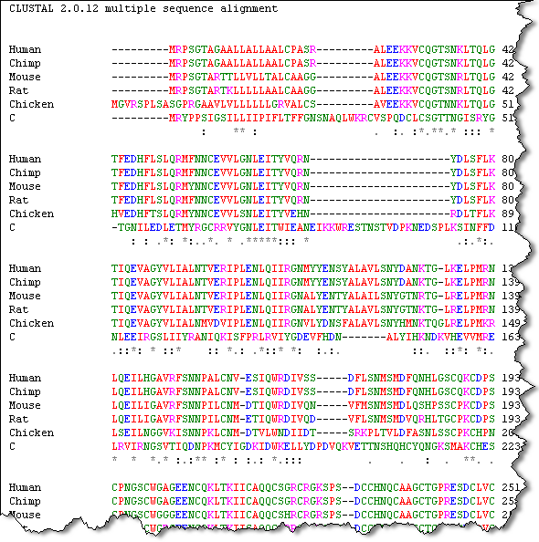
Multiple Sequence Alignment
Tools: ClustalW and T-coffee

Slide 59
Create a multiple sequence alignment plot of six PLCg1 orthologs (human, mouse, chimps, rat, warm and chicken)
Resources
ClustalW: http://www.ebi.ac.uk/clustalw/index.html
T-coffee: http://www.ebi.ac.uk/t-coffee/
Sequence Manipulation Suit: http://www.bioinformatics.org/sms2/color_align_cons.html
Link to the video tutorial:
http://media.hsls.pitt.edu/media/clres2705/msa.swf
http://www.hsls.pitt.edu/molbio

Slide 60
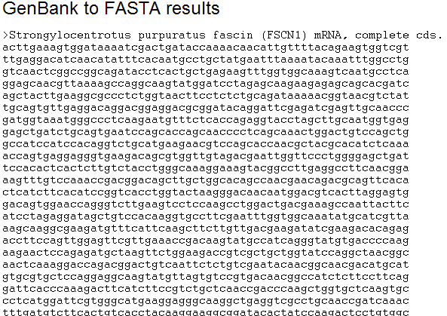
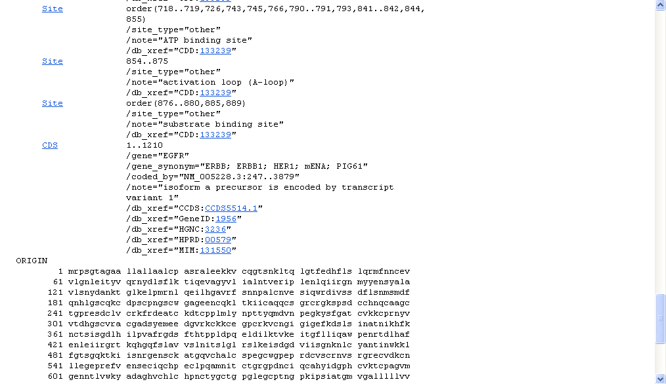
Sequence Manipulation & Format Conversion
Sequence Manipulation Suite
http://bioinformatics.org/sms2/
Readseq
http://thr.cit.nih.gov/molbio/readseq/
GenePept
FASTA

Slide 61
Convert sequence formats.
example: raw to FASTA or GenBank to FASTA etc.
Resources
Readseq: http://www-bimas.cit.nih.gov/molbio/readseq/
Sequence Manipulation Suit: http://www.bioinformatics.org/sms2/genbank_fasta.html
Link to the video tutorial:
http://media.hsls.pitt.edu/media/clres2705/readseq.swf
http://www.hsls.pitt.edu/molbio

Slide 62
Thank you! Any questions?
Carrie Iwema Ansuman Chattopadhyay
iwema@pitt.edu ansuman@pitt.edu
412-383-6887 412-648-1297
http://www.hsls.pitt.edu/guides/genetics

