Slide 1
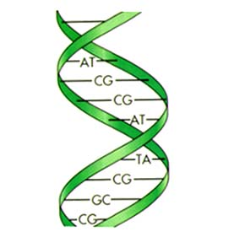
Online Resources for Psychiatric Genetics 19th March, 2009
Ansuman Chattopadhyay, PhD
Head, Molecular Biology Information Services
Health Sciences Library System
University of Pittsburgh
ansuman@pitt.edu
http://www.hsls.pitt.edu/guides/genetics

Slide 2
How to
Search PubMed
Identify Disease Causing Genes
Find Genes and Proteins Centered Information
Predict Disease Causing SNPs
http://www.hsls.pitt.edu/guides/genetics

Slide 3
Ansuman Chattopadhyay, Ph.D.
ansuman@pitt.edu
1990-1996
University of Nebraska-Lincoln
PhD. in Biochemistry
Protein synthesis initiation in eukaryotic system
1997-2001
Vanderbilt University School of Medicine, Nashville
Research Fellow
Epidermal Growth Factor (EGF) mediated signal transduction
2001-2002
Cellomics Inc., Pittsburgh
Knowledge Engineer
2002- 2006
Information Specialist in Molecular Biology and Genetics
HSLS, University of Pittsburgh
2006- Present
Head, Molecular Biology Information Service
HSLS, University of Pittsburgh
http://www.hsls.pitt.edu/guides/genetics

Slide 4
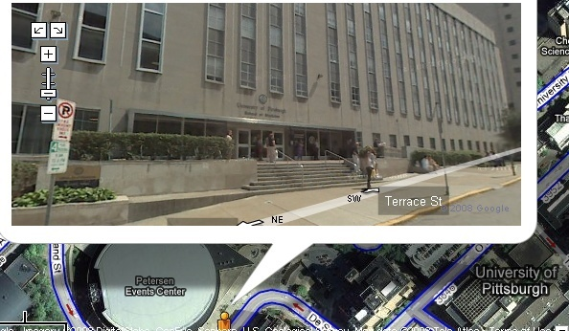
Molecular Biology Information Service
http://www.hsls.pitt.edu/guides/genetics

Slide 5
HSLS Molecular Biology Information Service
Workshops
Website
Software Licensing
Bioinformatics Consultations
http://www.hsls.pitt.edu/guides/genetics

Slide 6
In silico Support
Literature
Search
Sequence Analysis
Omics Data Analysis
http://www.hsls.pitt.edu/guides/genetics

Slide 7
HSLS Molecular Biology Information Service
http://www.hsls.pitt.edu/guides/genetics

Slide 8
Literature Search
http://www.hsls.pitt.edu/guides/genetics

Slide 9
Literature Informatics
US National Library of Medicine (NLM) Medline Database
Medical Subject Heading
PubMed Based Literature Informatics Tools
ClusterMed
GoPubMed
NovoSeek
EtBlast
PubMed
MESH Database
ClusterMed
GoPubMed
http://www.hsls.pitt.edu/guides/genetics

Slide 10
PubMed (http://pubmed.gov)
MEDLINE is the largest component of PubMed
the freely accessible online database of
biomedical journal citations and abstracts
created by the U.S. National Library of Medicine
(NLM®).
5,200 journals published in the United States and
more than 80 other countries
Contains citations indexed 1949 to the present.
http://www.hsls.pitt.edu/guides/genetics

Slide 11
PubMed Search Stats
http://www.hsls.pitt.edu/guides/genetics

Slide 12
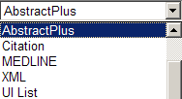
PubMed Display: Abstract Plus
http://www.hsls.pitt.edu/guides/genetics

Slide 13
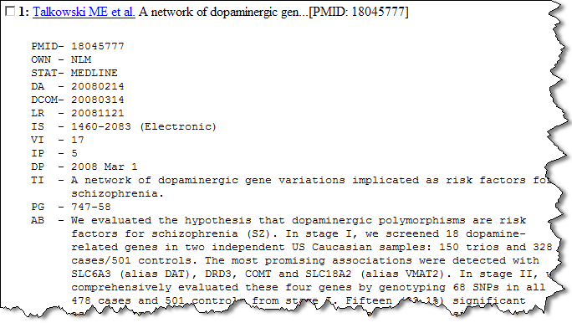
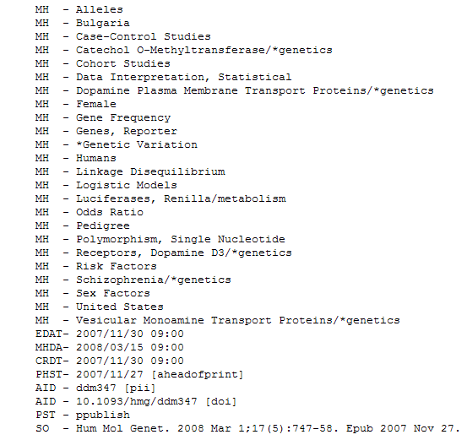
PubMed Display: Medline
http://www.hsls.pitt.edu/guides/genetics

Slide 14
Medical Subject Headings (MeSH)
The U.S. National Library of Medicine's controlled vocabulary (thesaurus)
Arranged in a hierarchical manner called the MeSH Tree Structures
Updated annually
http://www.hsls.pitt.edu/guides/genetics

Slide 15
MeSH Vocabulary
Headings
over 24,000 representing concepts found in the biomedical literature (Body Weight, Kidney, Radioactive Waste)
Subheadings
attached to headings to describe a specific aspect of a concept
(adverse effects , metabolism, diagnosis, therapy)
Supplementary Concept Records
over 172,000 terms in a separate chemical thesaurus -updated weekly (cordycepin , valspodar , tacrolimus binding protein 4)
Publication Types
(Letter, Review, Randomized Controlled Trial)
http://www.hsls.pitt.edu/guides/genetics

Slide 16
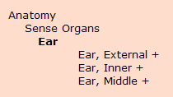
MeSH Tree Structure
A. Anatomy B. Organisms C. Diseases D. Chemical and Drugs E. Analytical, Diagnostic and
Therapeutic Techniques and Equipment F. Psychiatry and Psychology G. Biological Sciences H. Physical Sciences I. Anthropology, Education,
Sociology and Social Phenomena J. Technology and Food and Beverages K. Humanities L. Information Science M. Persons N. Health Care V. Publication Characteristics Z. Geographic Locations
http://www.hsls.pitt.edu/guides/genetics

Slide 17
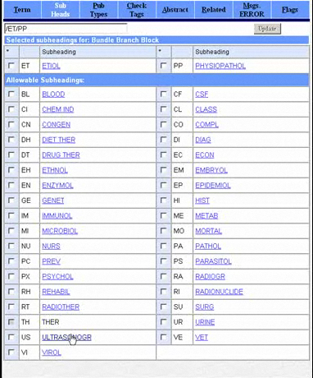
MeSH Indexing
Source: NLM
http://www.hsls.pitt.edu/guides/genetics

Slide 18
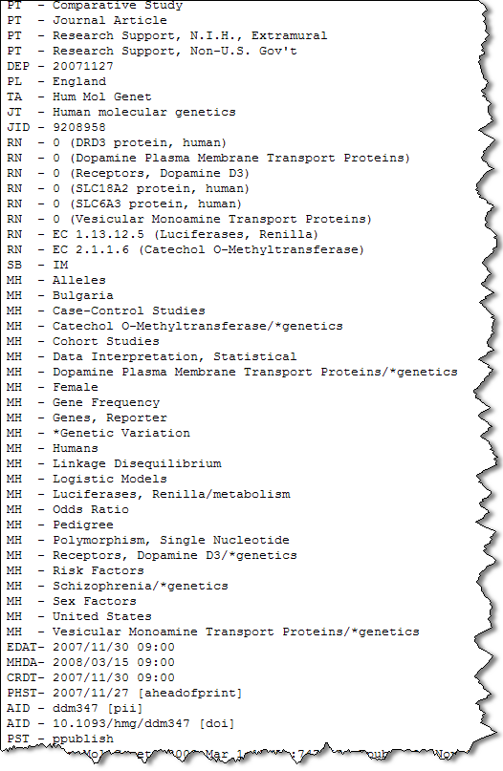
MeSH Indexing
Genes/Chemicals
MeSH Terms
http://www.hsls.pitt.edu/guides/genetics

Slide 19
Information Overload
197K
Breast Cancer
82K
Schizophrenia
6.4K
BRCA1
48 K
5,200
Journals
p53
http://www.hsls.pitt.edu/guides/genetics

Slide 20
PubMed Search
Retrieve published articles
on
Dengue outbreaks
Dengue outbreaks in India
Dengue outbreaks outside India
including
Statistical and numerical data on dengue outbreaks
http://www.hsls.pitt.edu/guides/genetics

Slide 21
PubMed Search: Dengue Outbreaks
1
http://www.ncbi.nlm.nih.gov/mesh?itool=sidebar
http://www.hsls.pitt.edu/guides/genetics

Slide 22
PubMed Search: Dengue Outbreaks MESH DATABASE
2
Dengue
http://www.hsls.pitt.edu/guides/genetics

Slide 23
PubMed Search: Building Query
http://www.hsls.pitt.edu/guides/genetics

Slide 24
PubMed Search: Building Query
http://www.hsls.pitt.edu/guides/genetics

Slide 25
PubMed Search: Building Query
5
3
4
http://www.hsls.pitt.edu/guides/genetics

Slide 26
PubMed Search: Building Query
6
http://www.hsls.pitt.edu/guides/genetics

Slide 27
PubMed Search: Building Query
7
http://www.hsls.pitt.edu/guides/genetics

Slide 28
PubMed Search: Building Query
9
8
http://www.hsls.pitt.edu/guides/genetics

Slide 29
PubMed Search: Building Query
10
http://www.hsls.pitt.edu/guides/genetics

Slide 30
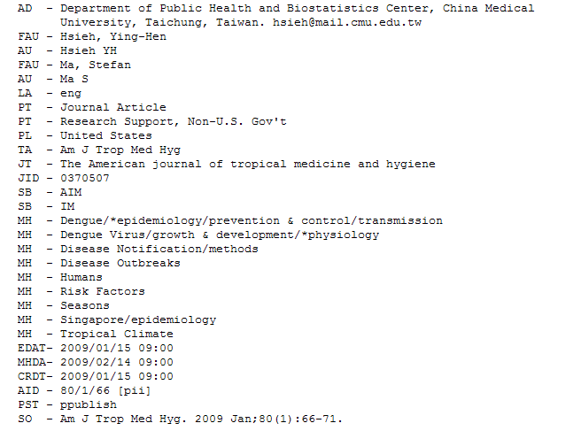
PubMed Search: Building Query
http://www.hsls.pitt.edu/guides/genetics

Slide 31
PubMed Search: Building Query
Term | Boolean | Term | Boolean | Term | # of Papers
Dengue | AND | outbreaks |  |  | 687
Dengue | AND | outbreaks | AND | India | 109
Dengue | AND | outbreaks | NOT | India | 578
Dengue | AND | Outbreaks/Statistics and numerical data |  |  | 82
http://www.hsls.pitt.edu/guides/genetics

Slide 32
Search Result Clustering
http://www.hsls.pitt.edu/guides/genetics

Slide 33
Search Result Clustering
http://clusty.com
http://www.hsls.pitt.edu/guides/genetics

Slide 34
Vivisimo ClusterMed
http://demos.vivisimo.com/vivisimo/cgi-bin/query-meta?v:frame=form&frontpage=1&v:project=clustermed
http://www.hsls.pitt.edu/guides/genetics
Notes:
Sends requests to the PubMed search engine and clusters the search results.

Slide 35
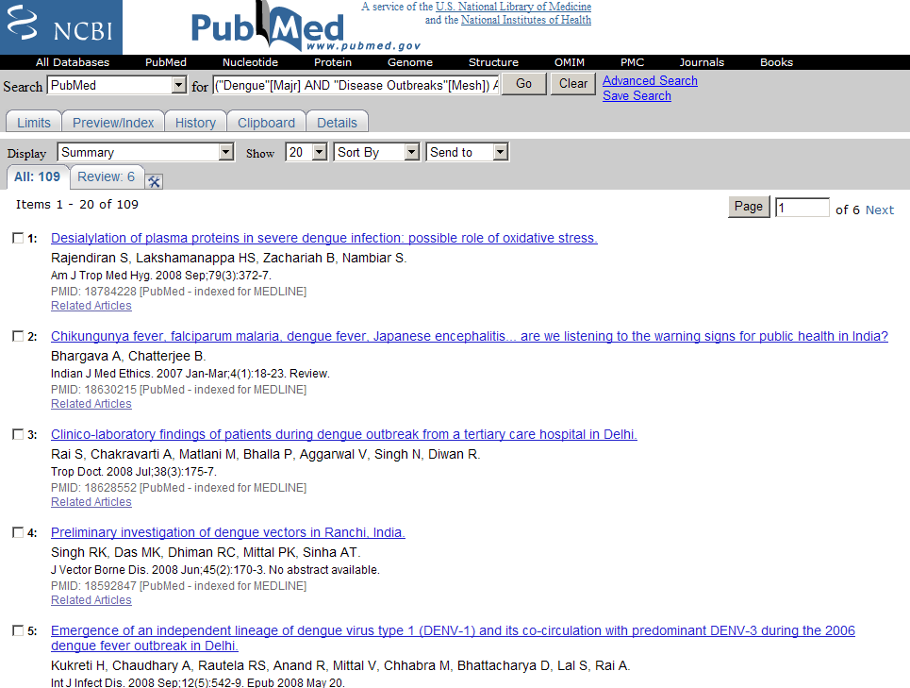
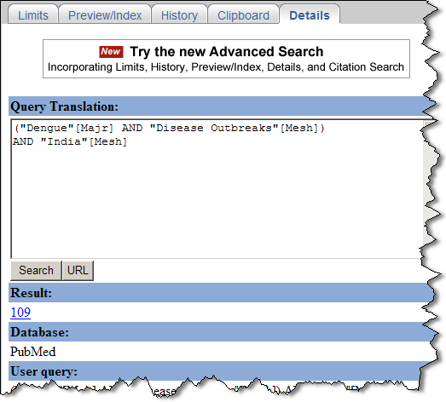
Query Details
Dengue | AND | Outbreaks | AND | India | 109
http://www.hsls.pitt.edu/guides/genetics
Notes:
Click “Details” tab to retrieve query translation.

Slide 36
ClusterMed
Topics
http://www.hsls.pitt.edu/guides/genetics

Slide 37
Clustering in PubMed: ClusterMed
organizes the long list of results returned by PubMed into hierarchical folders with meaningful categories, allowing researchers to hone in on the most relevant results quickly.
does this on-the-fly without requiring any pre-processing, using terms taken from the brief descriptions in the search results.
with the folders, users can discover themes, view related articles, and drill down from the topic hierarchy
http://www.hsls.pitt.edu/guides/genetics

Slide 38
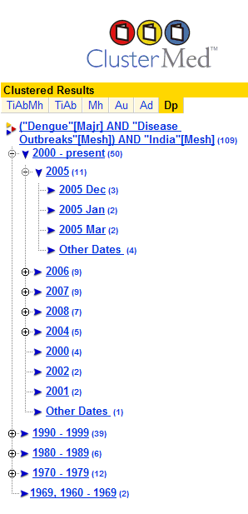
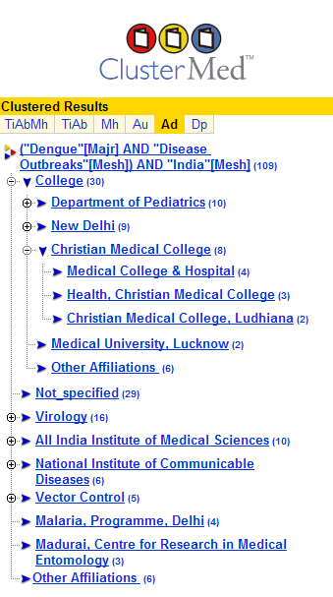
Topical Clusters
Pub Dates
Institutions
Authors
http://www.hsls.pitt.edu/guides/genetics
Notes:
ClusterMed:
organizes the long list of results returned by PubMed into hierarchical folders with meaningful categories, allowing researchers to hone in on the most relevant results quickly.
does this on-the-fly without requiring any pre-processing, using terms taken from the brief descriptions in the search results.
with the folders, users can discover themes, view related articles, and drill down from the topic hierarchy

Slide 39
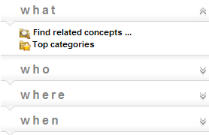
GoPubMed Developed by Transinsight
http://www.gopubmed.com/
http://www.hsls.pitt.edu/guides/genetics
Notes:
Knowledge-based search engine for biomedical texts. It allows users to identify experts in the biomedical field.

Slide 40
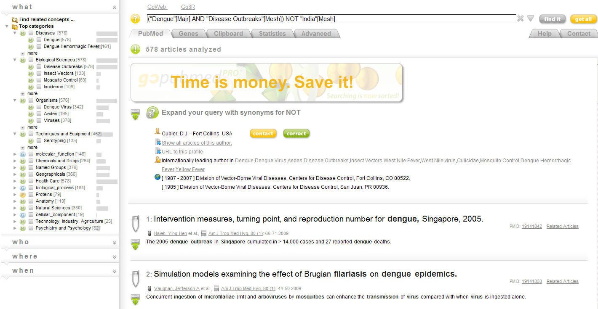
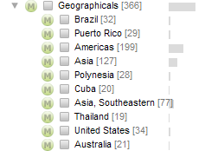
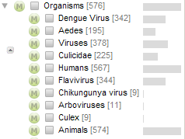
GoPubMed
Dengue | AND | Outbreaks | NOT | India | 578
http://www.hsls.pitt.edu/guides/genetics

Slide 41
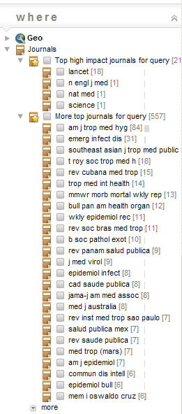
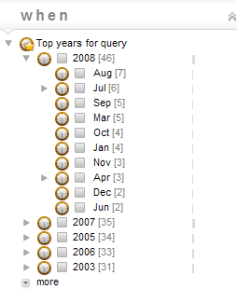
GoPubMed
Journals
Authors
Pub Dates
Dengue | AND | Outbreaks | NOT | India | 578
http://www.hsls.pitt.edu/guides/genetics

Slide 42
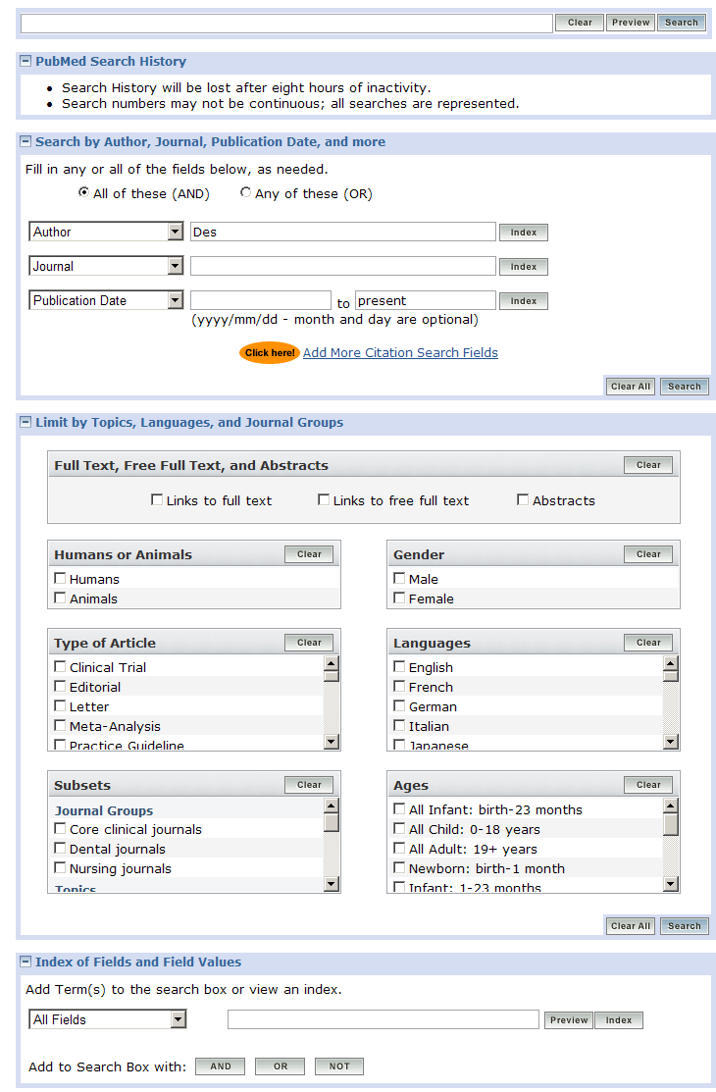
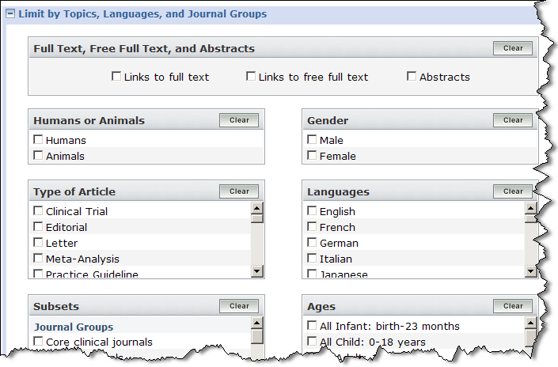
PubMed Advanced Search
http://www.hsls.pitt.edu/guides/genetics

Slide 43
Literature Search Workflow
PubMed
MESH Database
ClusterMed
GoPubMed
http://www.hsls.pitt.edu/guides/genetics

Slide 44
PubMed Query with Boolean
Retrieve articles focused on molecular genetics of Schizophrenia published in past five years:
("schizophrenia"[Majr] AND (("genetics, medical"[MeSH Terms] OR ("genetics"[All Fields] AND "medical"[All Fields]) OR "medical genetics"[All Fields] OR ("medical"[All Fields] AND "genetics"[All Fields])) OR ("genotype"[MeSH Terms] OR "genotype"[All Fields]) OR "genetics"[Subheading] AND ("genetics"[Subheading] OR "genetics"[All Fields] OR "genetics"[MeSH Terms])) AND ("2004/03/13"[PDat] : "2009/03/11"[PDat])
http://www.hsls.pitt.edu/guides/genetics

Slide 45
Research on Optimal Search Strategies
http://www.hsls.pitt.edu/guides/genetics

Slide 46
PubMed Pre-Build Queries
http://www.ncbi.nlm.nih.gov/entrez/query/static/clinical.shtml
http://www.hsls.pitt.edu/guides/genetics

Slide 47
PubMed Query with Boolean
Retrieve articles focused on molecular genetics of Schizophrenia published in past five years:
("schizophrenia"[Majr] AND (("genetics, medical"[MeSH Terms] OR ("genetics"[All Fields] AND "medical"[All Fields]) OR "medical genetics"[All Fields] OR ("medical"[All Fields] AND "genetics"[All Fields])) OR ("genotype"[MeSH Terms] OR "genotype"[All Fields]) OR "genetics"[Subheading] AND ("genetics"[Subheading] OR "genetics"[All Fields] OR "genetics"[MeSH Terms])) AND ("2004/03/13"[PDat] : "2009/03/11"[PDat])
http://www.hsls.pitt.edu/guides/genetics

Slide 48
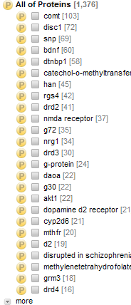
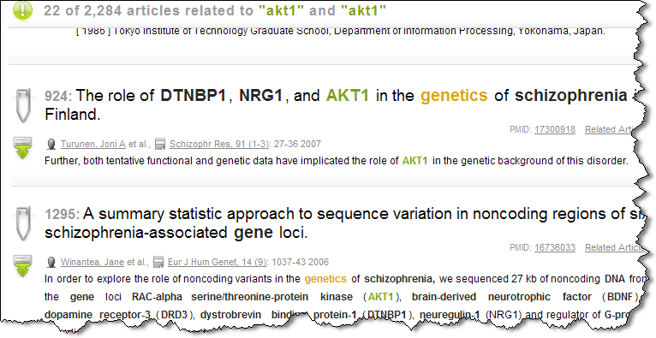
GoPubMed Analysis
http://www.hsls.pitt.edu/guides/genetics

Slide 49
GoPubMed Search Result Statistics
http://www.hsls.pitt.edu/guides/genetics

Slide 50
Go PubMed Authors Network
http://www.hsls.pitt.edu/guides/genetics

Slide 51
GoPubMed World Map of Publications
http://www.hsls.pitt.edu/guides/genetics

Slide 52
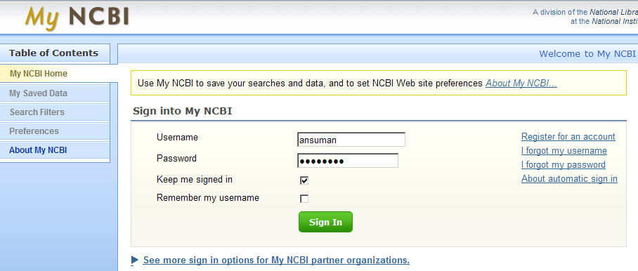
My NCBI: an Automated email Notification Tool
Save your searches at MyNCBI and set up an email notification on new publication based on your search query
http://www.hsls.pitt.edu/guides/genetics

Slide 53
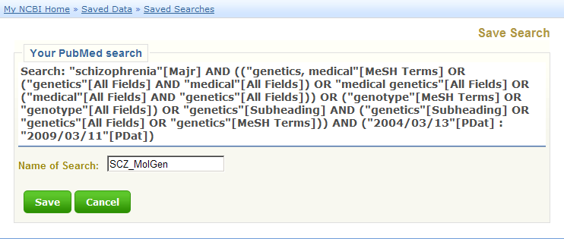
My NCBI
1
2
3
http://www.hsls.pitt.edu/guides/genetics

Slide 54
My NCBI
4
http://www.hsls.pitt.edu/guides/genetics

Slide 55
NovoSeek : a Search Engine for Biomedical Literature in Medline and US Grants
http://www.hsls.pitt.edu/guides/genetics

Slide 56
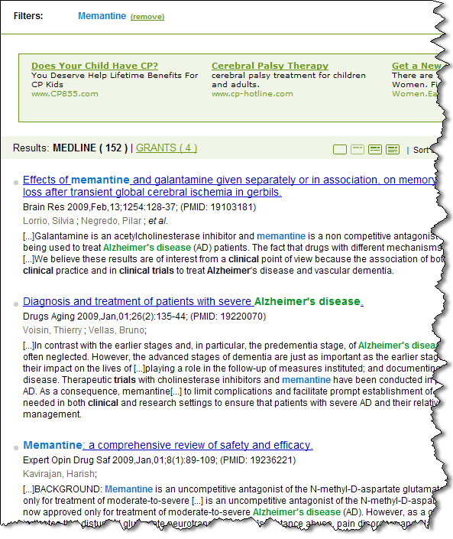
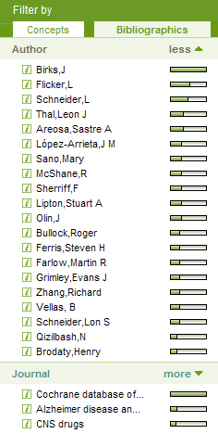
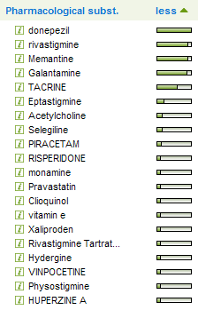
NovoSeek Search: Alzheimer Clinical Trials
http://www.hsls.pitt.edu/guides/genetics

Slide 57
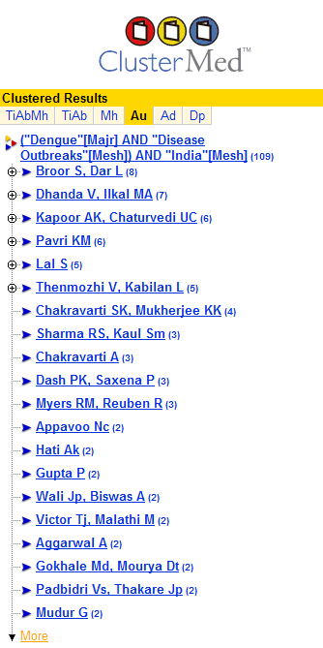
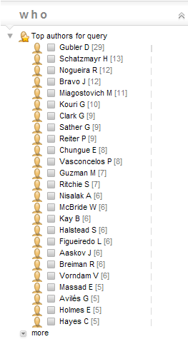
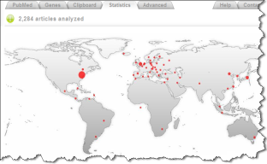
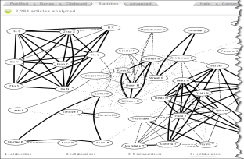
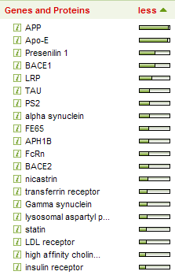
Literature Search Workflow
Authors
Topics
S
E
A
R
C
H
L
I
T
E
R
A
T
U
R
E
Global Map
Authors Networks
Journals
Genes
http://www.hsls.pitt.edu/guides/genetics

Slide 58
eTBLAST
This application is designed to identify susceptibility genes for bipolar disorder (BD) by testing single nucleotide polymorphisms (SNPs) across chromosomal regions previously linked to BD. Our proposal is an ancillary study to the Systematic Treatment Enhancement Program for Bipolar Disorder (STEP-BD), a large treatment study involving approximately 5000 affected individuals. The sample will consist of consenting probands from STEP-BD (n = 1780), consenting family members, and a sample of unrelated controls. ………
Visualize Related Articles
Find an Expert in this Field
Find a Journal for your Manuscript
View the Publication History of this Topic
ABSTRACT
http://www.hsls.pitt.edu/guides/genetics

Slide 59
eTBLAST
http://www.hsls.pitt.edu/guides/genetics

Slide 60
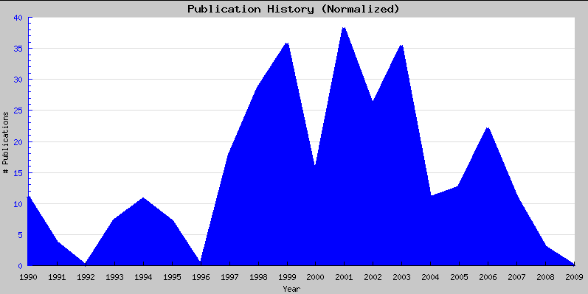
eTBLAST Analysis
http://www.hsls.pitt.edu/guides/genetics

Slide 61
eTBLAST Analysis on Scientific Papers
http://www.hsls.pitt.edu/guides/genetics

Slide 62
Growth of Molecular Databases
og
1078
2009: 1170
2008: 1078
65
Source: Nodal Point Blog
http://www.hsls.pitt.edu/guides/genetics

Slide 63
Molecular Databases
Nucleic Acids Research: Oxford Journals
Annual Databases Issue
Annual Web Server Issue
Journals
Bioinformatics
BMC Bioinformatics
http://www.hsls.pitt.edu/guides/genetics

Slide 64
HSLS OBRC
http://www.hsls.pitt.edu/guides/genetics

Slide 65
Molecular Databases Catalog
HSLS OBRC
2379 links to databases and software
~5000 hits/day
http://www.hsls.pitt.edu/guides/genetics

Slide 66
Online Bioinformatics Resources Collection
http://www.hsls.pitt.edu/guides/genetics

Slide 67
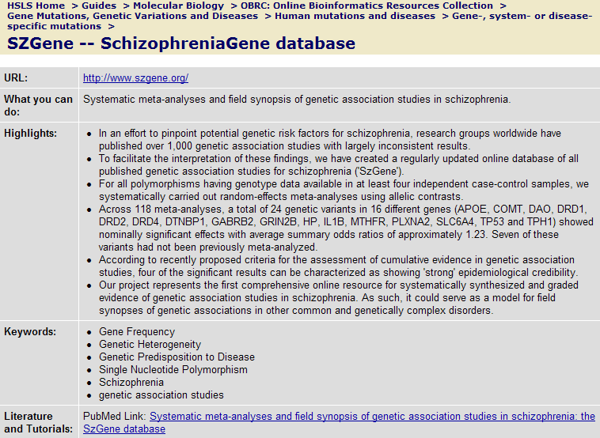
HSLS OBRC
http://www.hsls.pitt.edu/guides/genetics

Slide 68
HSLS OBRC
http://www.hsls.pitt.edu/guides/genetics

Slide 69
Bioinformatics Resources on Psychiatric Disorders
http://www.hsls.pitt.edu/guides/genetics

Slide 70
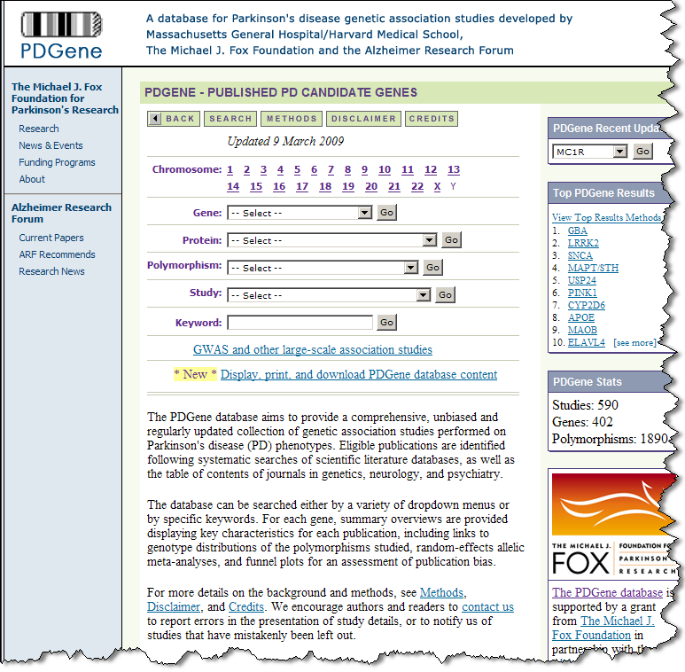
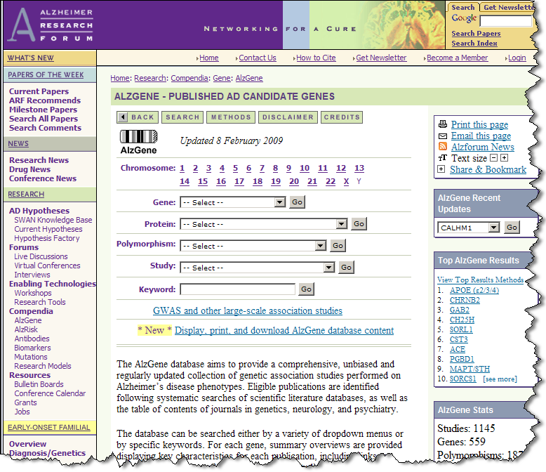
Disease Gene Databases
http://www.hsls.pitt.edu/guides/genetics

Slide 71
Disease Causing Genes
http://www.hsls.pitt.edu/guides/genetics

Slide 72
Identify Disease Causing Genes
US CDC’s HuGE Navigator
http://www.hugenavigator.net/
Gene Prospector
http://www.hugenavigator.net/HuGENavigator/geneProspectorStartPage.do
NIH GAD
http://geneticassociationdb.nih.gov/
A Catalog of Published Genome-Wide Association Studies
http://www.genome.gov/page.cfm?pageID=26525384#searchForm
http://www.hsls.pitt.edu/guides/genetics

Slide 73
Identify Disease Causing Genes
The Human Genome Epidemiology Network (HuGENet™) :
a voluntary, international collaboration focused on assessing the role of human genome variation in health and disease at the population level.
maintained a database of published, population-based epidemiologic studies of human genes extracted and curated from PubMed.
HuGE Navigator provides access to a continuously updated knowledge base in human genome epidemiology
information on population prevalence of genetic variants
gene-disease associations
gene-gene and gene- environment interactions
evaluation of genetic tests
http://www.hsls.pitt.edu/guides/genetics

Slide 74
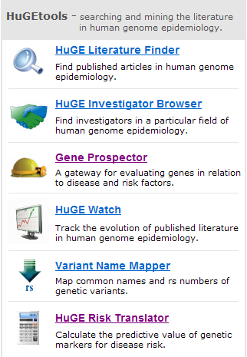
Informatics Tools for Human Epidemiology
http://www.hsls.pitt.edu/guides/genetics

Slide 75
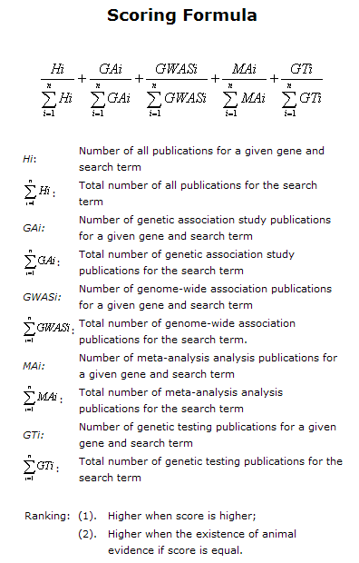
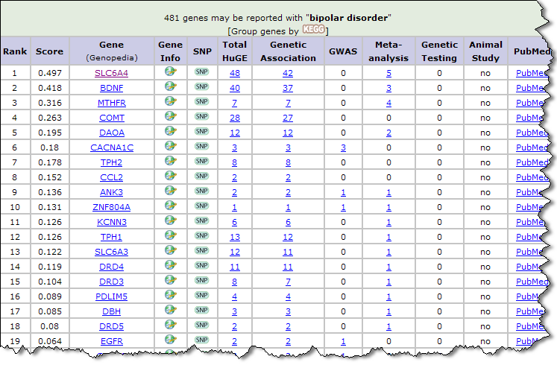
Finding Disease Causing Genes
http://www.hsls.pitt.edu/guides/genetics
Notes:
Gene Prospector is a bioinformatics tool designed to sort, rank, and display information about genes in relation to human diseases, risk factors and other phenotypes. Links are provided to evidence from published literature and to other online data sources. Search terms can include diseases, risk factors and phenotypes

Slide 76
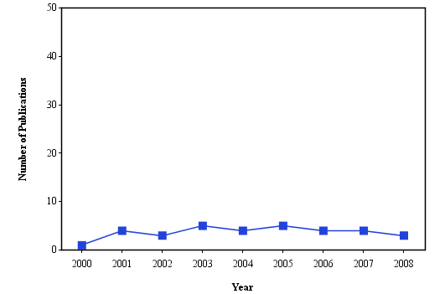
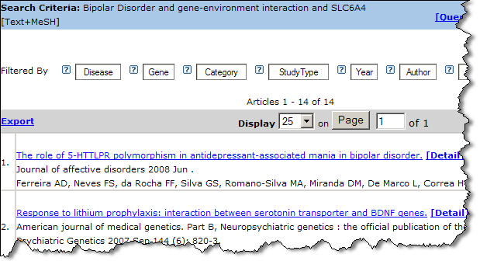
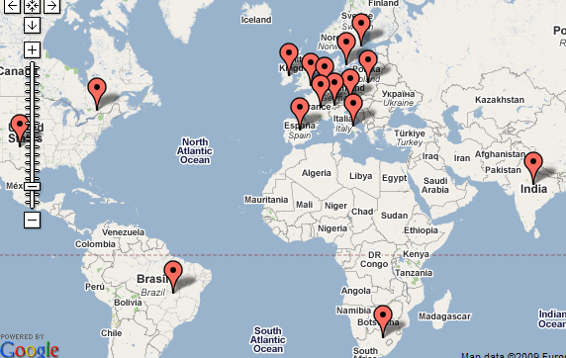
Gene to Diseases
http://www.hsls.pitt.edu/guides/genetics

Slide 77
Genes and Proteins Centered Information
http://www.hsls.pitt.edu/guides/genetics

Slide 78
Gene/Protein Centered Information
NCBI Gene Database
Your Favorite Gene – SigmaAldrich
Millipore Pathways
http://www.hsls.pitt.edu/guides/genetics

Slide 79
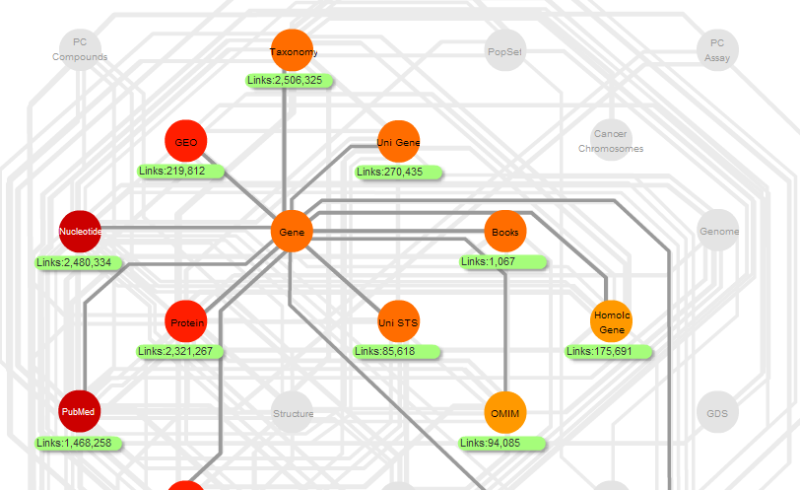
US NCBI Databases
http://www.hsls.pitt.edu/guides/genetics

Slide 80
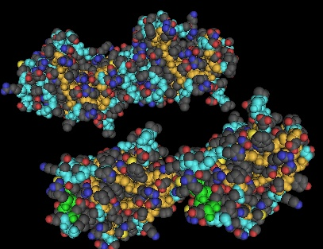
US NCBI : Entrez Gene
Chromosomal
Localization
mRNA Sequence
Amino acid
Sequence
Genomic
Sequence
Homologous
Sequences
Expression
Profile
3D Structure
Interacting
Partners
Disease
SNP
http://www.hsls.pitt.edu/guides/genetics

Slide 81
Your Favorite Gene Search
http://www.hsls.pitt.edu/guides/genetics

Slide 82
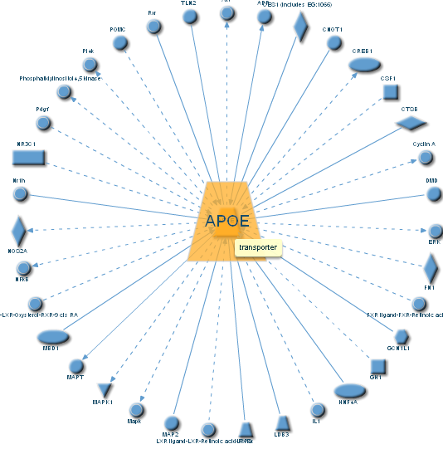
Your Favorite Gene Display
http://www.hsls.pitt.edu/guides/genetics

Slide 83
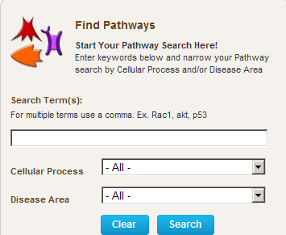
Millipore Pathway Search
http://www.hsls.pitt.edu/guides/genetics

Slide 84
Prediction of Disease Causing SNPs
http://www.hsls.pitt.edu/guides/genetics

Slide 85
Single Nucleotide Polymorphisms
Scientists expect that comparison of genomic sequences taken from two unrelated individuals will reveal that they are 99.9% identical. The 0.1% difference is due to genetic variations, and mainly one form of variation called single nucleotide polymorphisms
These polymorphisms are considered one of the key factors that makes each and every one of us different and can have a major impact on how we respond to diseases; environmental insults such as bacteria, viruses and chemicals; and drugs and other therapies. This makes genetic variations of great value for biomedical research and for developing pharmaceutical products or medical diagnostics
http://www.hsls.pitt.edu/guides/genetics

Slide 86
Human Genetic Variations
Primarily two types of genetic mutation events create all
forms of variations:
Single base mutation which substitutes one nucleotide for another -Single Nucleotide Polymorphisms (SNP)
Insertion or deletion of one or more nucleotide(s) -Tandem Repeat Polymorphisms -Insertion/Deletion Polymorphisms
http://www.hsls.pitt.edu/guides/genetics

Slide 87
Single Nucleotide Polymorphism
Single nucleotide polymorphisms (SNP) are DNA sequence variations
that occur when a single nucleotide (A,T,C,or G) in the genome sequence is altered.
SNPS are the most common class of polymorphisms. example:
http://www.hsls.pitt.edu/guides/genetics

Slide 88
Estimated Numbers of Human Genetic Variations
SNPs appear at 0.3-1-kb average intervals, considering the size of entire human genome, which is 3X10⁷ bp, the total number scales up to 5-10 million.
In silico estimation of potentially polymorphic VNTR are over 100,000 across the human genome.
The short insertion/deletions are very difficult to quantify and the number is likely to fall in between SNPs and VNTR
http://www.hsls.pitt.edu/guides/genetics

Slide 89
Polymorphisms and Disease Markers
Very few of these polymorphisms show direct impact on deleterious phenotype.
The non-disease-causing polymorphisms when mapped to the genome, may serve as markers to identify and map other genes that do cause disease when mutated.
If these non-disease-causing variations are found to be inherited with a particular trait, but do not cause the trait, they may provide evidence of where the trait's gene is located in the genome.
http://www.hsls.pitt.edu/guides/genetics

Slide 90
SNPs and Mutations
Terminology for variation at a single nucleotide position is defined by allele frequency.
A single base change, occurring in a population at a frequency of >1% is termed a single nucleotide polymorphism (SNP)
When a single base change occurs at <1% it is considered to be a mutation
http://www.hsls.pitt.edu/guides/genetics

Slide 91
Life Cycle of SNPs and Mutations
http://www.hsls.pitt.edu/guides/genetics

Slide 92
Classification of SNPs
http://www.hsls.pitt.edu/guides/genetics
Notes:
SNPs may occur at any position in the following gene structure and based on its location it can be classified as: intronic, exonic, or promoter region etc.

Slide 93
Coding SNPs
http://www.hsls.pitt.edu/guides/genetics

Slide 94
Genetic Variations Databases
dbSNP
http://www.ncbi.nlm.nih.gov/SNP/index.html
Online Mendelian Inheritance in Man (OMIM)
http://www.ncbi.nlm.nih.gov/sites/entrez?db=OMIM
International HapMap Project
http://www.hapmap.org/
Genome Variation Server (Seattle SNPs)
http://gvs.gs.washington.edu/GVS/
http://www.hsls.pitt.edu/guides/genetics

Slide 95
dbSNP
URL: http://www.ncbi.nlm.nih.gov/SNP/index.html
The Single Nucleotide Polymorphism database (dbSNP) is a public- domain archive for a broad collection of simple genetic polymorphisms
This collection of polymorphisms includes:
Single-base nucleotide substitutions (also known as single nucleotide polymorphisms or SNPs)
Small-scale multi-base deletions or insertions (also called deletion insertion polymorphisms or DIPs)
Microsatellite repeat variations (also called short tandem repeats or STRs)
http://www.hsls.pitt.edu/guides/genetics

Slide 96
dbSNP Data Type
The SNP database has two major classes of content:
Submitted data:
original observations of sequence variation: Submitted SNPs (SS) with ss# (ss 5586300)
Computed data:
content generated during the dbSNP "build" cycle by computation on original submitted data: Reference SNP Clusters (Ref SNP) with rs# (rs 4986582)
http://www.hsls.pitt.edu/guides/genetics

Slide 97
Functional Analysis of SNPs
http://www.hsls.pitt.edu/guides/genetics

Slide 98
SNPs and the Structure of a Gene
http://www.hsls.pitt.edu/guides/genetics

Slide 99
Decision Tree for SNP Analysis
http://www.hsls.pitt.edu/guides/genetics

Slide 100
Exonic Splicing Enhancer/Silencer
http://www.hsls.pitt.edu/guides/genetics

Slide 101
Functional Analysis of SNPs
A gene variant primarily found in African Americans, that slightly increases the risk for developing an irregular heartbeat, known as arrhythmia. The variant occurs in the cardiac sodium channel gene SCN5A which results a change of amino acid at the position of 1102 from serine to tyrosine (S To Y) . Can you predict the effect of this non-synonymous SNP (rs7626962).
Answer
http://www.hsls.pitt.edu/guides/genetics

Slide 102
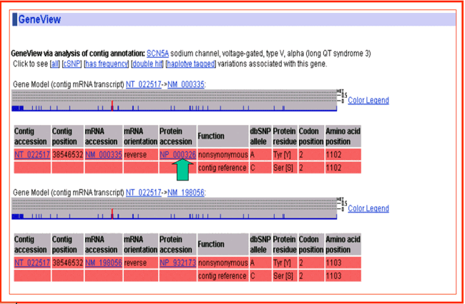
SNP Gene View for SCN5A

Slide 103
Multiple Sequence Alignment
http://www.hsls.pitt.edu/guides/genetics

Slide 104
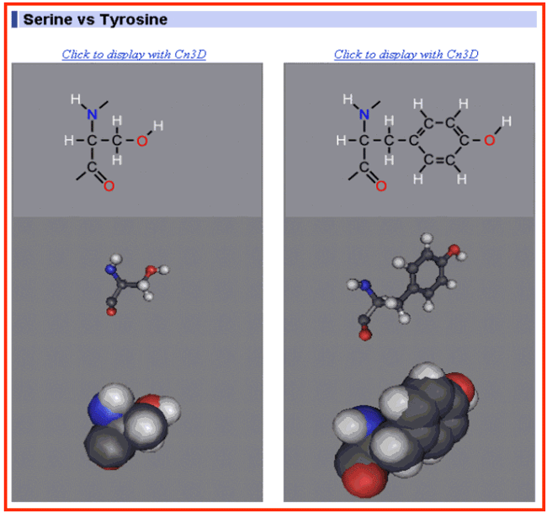
Amino Acids Comparison
NCBI Amino Acid Explorer
http://www.hsls.pitt.edu/guides/genetics

Slide 105
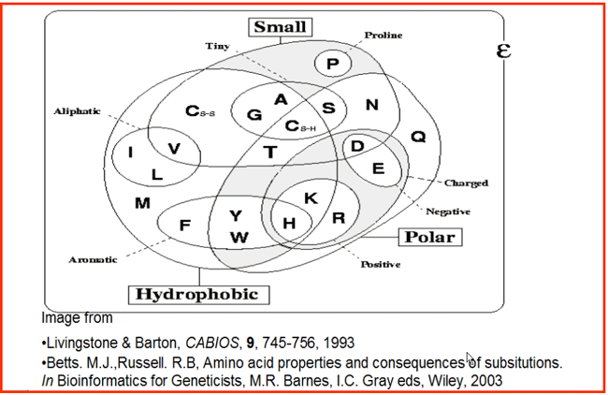
Compare Amino Acids Properties
Amino Acid Properties Table: http://www.russell.embl.de/aas/
http://www.hsls.pitt.edu/guides/genetics

Slide 106
Amino Acids Substitution Preference
http://www.hsls.pitt.edu/guides/genetics

Slide 107
Tools for Amino Acid Substitution Effect Prediction
SIFT
http://sift.jcvi.org/
PolyPhen
http://genetics.bwh.harvard.edu/pph/
SNPs3D
http://www.snps3d.org/
pMUT
http://mmb2.pcb.ub.es:8080/PMut/
http://www.hsls.pitt.edu/guides/genetics

Slide 108
Comparison of AAS prediction tools
Pauline C. Ng and Steven Henikoff, Annu. Rev. Genomics Hum. Genet. 2006. 7:61–80

Slide 109
Tools on Functional SNP Analysis
Search.HSLS MolBio link
http://search.hsls.pitt.edu/vivisimo/cgi-bin/query-meta?v%3aproject=BioInfoTools&v%3afile=viv_B7AUre&v%3aframe=list&v%3astate=root%7cN891&id=N891&action=list&
FASTSNP -- an always up-to-date and extendable service for SNP function analysis and prioritization
http://fastsnp.ibms.sinica.edu.tw/
F-SNP: computationally predicted functional SNPs for disease association studies.
http://compbio.cs.queensu.ca/F-SNP/
http://www.hsls.pitt.edu/guides/genetics

Slide 110
FASTSNP Analysis
http://www.hsls.pitt.edu/guides/genetics

Slide 111
FASTSNP Analysis
http://www.hsls.pitt.edu/guides/genetics

Slide 112
F-SNP: A Collection of Functional SNPs Specifically Prioritized for Disease Association studies
http://www.hsls.pitt.edu/guides/genetics

Slide 113
F-SNP: A Collection of Functional SNPs Specifically Prioritized for Disease Association Studies
http://www.hsls.pitt.edu/guides/genetics

Slide 114
Summary
Literature Search
Disease Causing Genes
Genes and Proteins
Information
SNPs Functional Analysis
http://www.hsls.pitt.edu/guides/genetics

Slide 115
Thank you!

