Slide 1


Pathway Informatics
6th July, 2015
Ansuman Chattopadhyay, PhD
Head, Molecular Biology Information Services
Health Sciences Library System
University of Pittsburgh
ansuman@pitt.edu

Slide 2
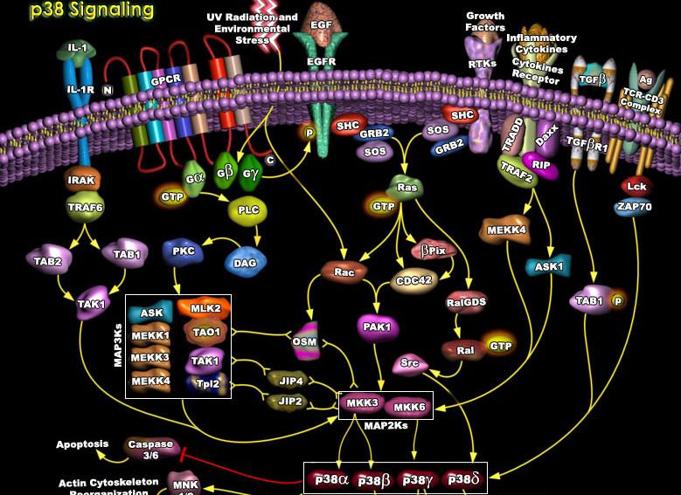
Biological Pathway Map
http://www.hsls.pitt.edu/molbio

Slide 3
Pathway Informatics
List of Genes
Protein-Protein Interaction Database
Pathway Map
http://www.hsls.pitt.edu/molbio

Slide 4
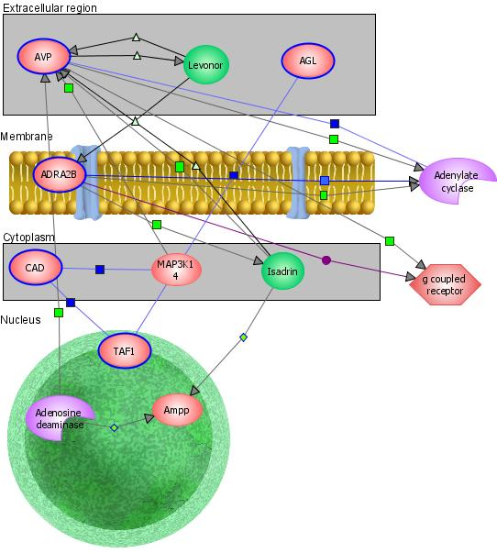
Gene list to pathways
Gene List
Biological Interaction Network
Biological Table
http://www.hsls.pitt.edu/molbio

Slide 5
Topics
Databases
  Biological Pathway Maps
  Protein-Protein Interaction
  High-throughput gene expression (Microarray) Database
http://www.hsls.pitt.edu/molbio

Slide 6
Topics
Software
Create a gene list: Geo2R, NextBio
Pathway Analysis : NIH DAVID, Ingenuity IPA, Metacore,
http://www.hsls.pitt.edu/molbio

Slide 7
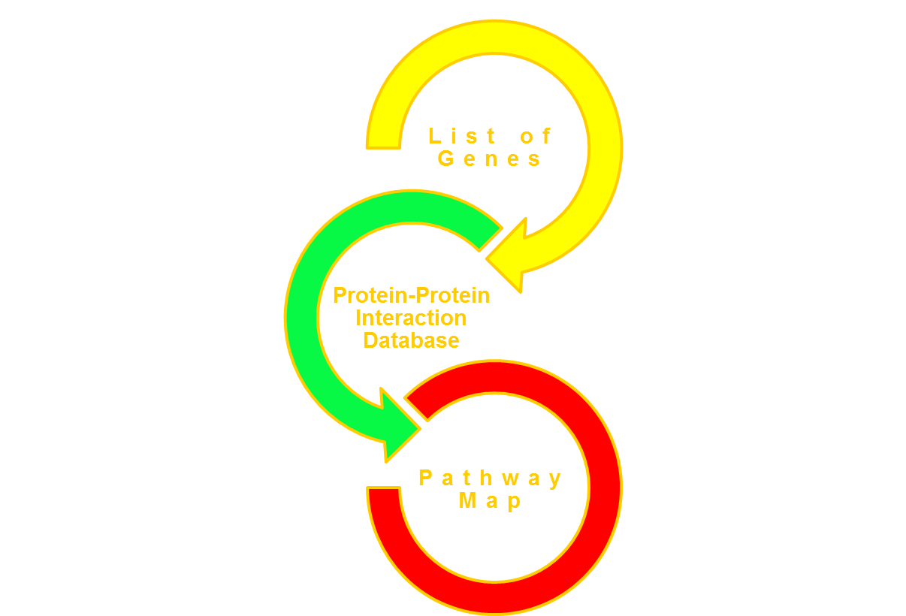
Pathway Databases
http://www.hsls.pitt.edu/molbio

Slide 8
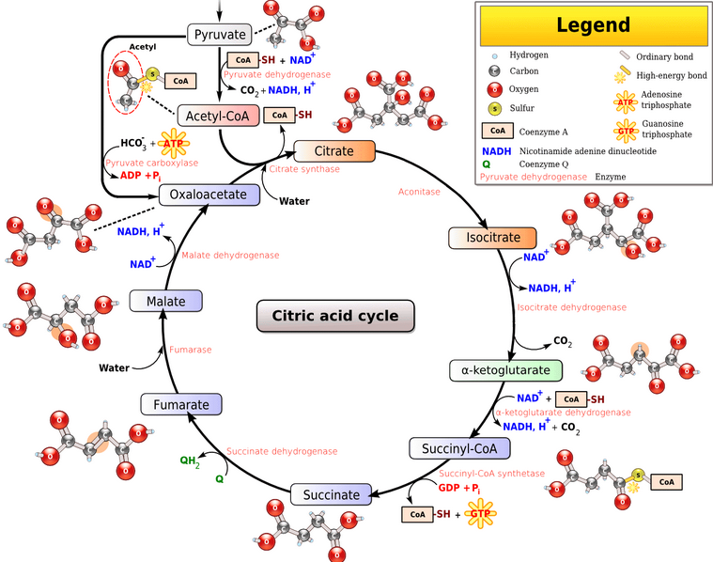
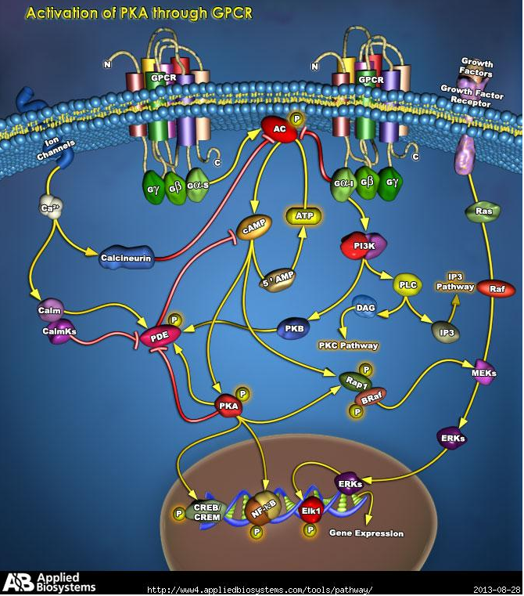
Biological Pathways
Metabolic
Signaling
http://www.hsls.pitt.edu/molbio

Slide 9
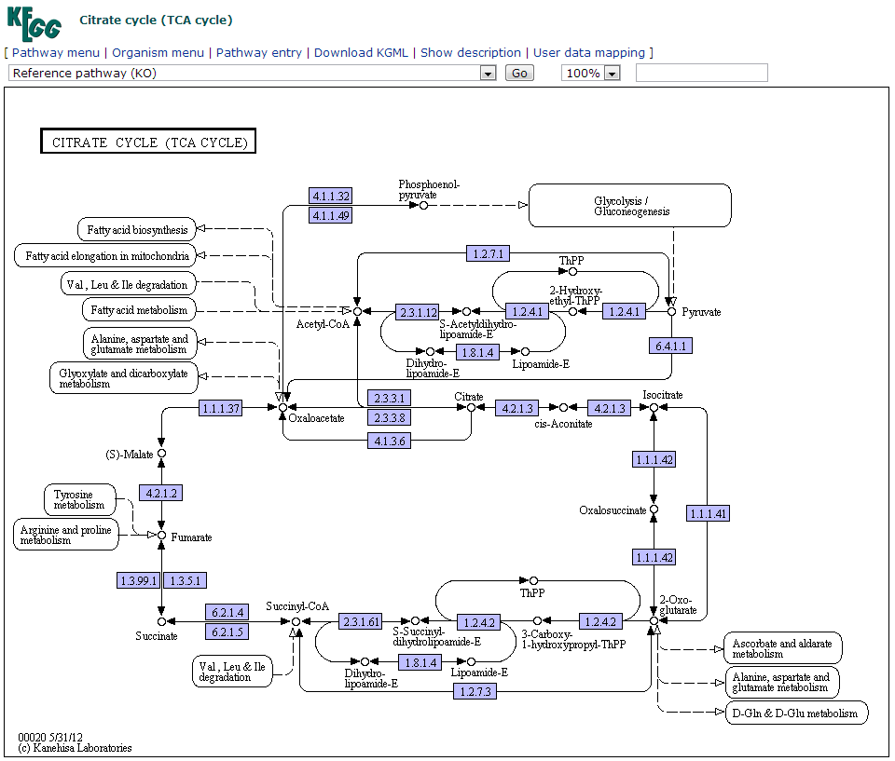
Biological Pathway Databases
KEGG
Ingenuity IPA
GeneGo Metacore
Millipore Pathways (Metacore)
Sigma Your Favorite Genes (IPA)
Life Technologies GeneAssist
Pathway Commons
http://www.hsls.pitt.edu/molbio

Slide 10
Databases-Pathways
NCBI Biosystems
  KEGG
  http://www.ncbi.nlm.nih.gov/biosystems
Pathway Commons: http://www.pathwaycommons.org/pc/
    YFG – Sigma Aldrich: Your Favorite Gene
  Millipore Pathways: http://www.millipore.com/pathways/pw/pathways
Applied BioSystems: http://www5.appliedbiosystems.com/tools/pathway/
http://www.hsls.pitt.edu/molbio

Slide 11
PPI Databases
http://www.hsls.pitt.edu/molbio

Slide 12
What proteins interact with my favorite protein?
http://www.hsls.pitt.edu/molbio

Slide 13
PPI Databases
BioGRID
STRING
http://www.hsls.pitt.edu/molbio

Slide 14
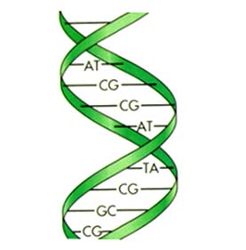
Retrieve interacting partners of a protein of your interest
-What proteins interact with human EGFR?
-
Resources
BioGrid: http://thebiogrid.org/
STRING: http://string-db.org/
Link to the video tutorial:
http://media.hsls.pitt.edu/media/molbiovideos/ppi.swf

Slide 15

BioGrid
http://www.hsls.pitt.edu/molbio

Slide 16
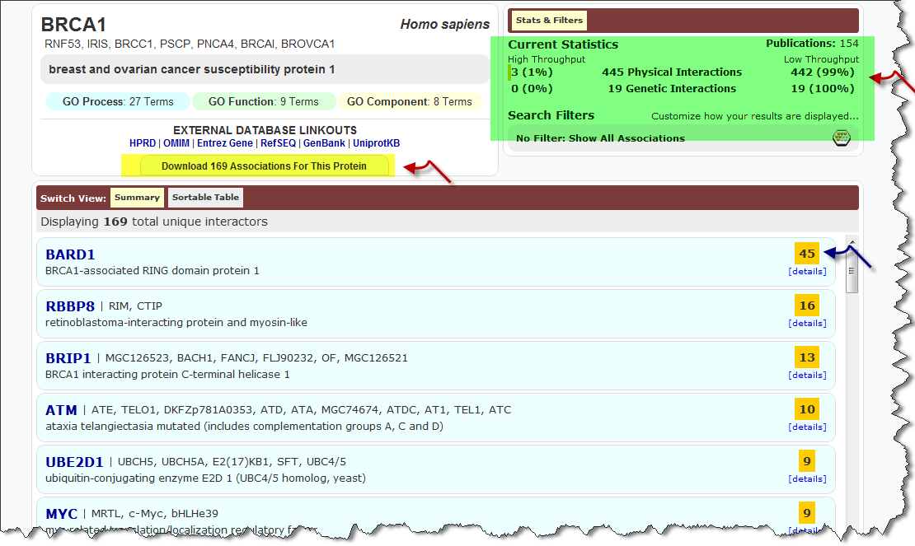
BioGrid Search Result Page
http://www.hsls.pitt.edu/molbio

Slide 17
STRING - Known and Predicted Protein-Protein Interactions
An ultimate resource for finding both predicted and experimental verified PPI
Not limited to human, mouse and rat
Developed at CPR, EMBL, SIB, KU, TUD and UZH
http://www.hsls.pitt.edu/molbio

Slide 18
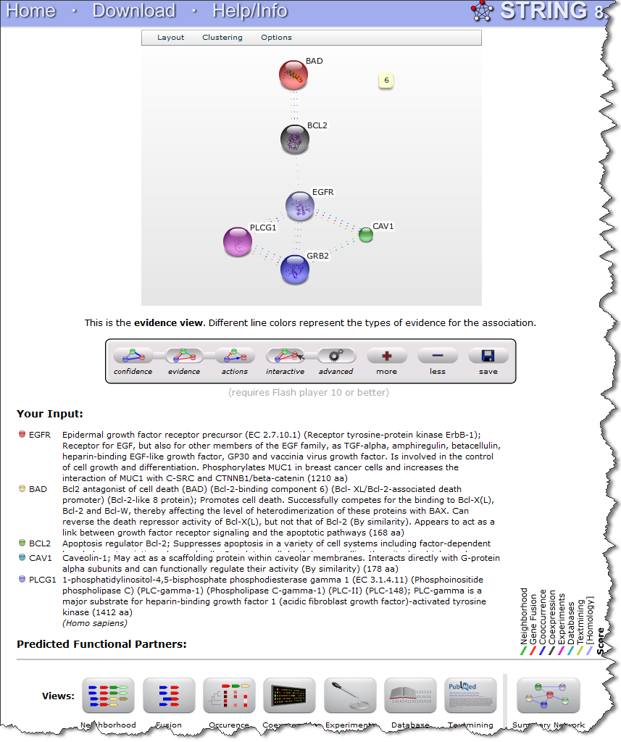
STRING
http://www.hsls.pitt.edu/molbio

Slide 19
Gene Lists
http://www.hsls.pitt.edu/molbio

Slide 20
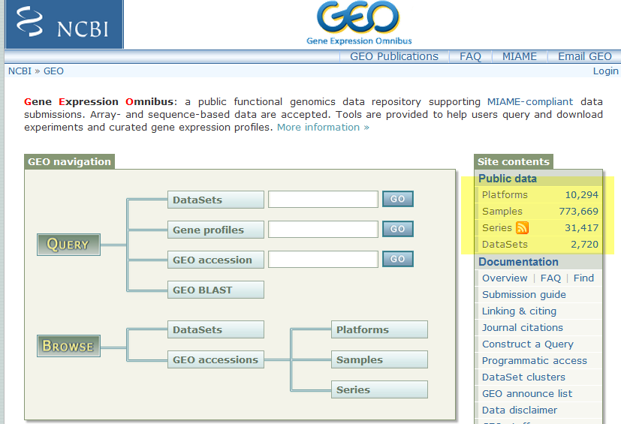
Gene Lists
Microarrays
Protein arrays
CHIP-chip
SNP arrays
RNA Seq
Literature Search
http://www.hsls.pitt.edu/molbio

Slide 21
Gene Expression Databases
NCBI
Gene Expression Omnibus (GEO)
EBI
ArrayExpress
http://www.hsls.pitt.edu/molbio

Slide 22
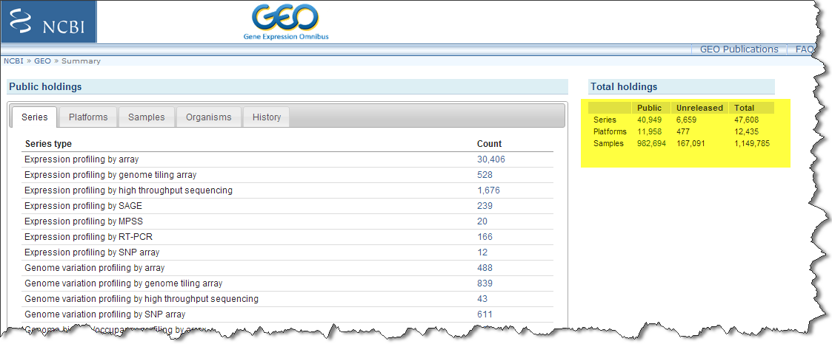
Gene Expression Database
http://www.hsls.pitt.edu/molbio

Slide 23
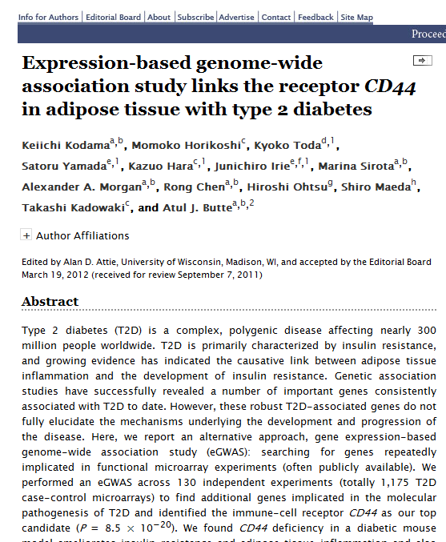
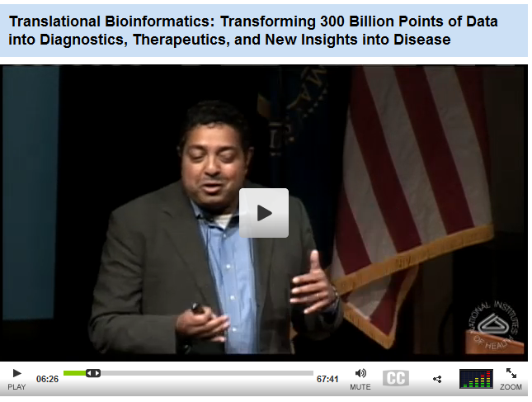
Use of GEO Data
                http://goo.gl/yD2hR
http://www.hsls.pitt.edu/molbio

Slide 24
Generate a gene list
http://www.hsls.pitt.edu/molbio

Slide 25
Pathway Analysis
Control
A549 cell
+
Ethanol (25μmol/L) 48 hr
Treated
A549 cell
+
Resveratrol (25μmol/L) 48 hr
http://www.hsls.pitt.edu/molbio

Slide 26
Retrieve Gene Expression data
NCBI GEO
EBI ArrayExpress
NextBio Research
http://www.hsls.pitt.edu/molbio

Slide 27
Gene Expression Database
http://www.hsls.pitt.edu/molbio

Slide 28
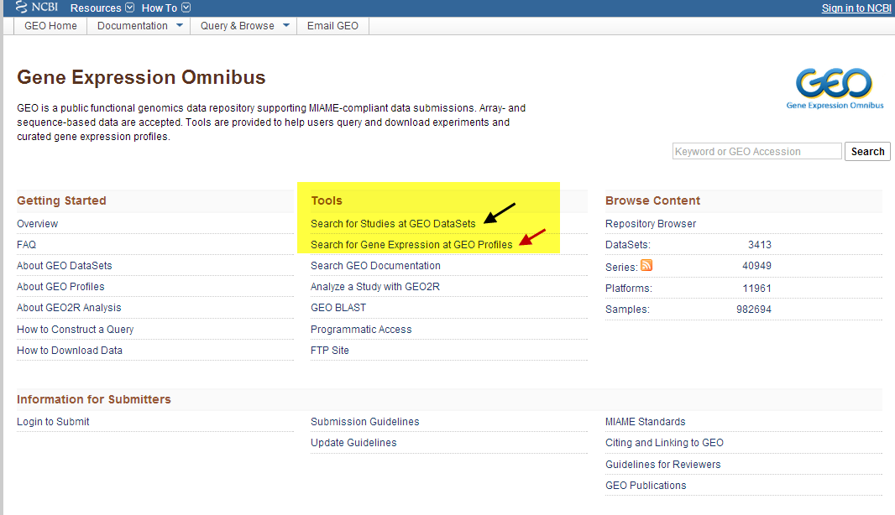
Searching GEO
http://www.hsls.pitt.edu/molbio

Slide 29
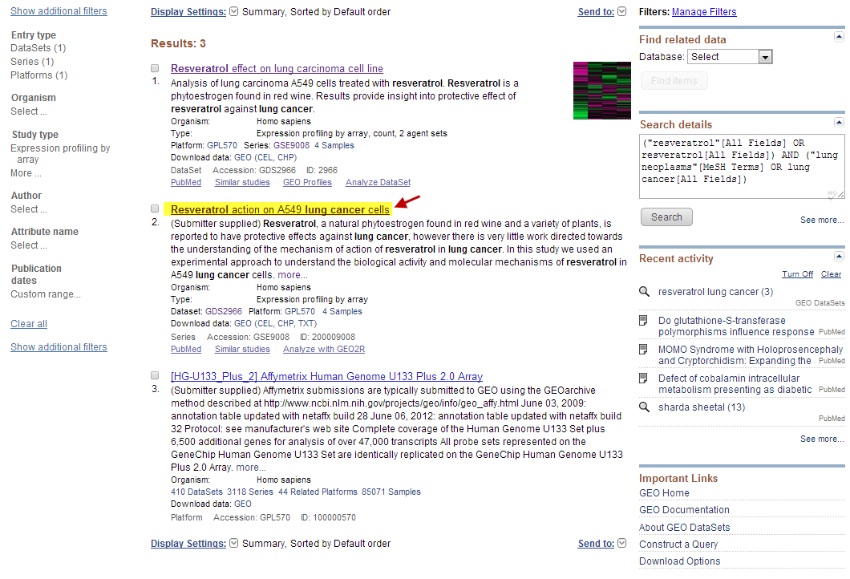
Searching GEO
http://www.hsls.pitt.edu/molbio

Slide 30
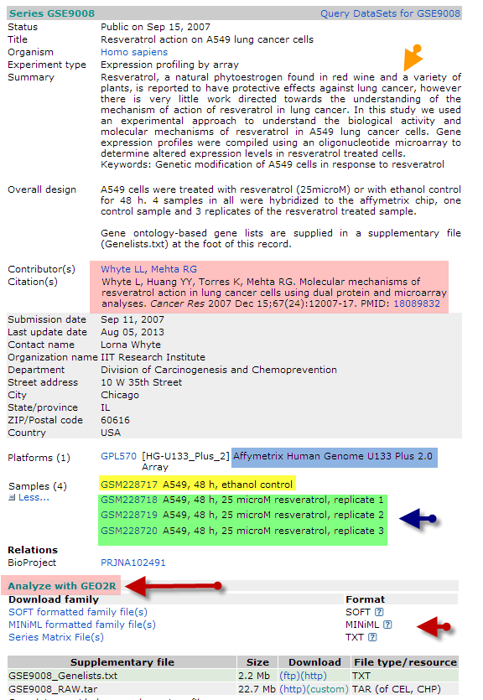
Searching GEO
http://www.hsls.pitt.edu/molbio

Slide 31
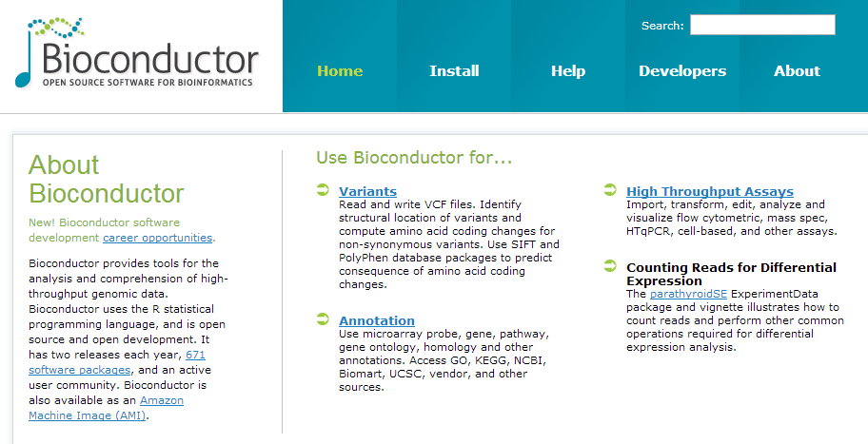
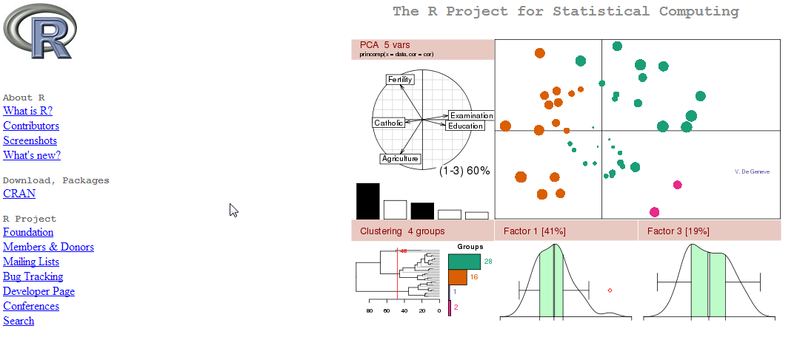
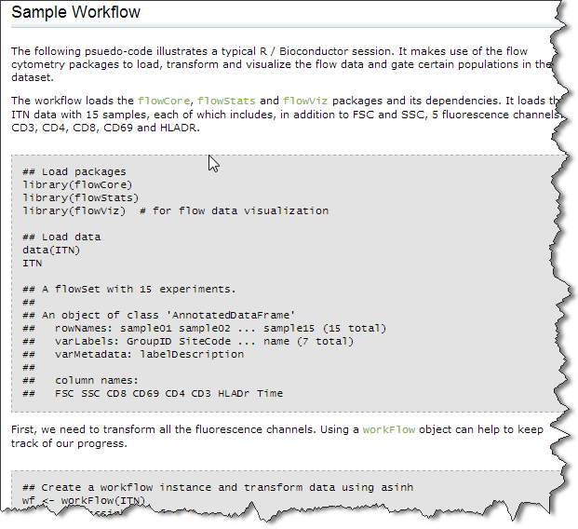
GEO2R
http://www.hsls.pitt.edu/molbio

Slide 32
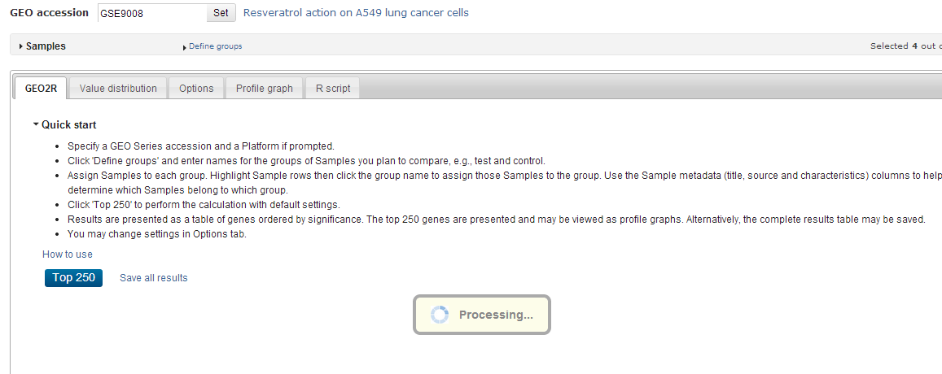
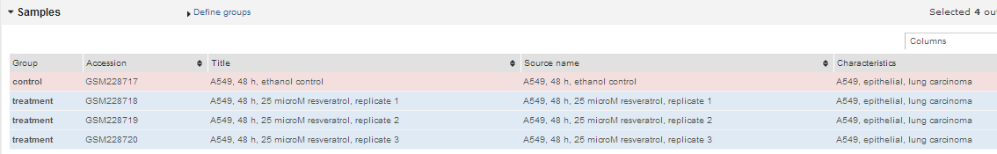
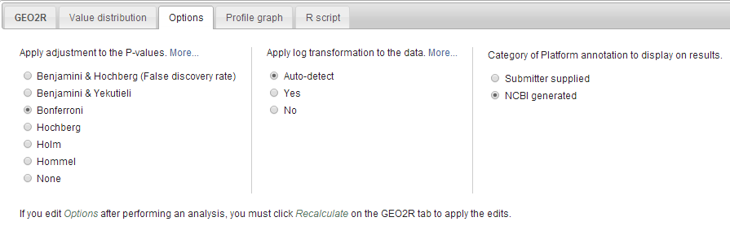
GEO2R – Experiment to Gene List
http://www.hsls.pitt.edu/molbio

Slide 33
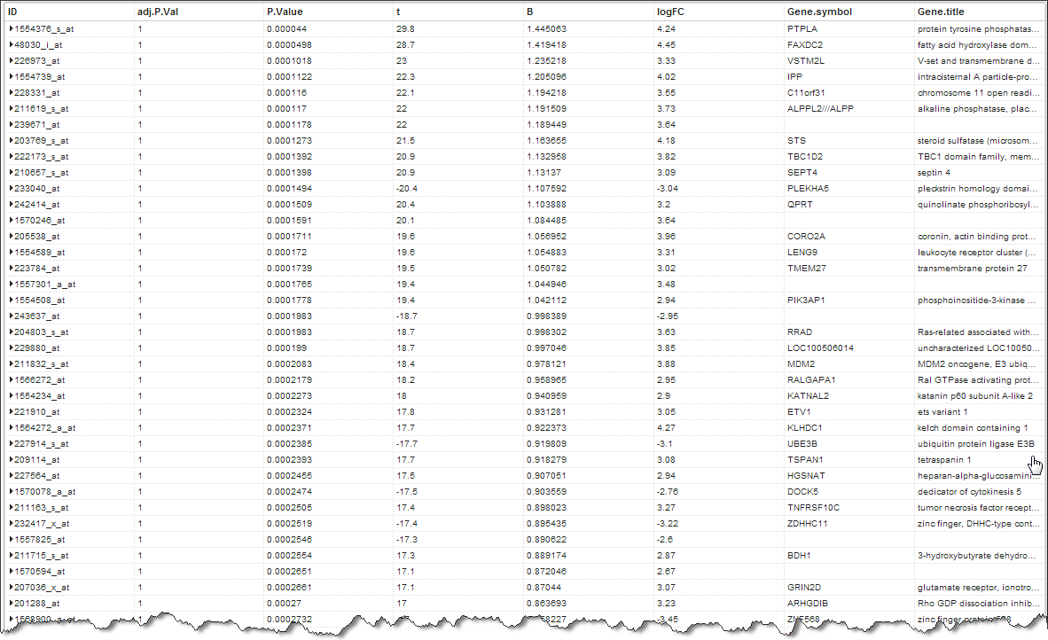
GEO2R – Experiment to Gene List
http://www.hsls.pitt.edu/molbio

Slide 34
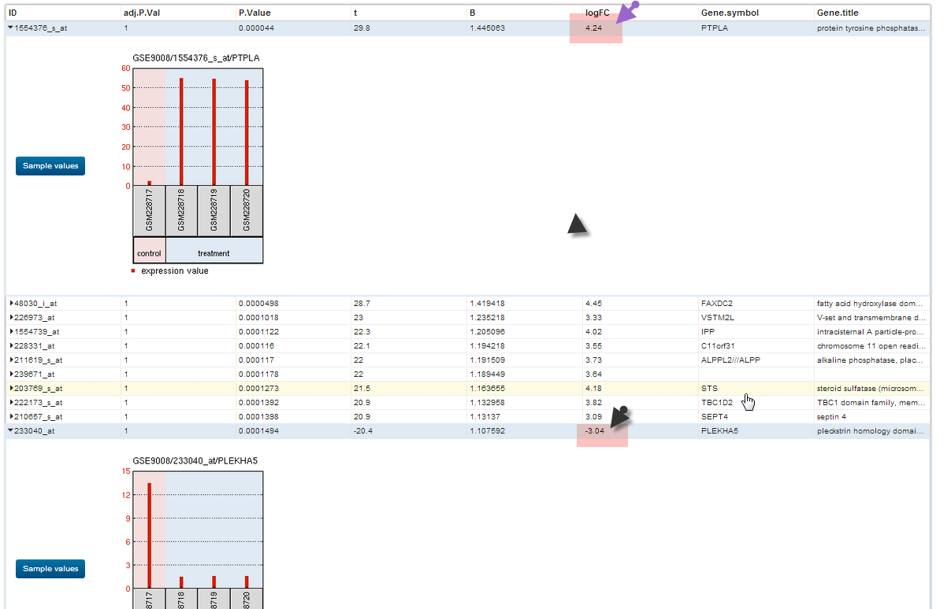
GEO2R – Experiment to Gene List
http://www.hsls.pitt.edu/molbio

Slide 35
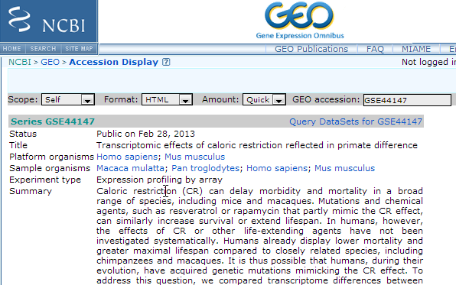
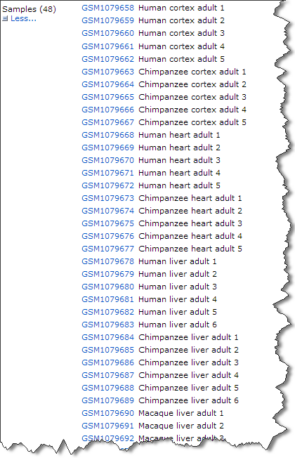
http://www.hsls.pitt.edu/molbio

Slide 36
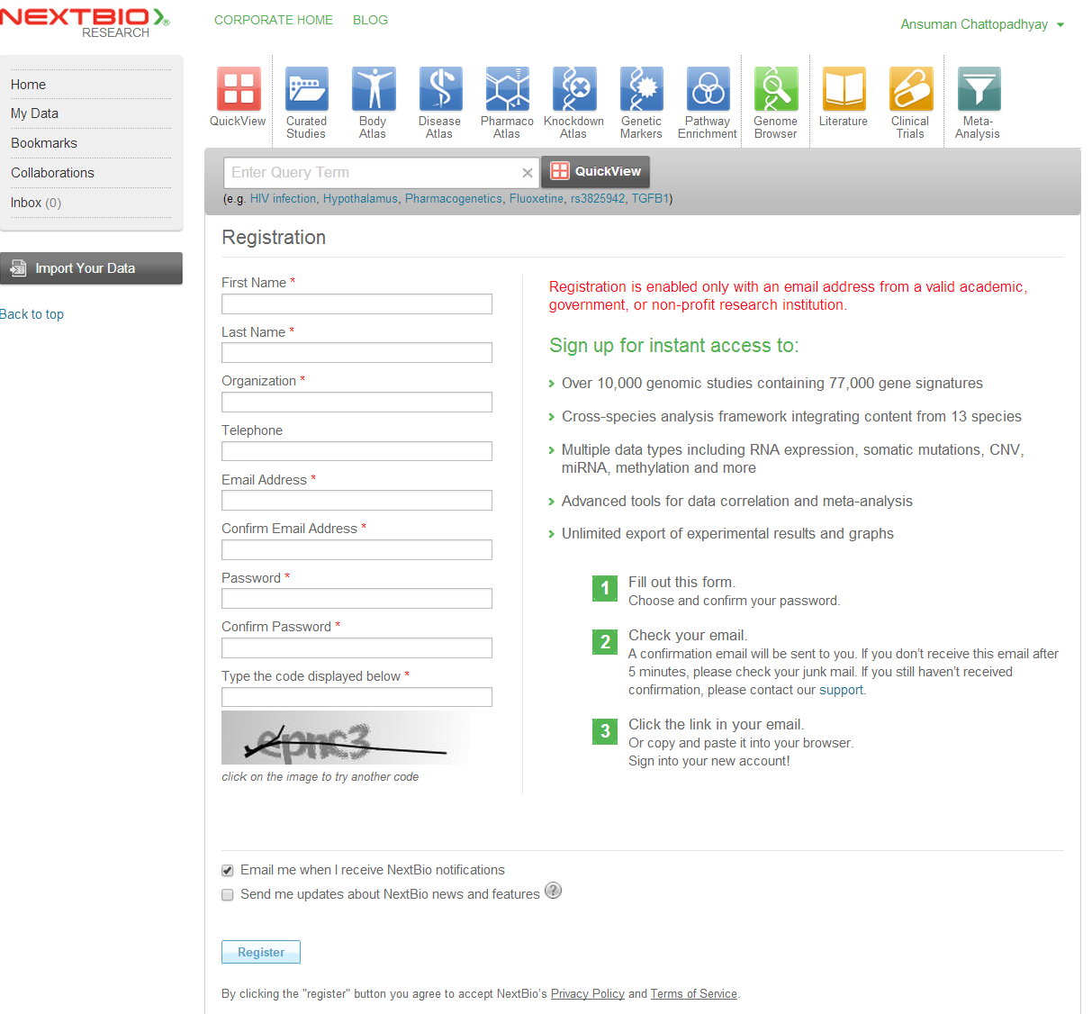
NextBio Registration
https://www.nextbio.com/b/register/register.nb
http://www.hsls.pitt.edu/molbio

Slide 37
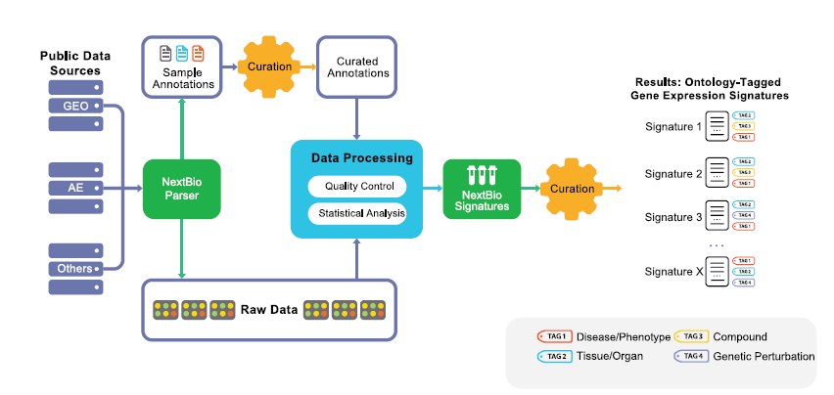
NextBio
http://www.hsls.pitt.edu/molbio

Slide 38
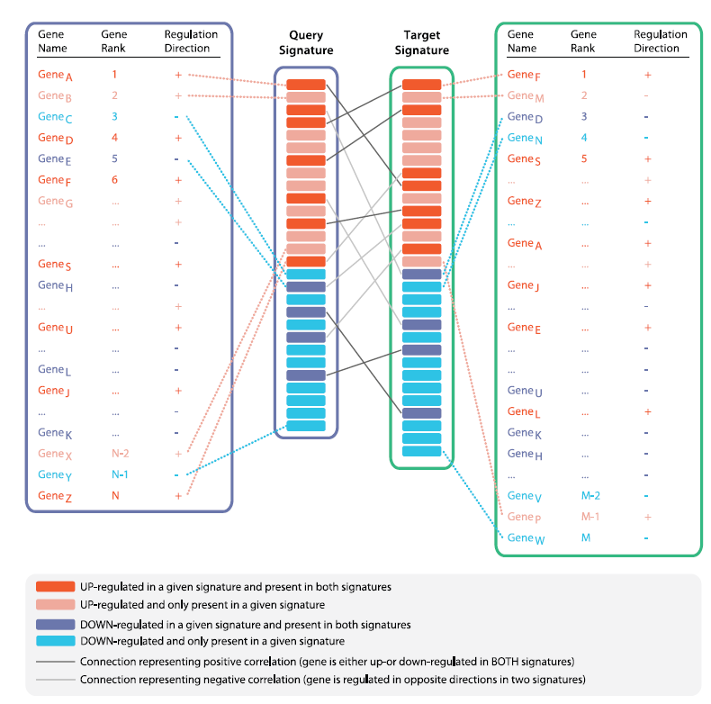
NextBio
http://www.hsls.pitt.edu/molbio

Slide 39
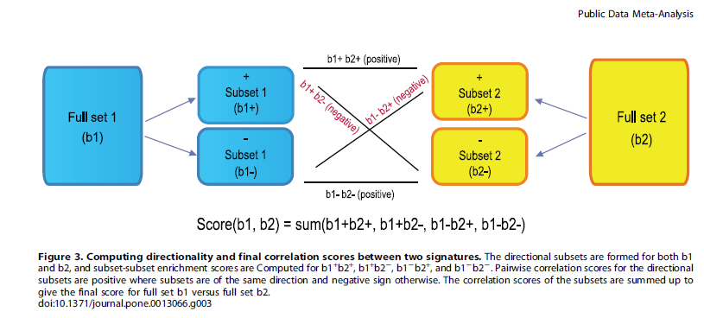
NextBio
http://www.hsls.pitt.edu/molbio

Slide 40
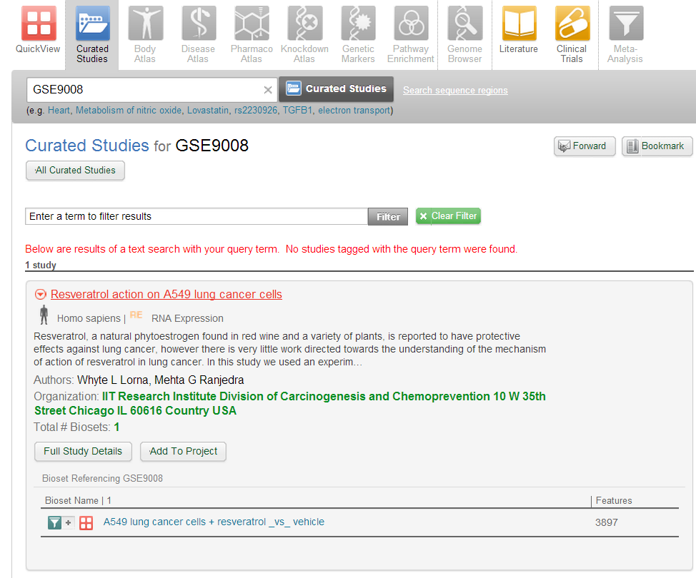
NextBio Search
http://www.hsls.pitt.edu/molbio

Slide 41
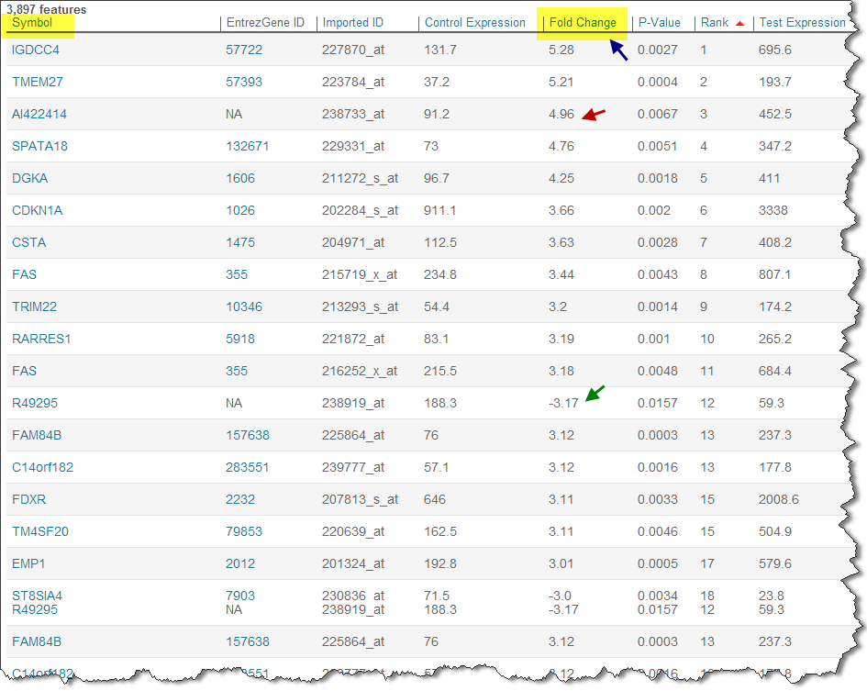
NextBio GeneList
http://www.hsls.pitt.edu/molbio

Slide 42
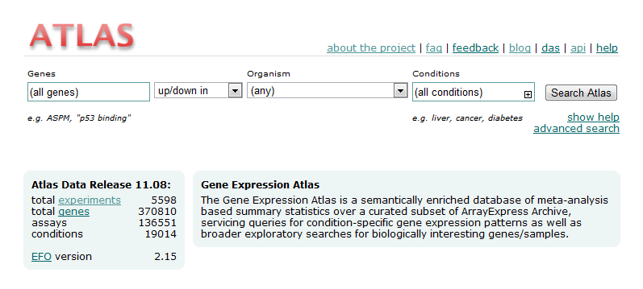
Gene Expression Atlas
http://www.ebi.ac.uk/gxa/
http://www.hsls.pitt.edu/molbio

Slide 43
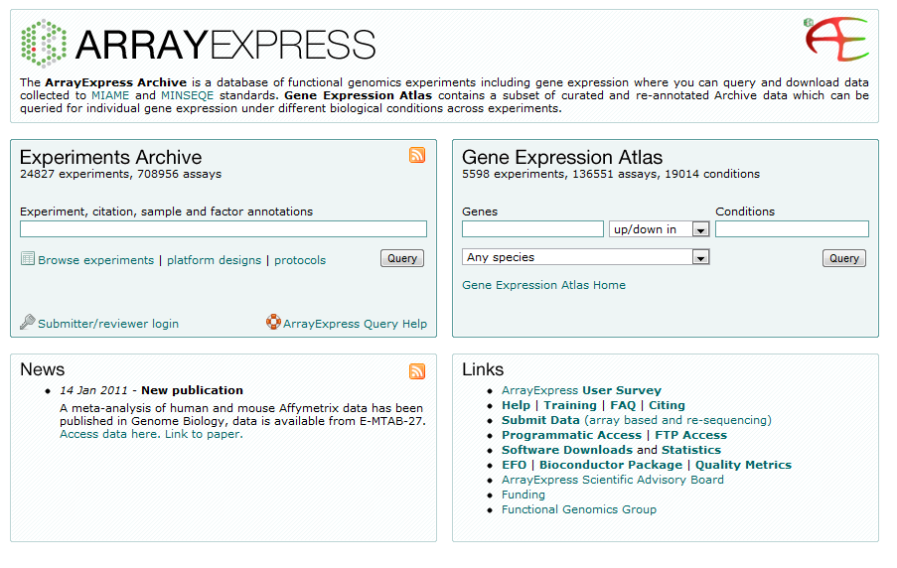
Array Express
http://www.hsls.pitt.edu/guides/genetics

Slide 44
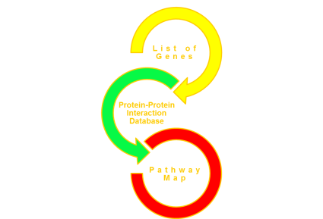
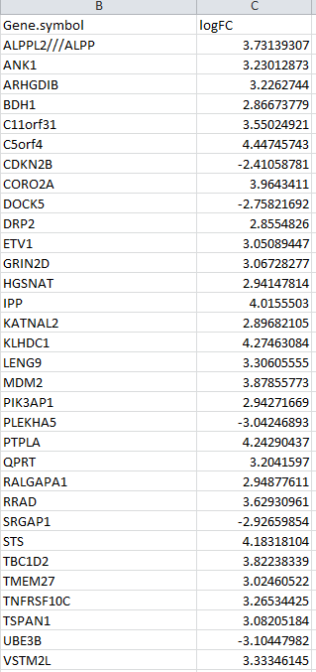
Literature to GeneList
GEO
Geo2R
Gene List
NextBio
http://www.hsls.pitt.edu/molbio

Slide 45
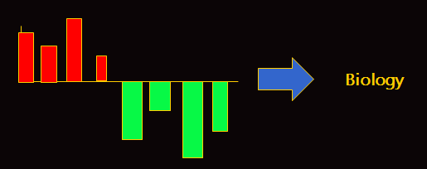
Gene Lists to Biology
http://www.hsls.pitt.edu/molbio

Slide 46
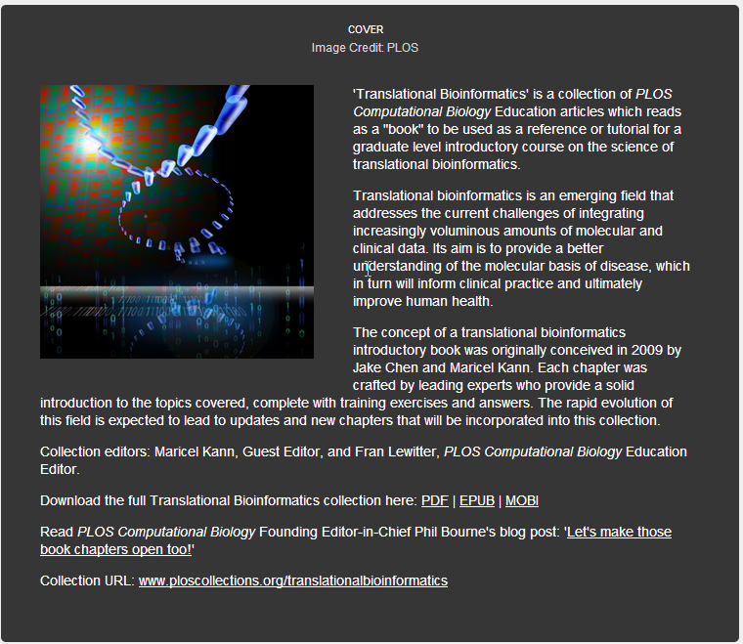

Suggested Reading
http://www.ploscollections.org/article/info%3Adoi%2F10.1371%2Fjournal.pcbi.1002820
http://www.hsls.pitt.edu/molbio

Slide 47







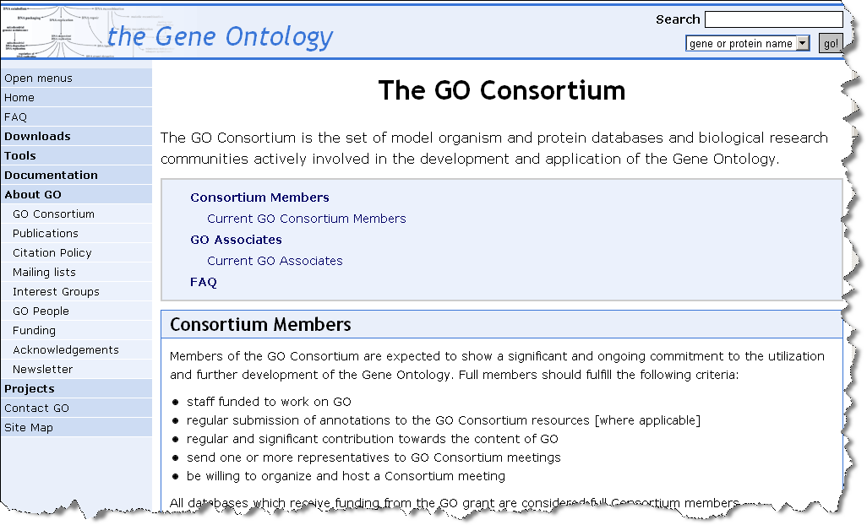
GO Consortium
http://www.hsls.pitt.edu/molbio

Slide 48
GO Annotation
Cellular Component
Biological Process
Molecular Function
http://www.hsls.pitt.edu/molbio

Slide 49
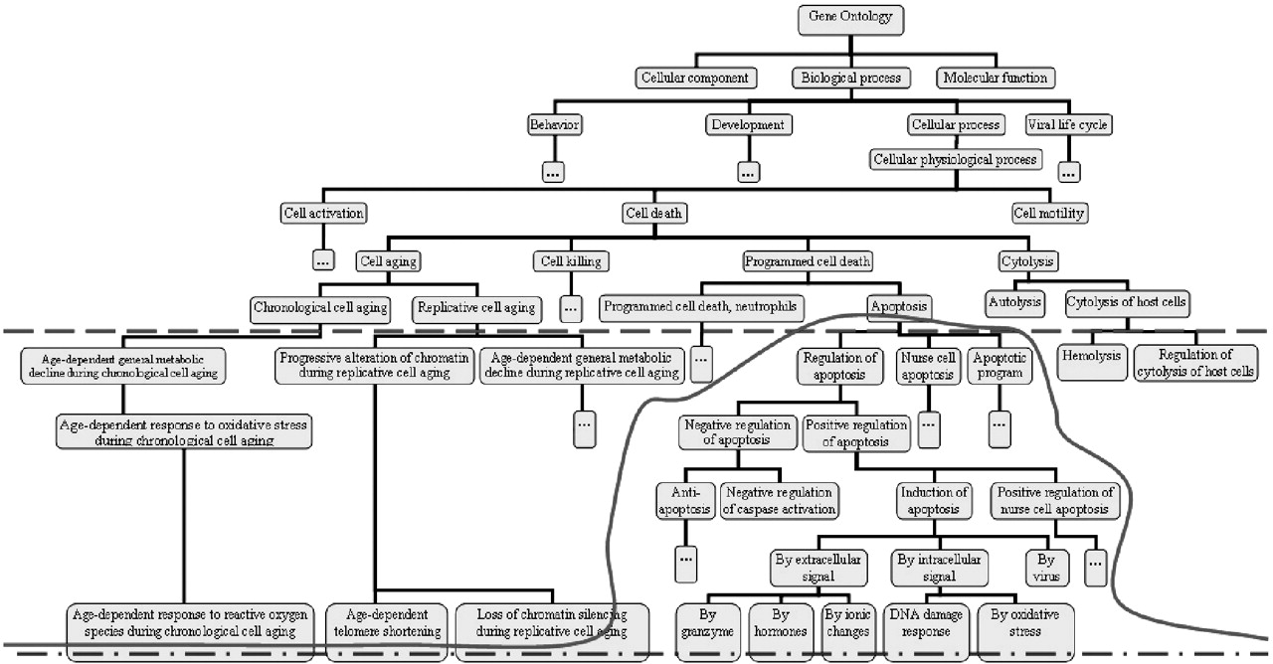

Levels of abstraction
Gene Ontology (GO)
Khatri, P. et al. Bioinformatics 2005 21:3587-3595; doi:10.1093/bioinformatics/bti565
Copyright restrictions may apply.

Slide 50
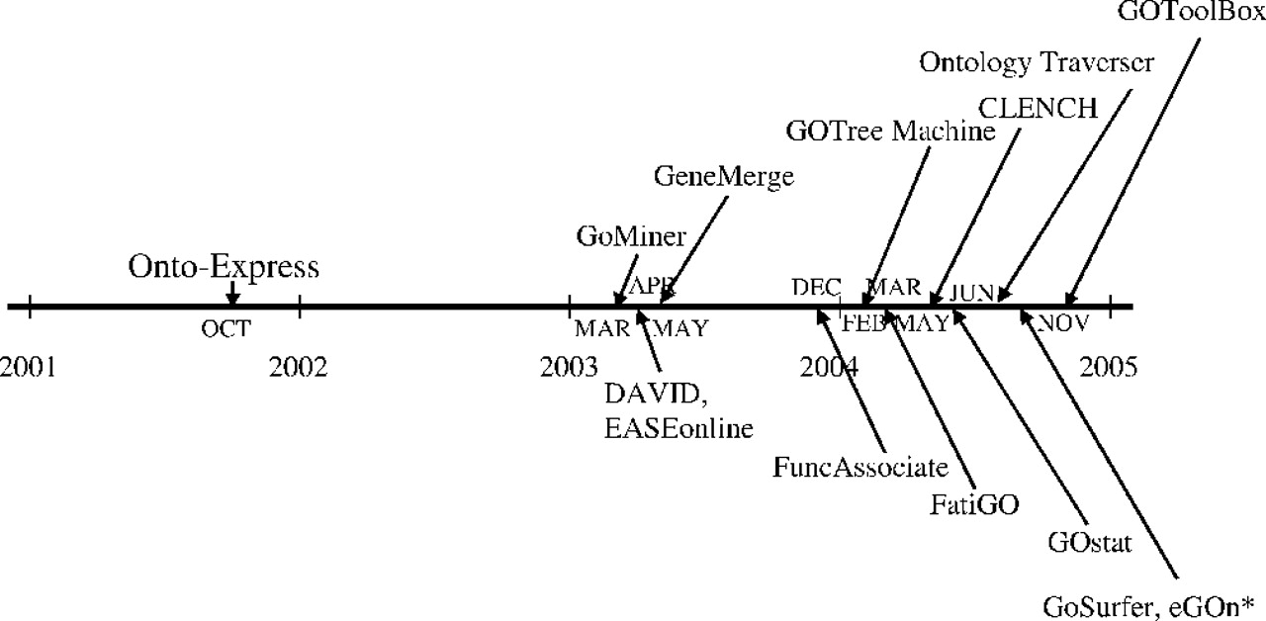
Evolution history of GO-based functional analysis software
Development of gene ontology based tools
Khatri, P. et al. Bioinformatics 2005 21:3587-3595; doi:10.1093/bioinformatics/bti565
Copyright restrictions may apply.

Slide 51
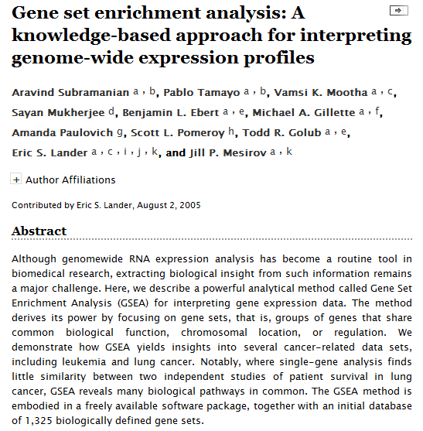

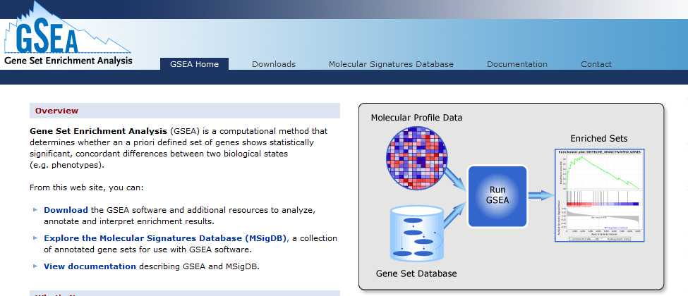
http://www.hsls.pitt.edu/molbio

Slide 52
Gene list to Biology
Biological List
Functions
Pathways
Biological Table
Interaction Networks
http://www.hsls.pitt.edu/molbio

Slide 53
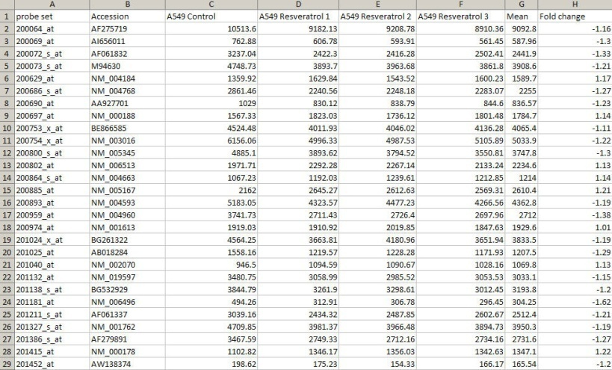
Discovery Step: Pathway Analysis
DAVID
Metacore
Ingenuity IPA
Gene List
http://www.hsls.pitt.edu/molbio

Slide 54
Pathway Analysis Software
NLP Driven
PathwayArchitect
PathwayStudio
Human Curated
Ingenuity IPA
GeneGO’s Metacore
Biobase Explain
“ Axin binds beta-catenin, GSK-3beta and APC.”
Extracted Facts:
Axin - beta-catenin interaction: Binding
Axin - GSK-3beta interaction: Binding
Axin - APC interaction: Binding
http://www.hsls.pitt.edu/molbio

Slide 55
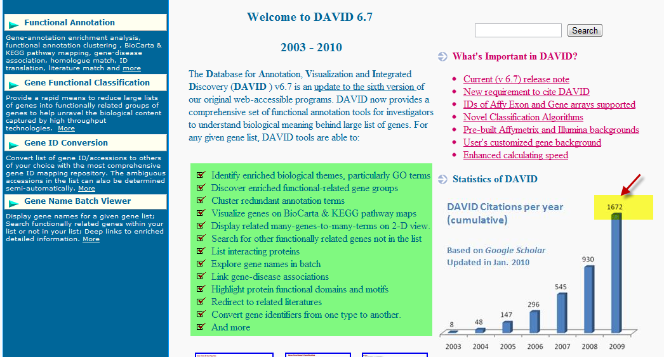
DAVID Bioinformatics Resources
http://www.hsls.pitt.edu/molbio

Slide 56
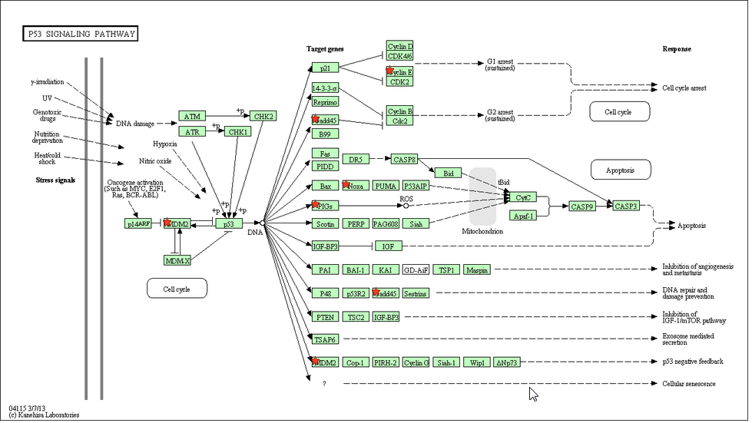
DAVID Tools
Functional Annotation
  Clustering
    Chart – Term centric
    Table – Gene centric
http://www.hsls.pitt.edu/molbio

Slide 57
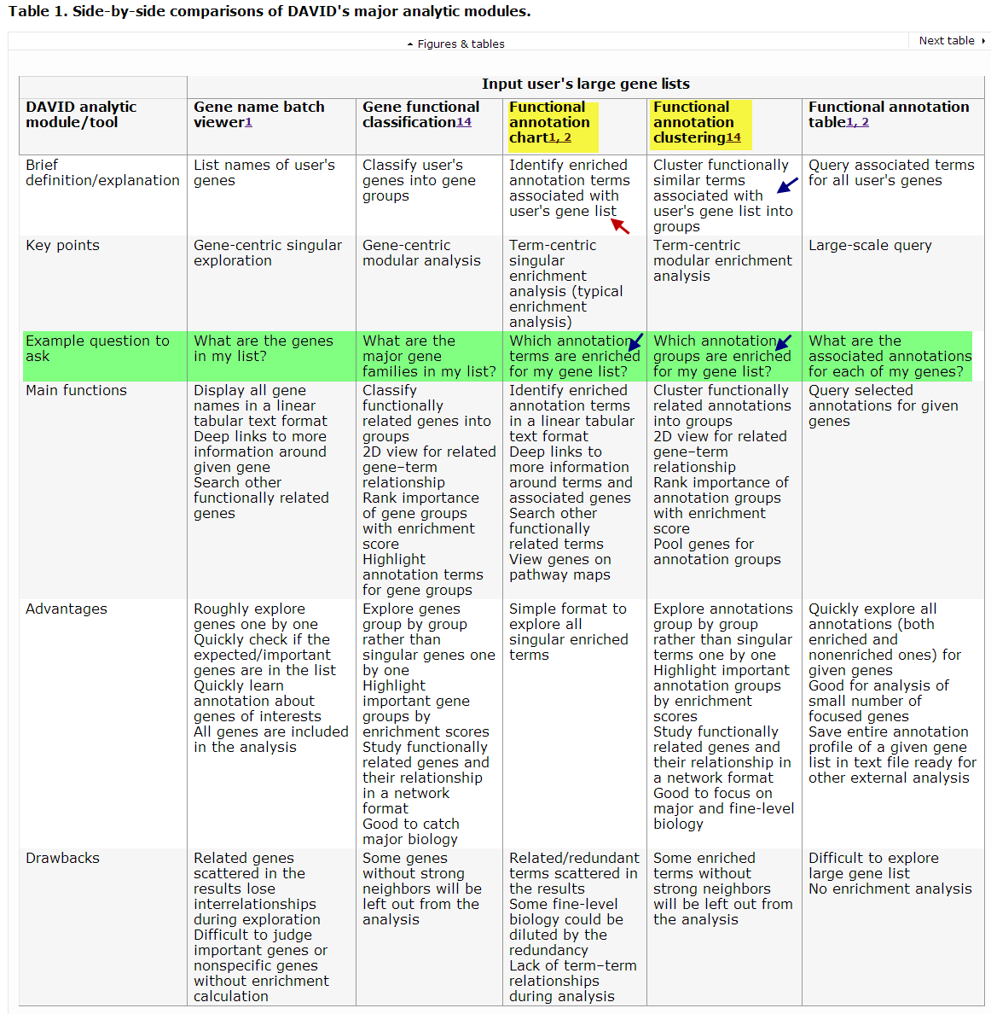
DAVID
http://www.nature.com/nprot/journal/v4/n1/fig_tab/nprot.2008.211_T1.html
http://www.hsls.pitt.edu/guides/genetics

Slide 58
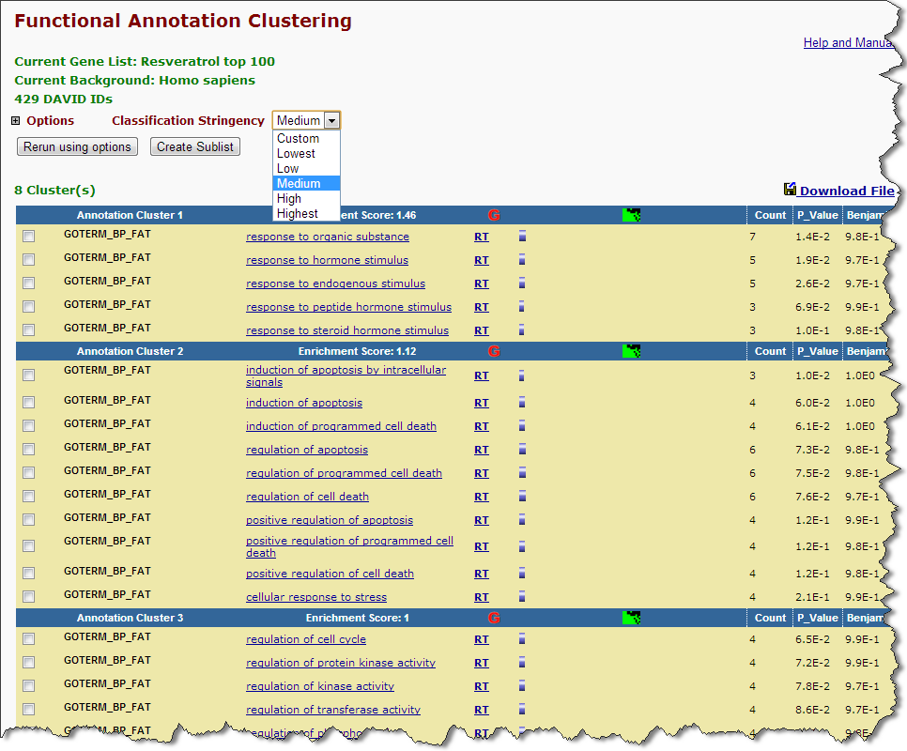
NIH DAVID
http://www.hsls.pitt.edu/molbio

Slide 59
Ingenuity IPA
http://www.hsls.pitt.edu/molbio

Slide 60
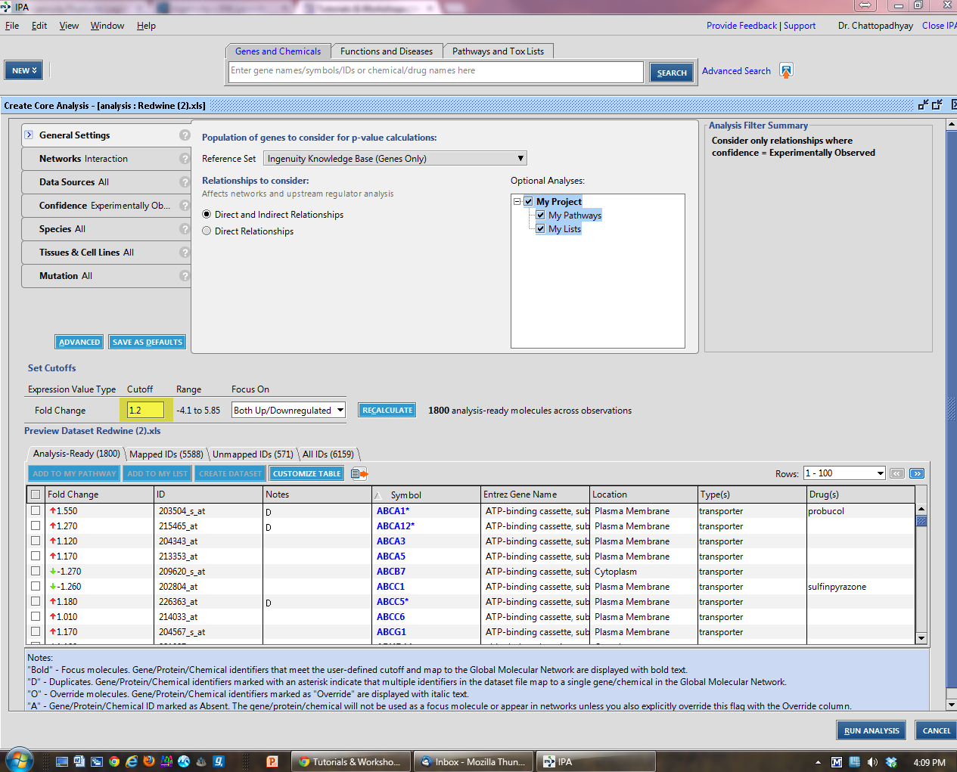
IPA

Slide 61
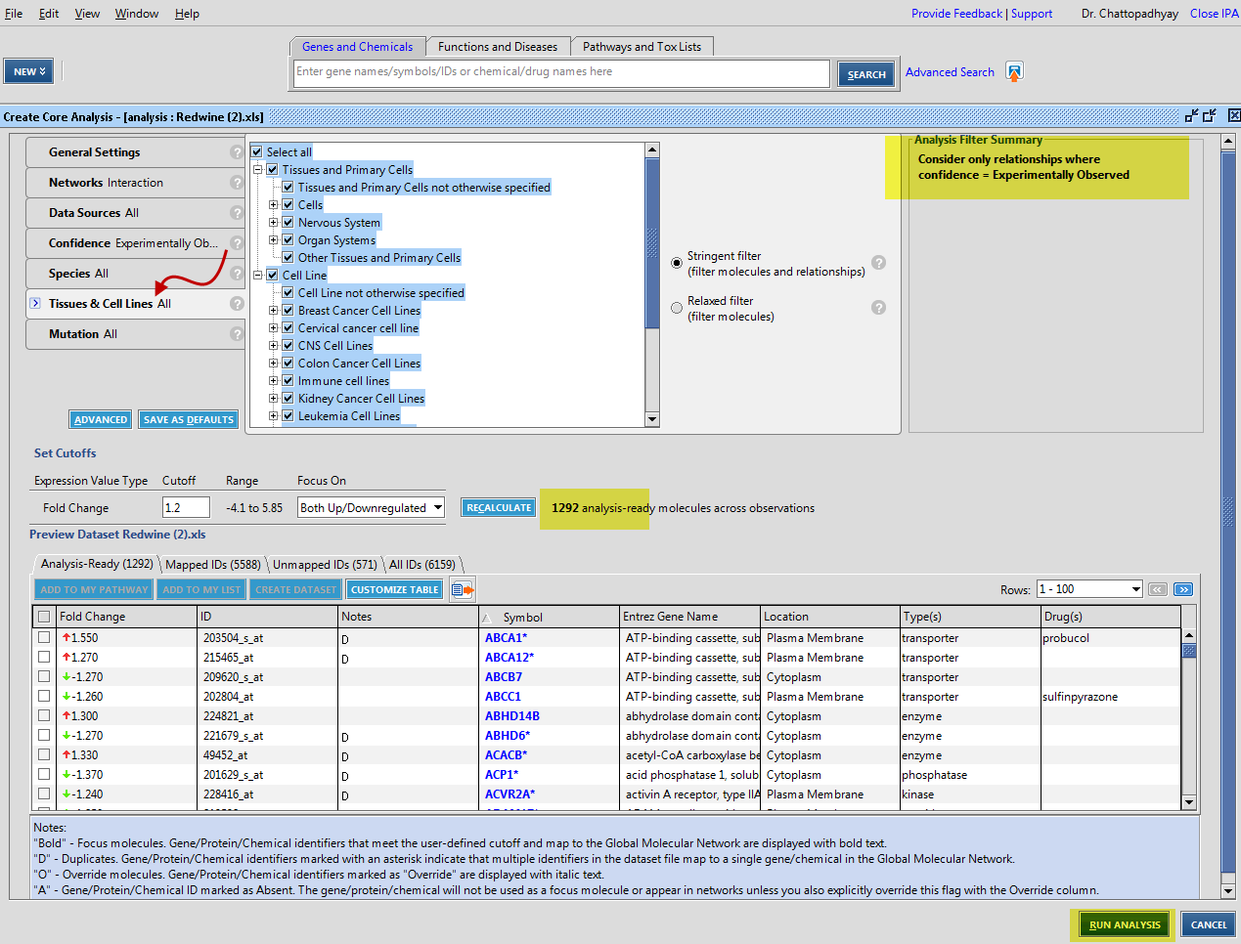
IPA

Slide 62


IPA

Slide 63

IPA Function

Slide 64

IPA Function

Slide 65


IPA Pathways

Slide 66


IPA Pathway

Slide 67

IPS Upstream Regulator

Slide 68

IPA Mechanistic Network

Slide 69

IPA Networks

Slide 70


IPA Networks

Slide 71

IPA

Slide 72

GeneGo: Metacore
http://www.hsls.pitt.edu/guides/genetics

Slide 73

Pathway Analysis: GeneGo Metacore
http://www.hsls.pitt.edu/guides/genetics

Slide 74

Metacore: Analyze Network (receptors)
p53
C-Myc

Slide 75


Metacore: Transcription Regulation
http://www.hsls.pitt.edu/guides/genetics

Slide 76

Cytoscape
http://www.hsls.pitt.edu/molbio

Slide 77
Hands-on Exercise
Use NIH DAVID to uncover enriched pathways associated with the “gene list – 1”
http://www.hsls.pitt.edu/molbio

Slide 78
Thank you!
Any questions?
Ansuman Chattopadhyay
ansuman@pitt.edu
http://www.hsls.pitt.edu/molbio

