Slide 1
Pitt MSTP: Intro to HSLS MolBio 4th June 2015
Ansuman Chattopadhyay, PhD
Carrie L Iwema, PhD, MLS, AHIP
Molecular Biology Information Services
Health Sciences Library System
University of Pittsburgh
ansuman@pitt.edu iwema@pitt.edu

Slide 2
HSLS Molecular Biology Information Service
Workshops
Website
Software Licensing
Bioinformatics Consultations
http://www.hsls.pitt.edu/molbio

Slide 3
Ansuman Chattopadhyay, Ph.D.
ansuman@pitt.edu
1990-1996
University of Nebraska-Lincoln
PhD. in Biochemistry
Protein synthesis initiation in eukaryotic system
1997-2001
Vanderbilt University School of Medicine, Nashville
Research Fellow
Epidermal Growth Factor (EGF) mediated signal transduction
2001-2002
Cellomics Inc., Pittsburgh
Knowledge Engineer
2002- 2006
Information Specialist in Molecular Biology and Genetics
HSLS, University of Pittsburgh
2006- Present
Head, Molecular Biology Information Service
HSLS, University of Pittsburgh
http://www.hsls.pitt.edu/molbio

Slide 4
Carrie L Iwema, PhD, MLS, AHIP
iwema@pitt.edu
1993-2001
SUNY Upstate Medical University, Syracuse
PhD in Neuroscience
Specificity of connectivity in the mammalian olfactory system
2001-2005
Yale University School of Medicine, New Haven
Postdoctoral Fellow
Development & regeneration in the mammalian olfactory system
2004-2006
Southern Connecticut State University, New Haven
Masters in Library Science
2006- 2007
Johns Hopkins Medical Institutions, Welch Medical Library, Baltimore
Basic Science Librarian
2007- Present
University of Pittsburgh, Health Sciences Library System, Pittsburgh
Information Specialist in Molecular Biology
http://www.hsls.pitt.edu/molbio

Slide 5
Topics
Literature Informatics
Bioinformatics Databases & Software
HSLS MolBio Services
http://www.hsls.pitt.edu/molbio

Slide 6
In silico Support
Literature
Search
Sequence Analysis
Omics Data Analysis
http://www.hsls.pitt.edu/molbio

Slide 7
Topics
Literature Informatics
Comprehensive search:
MESH term based PubMed Search
PubMed special topics query
Next-generation literature search tools:
GoPubMed, Quertle/Quetzal, PALM-IST
HuGE Navigator
eTBlast, JANE
http://www.hsls.pitt.edu/molbio

Slide 8
Growth of PubMed Citations
300K
Breast Cancer
115K
Schizophrenia
11.5K
BRCA1
76K
. p53
4th June 2015
Lu et al. Database (Oxford). 2011: baq036
http://www.hsls.pitt.edu/molbio

Slide 9
Literature Informatics
What genes are reported to be associated with the disease SCHIZOPHRENIA?
Find published literature with statistical and numerical data on DENGUE OUTBREAKS in India.
http://www.hsls.pitt.edu/molbio

Slide 10
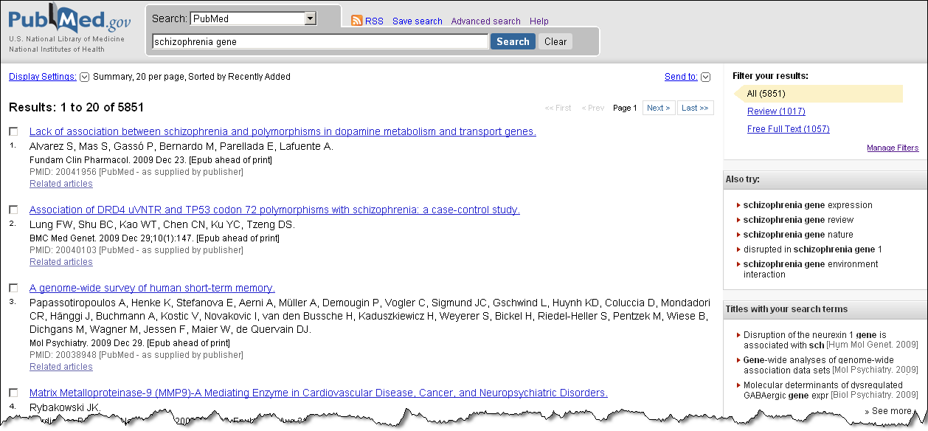
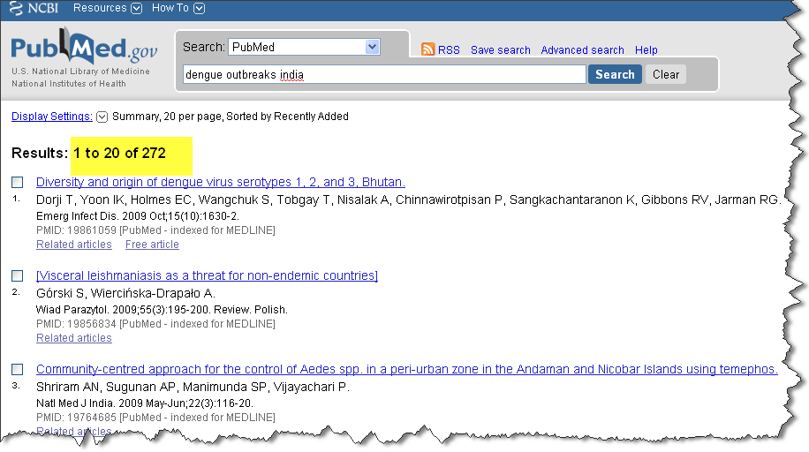
Literature Informatics
Schizophrenia: 114,809
Schizophrenia gene: 9,950
Citations: >24 million
Journals: >5600
Dengue outbreaks in India: 475
Dengue outbreaks statistics India: 40
http://www.hsls.pitt.edu/molbio

Slide 11
Challenges
Am I getting everything / the right things?
How to digest this?
http://www.hsls.pitt.edu/molbio

Slide 12
PubMed Search
Am I getting the right things?
Construct PubMed queries with MeSH terms using MeSH browser
http://www.hsls.pitt.edu/molbio

Slide 13
Medical Subject Headings (MeSH)
The U.S. National Library of Medicine's controlled vocabulary (thesaurus)
Arranged in a hierarchical manner called the MeSH Tree Structures
Updated continually
http://www.hsls.pitt.edu/molbio

Slide 14
MeSH Vocabulary
Headings
27,149 concepts found in the biomedical literature (Body Weight, Kidney, Radioactive Waste)
Subheadings
over 218,000 attached to headings to describe a specific aspect of a concept (adverse effects, metabolism, diagnosis, therapy)
Supplementary Concept Records
over 219,000 terms in a separate chemical thesaurus -updated weekly (cordycepin , valspodar , tacrolimus binding protein 4)
Publication Types
(Letter, Review, Randomized Controlled Trial)
http://www.hsls.pitt.edu/molbio

Slide 15
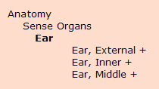
MeSH Tree Structure
A. Anatomy B. Organisms C. Diseases D. Chemicals and Drugs E. Analytical, Diagnostic and Therapeutic Techniques and Equipment F. Psychiatry and Psychology G. Phenomena and Processes H. Disciplines and Occupations I. Anthropology, Education, Sociology and Social Phenomena J. Technology, Industry, Agriculture K. Humanities L. Information Science M. Named Groups N. Health Care V. Publication Characteristics Z. Geographicals
http://www.hsls.pitt.edu/molbio

Slide 16
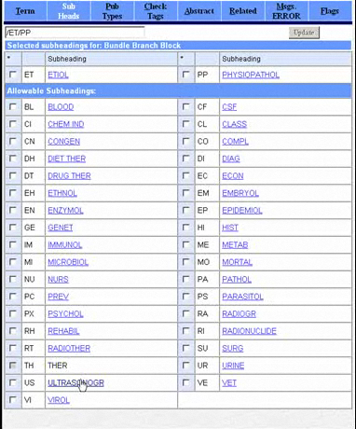
MeSH Indexing
Source: NLM
http://www.hsls.pitt.edu/molbio

Slide 17
MeSH Indexing
PMD: 18045777
http://www.hsls.pitt.edu/molbio

Slide 18
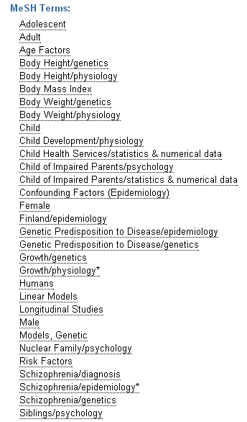
Medical Subject Heading (MeSH)
http://www.hsls.pitt.edu/molbio

Slide 19
MeSH Indexing
http://www.hsls.pitt.edu/molbio

Slide 20
PubMed Search

Slide 21
PubMed Search
Retrieve published articles on
Dengue outbreaks in India
Including
Statistical and numerical data
http://www.hsls.pitt.edu/molbio

Slide 22
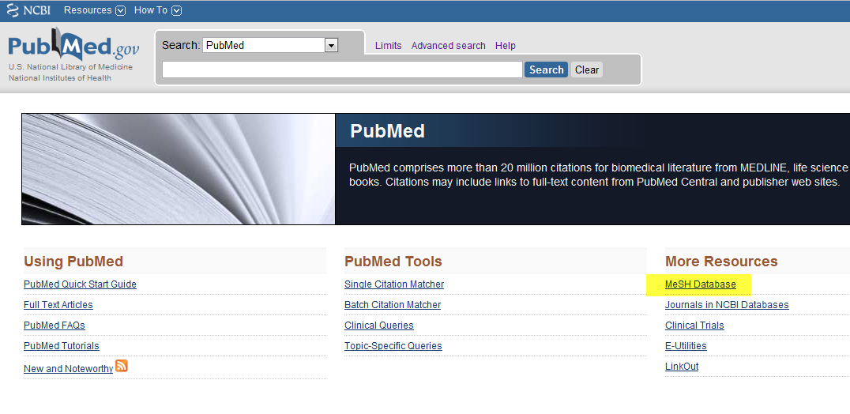
PubMed Query Using MeSH
http://www.ncbi.nlm.nih.gov/mesh
http://www.hsls.pitt.edu/molbio

Slide 23
Find articles on “Dengue outbreaks
in India” by searching PubMed
using MeSH terms
Resources
Mesh Browser : http://www.ncbi.nlm.nih.gov/mesh
PubMed: http://www.ncbi.nlm.nih.gov/pubmed
Link to the video tutorial:
http://media.hsls.pitt.edu/media/clres2705/mesh.swf
http://www.hsls.pitt.edu/molbio

Slide 24
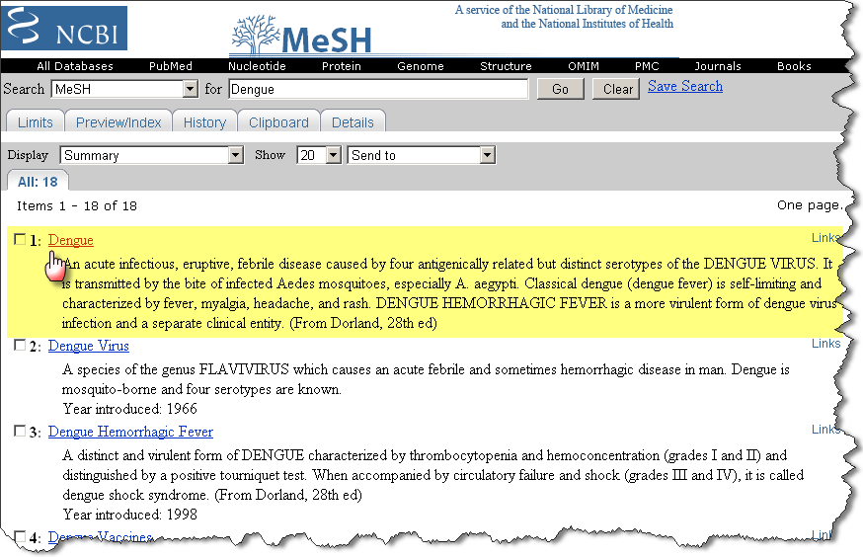
PubMed Query Using MeSH
http://www.hsls.pitt.edu/molbio

Slide 25
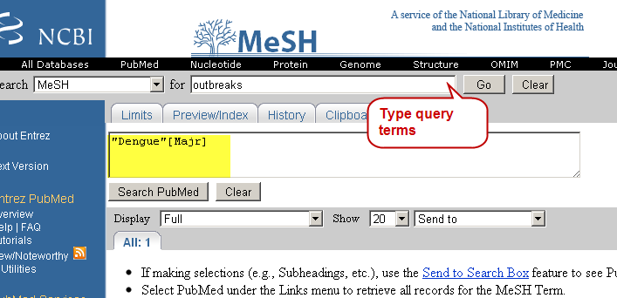
PubMed Query Using MeSH
http://www.hsls.pitt.edu/molbio

Slide 26
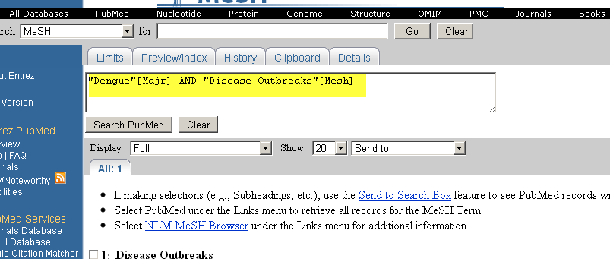
Building a PubMed Query
http://www.hsls.pitt.edu/molbio

Slide 27
Building a PubMed Query
http://www.hsls.pitt.edu/molbio

Slide 28
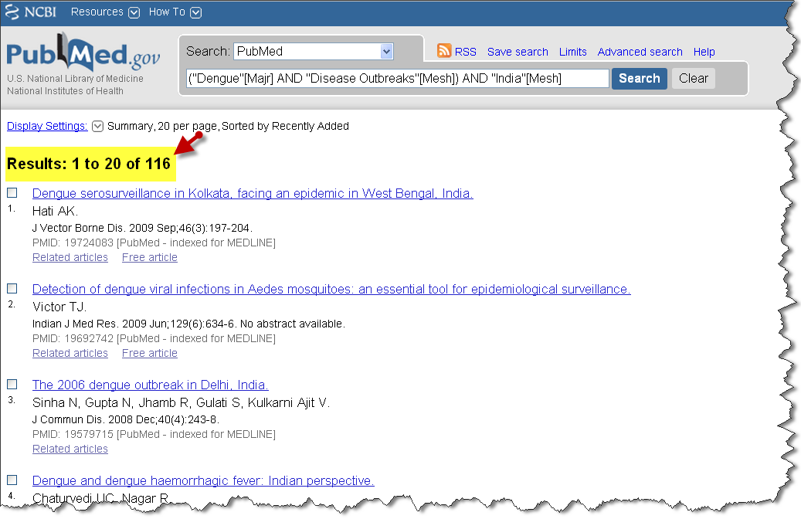
Building a PubMed Query
166
http://www.hsls.pitt.edu/molbio

Slide 29
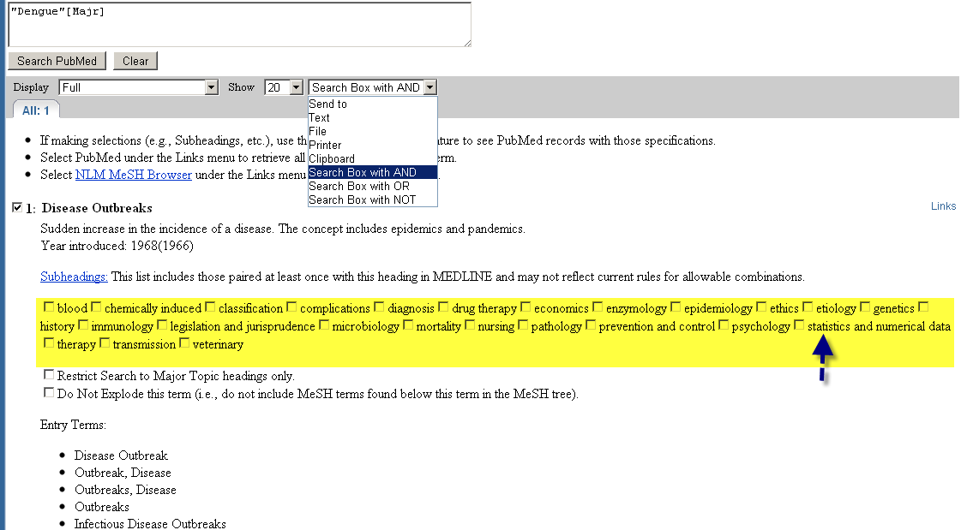
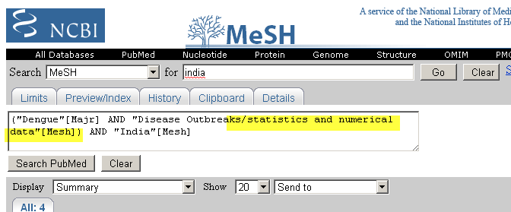
Building a PubMed Query
http://www.hsls.pitt.edu/molbio

Slide 30
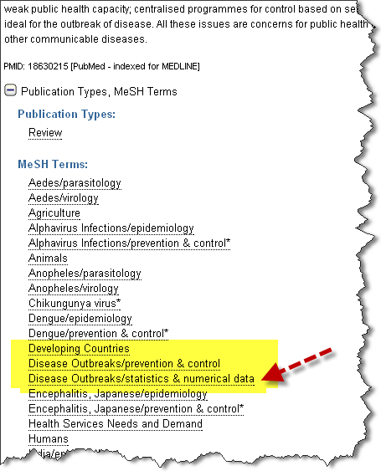
Building a PubMed Query
12
http://www.hsls.pitt.edu/molbio

Slide 31
Building PubMed Queries
Term | Boolean | Term | Boolean | Term | # papers
Dengue | AND | Outbreaks |  |  | 1,227
Dengue * | AND | Outbreaks |  |  | 1,120
Dengue | AND | Outbreaks | AND | India | 175
Dengue* | AND | Outbreaks | AND | India | 166
Dengue | AND | Outbreaks/ statistics and numerical data | AND | India | 12
Dengue* | AND | Outbreaks/ statistics and numerical data | AND | India | 12
http://www.hsls.pitt.edu/molbio

Slide 32
Useful Links for MeSH & PubMed
MeSH Browser: http://www.ncbi.nlm.nih.gov/mesh
18 ways to improve your PubMed searches by Carrie Iwema
http://goo.gl/B8rFf
PubMed Help. NCBI Handbook :
http://goo.gl/X4UAe
http://www.hsls.pitt.edu/molbio

Slide 33
PubMed Query
What genes are reported to be associated with the disease SCHIZOPHRENIA ?
Topic-Specific PubMed Queries
http://www.hsls.pitt.edu/molbio

Slide 34
Topic-Specific PubMed Queries
http://www.nlm.nih.gov/bsd/special_queries.html
http://www.hsls.pitt.edu/molbio

Slide 35
Find genes that are reported to be
associated with the disease
SCHIZOPHRENIA by searching PubMed
Resources
PubMed Clinical Queries: http://www.ncbi.nlm.nih.gov/pubmed/clinical
Link to the video tutorial:
http://media.hsls.pitt.edu/media/clres2705/scz.swf
http://www.hsls.pitt.edu/molbio

Slide 36
PubMed Special Topic Queries
http://www.hsls.pitt.edu/molbio

Slide 37
Search Filters
http://www.hsls.pitt.edu/molbio

Slide 38
PubMed Search Filter: Medical Genetics
("schizophrenia"[MeSH Terms] OR "schizophrenia"[All Fields]) AND (("genetics, medical"[MeSH Terms] OR ("genetics"[All Fields] AND "medical"[All Fields]) OR "medical genetics"[All Fields] OR ("medical"[All Fields] AND "genetics"[All Fields])) OR ("genotype"[MeSH Terms] OR "genotype"[All Fields]) OR "genetics"[Subheading] AND ("genetics"[Subheading] OR "genetics"[All Fields] OR "genetics"[MeSH Terms]))
http://www.hsls.pitt.edu/molbio

Slide 39
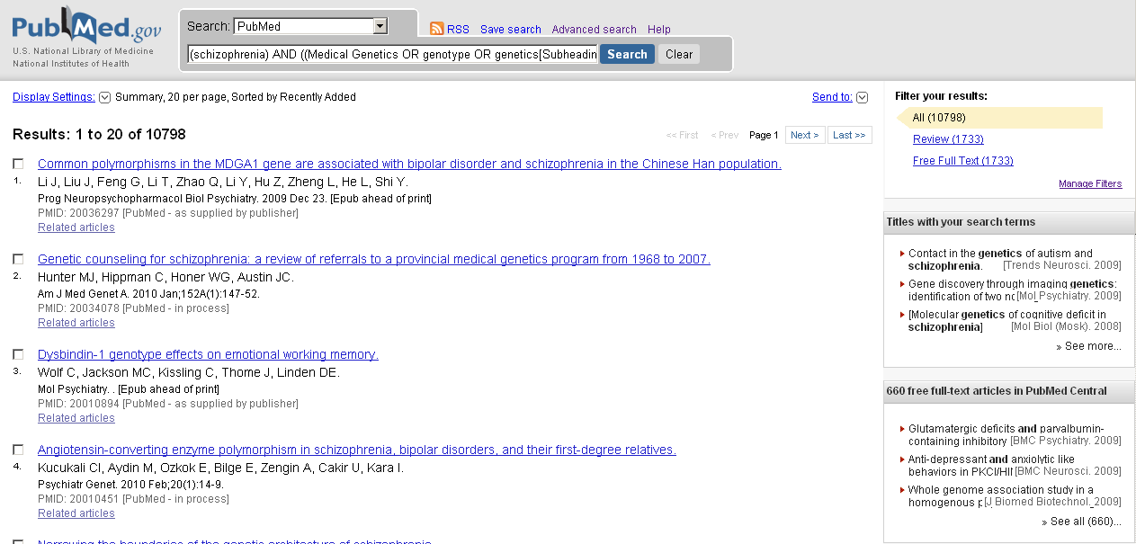
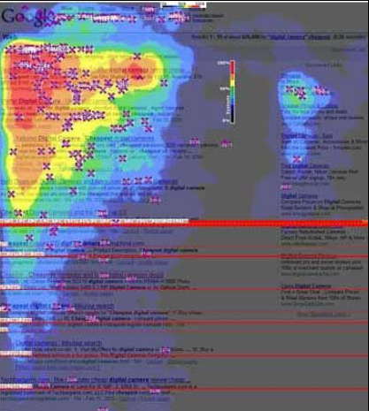
PubMed Search Result Display
How to digest
this?
http://www.hsls.pitt.edu/molbio
Notes:
PubMed result display: A list with citations, not intuitive for knowledge extraction.
Google Search result display:
When viewing a standard Google results page,
users tended to create an “F-shaped” pattern with their eye movements, focusing first and
longest on the upper-lefthand corner of the screen; moving down vertically through the first
two or three results; moving across the page to the first paid page result; moving down another
few vertical results; and then moving across again to the second paid result. (This study was
done only on left-to-right language search results—Chinese, Hebrew, etc. results would be
different.)
Ref: The Art of SEO, 1st Edition , Eric Enge etal., O’Reilly Media Inc.

Slide 40
Next-Generation Literature Search Tools

Slide 41
Latest Innovations in Literature Searching
GoPubMed
Display search results
sorted into meaningful
topics and subtopics
http://www.hsls.pitt.edu/molbio

Slide 42
GoPubMed
www.gopubmed.com
http://www.hsls.pitt.edu/molbio

Slide 43
Find genes that are reported to be
associated with the disease
SCHIZOPHRENIA by using GoPubMed
Resources
GoPubMed: http://www.gopubmed.org/web/gopubmed/2?WEB10O00h00100090000
Link to the video tutorial:
http://media.hsls.pitt.edu/media/clres2705/gopubmed.swf
http://www.hsls.pitt.edu/molbio

Slide 44
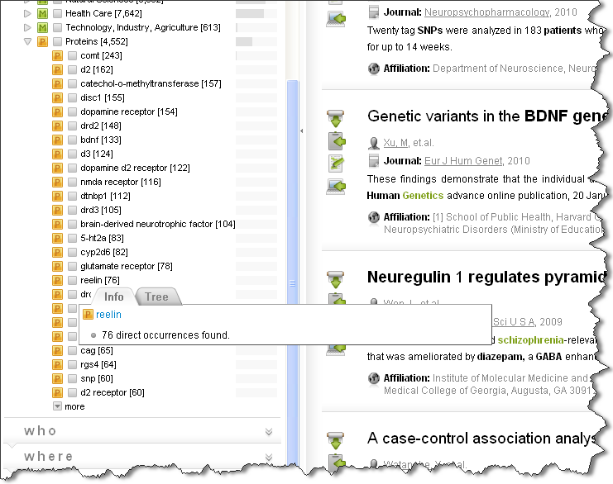
GoPubMed Search Result
http://www.hsls.pitt.edu/molbio

Slide 45
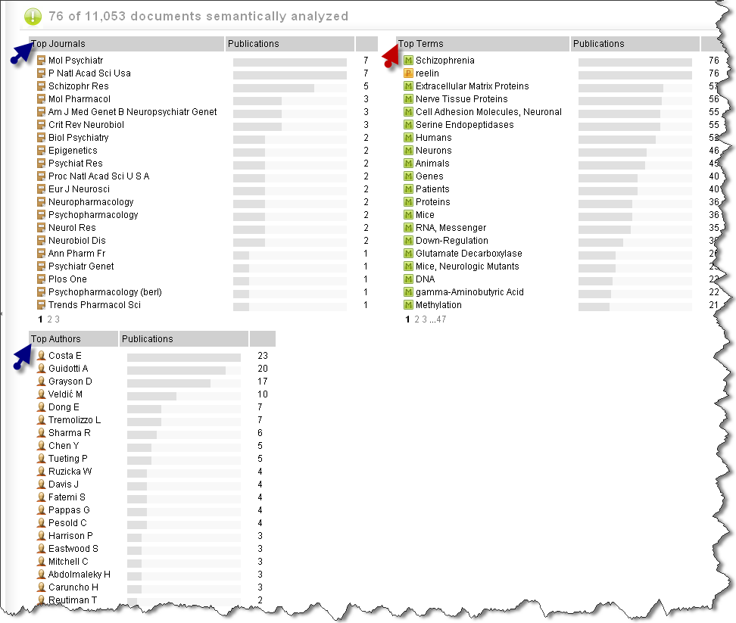
GoPubMed Search Result Analysis
http://www.hsls.pitt.edu/molbio

Slide 46
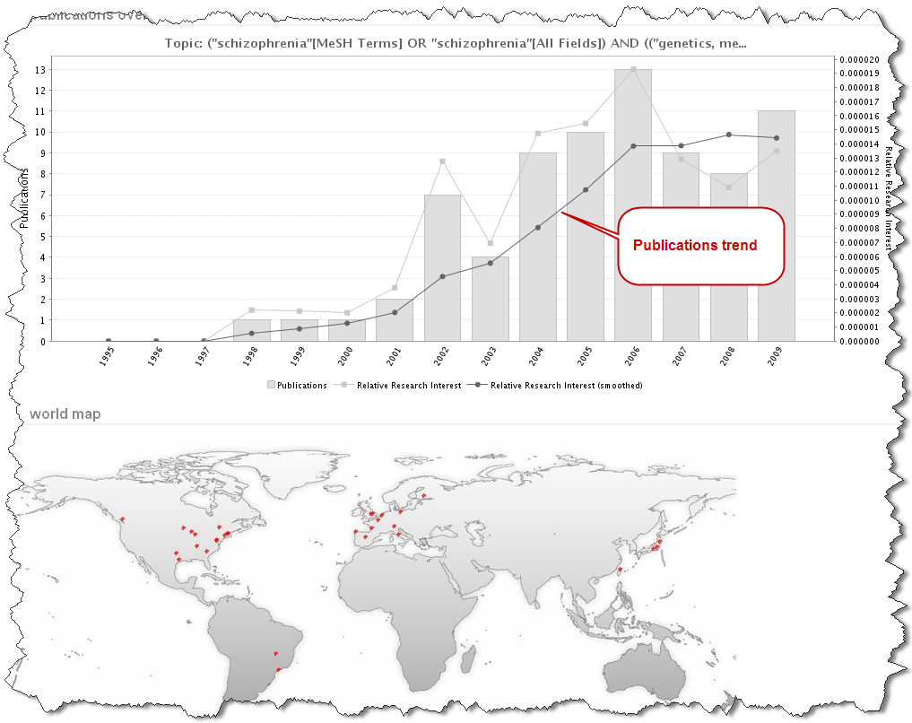
GoPubMed Search Result Analysis
http://www.hsls.pitt.edu/molbio

Slide 47
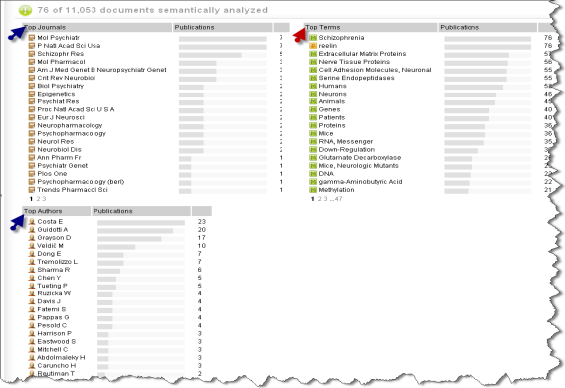
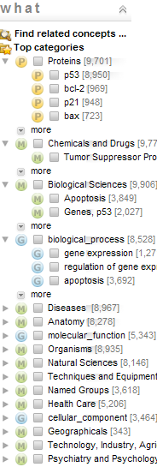
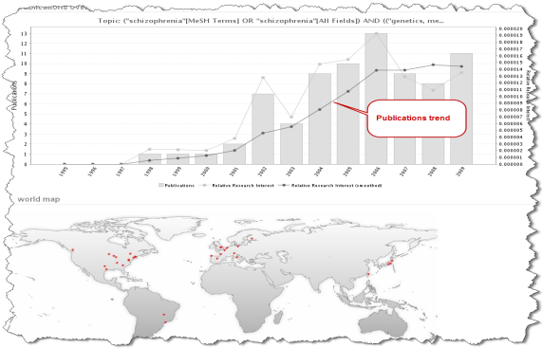
Latest Innovations in Literature Searching
http://www.hsls.pitt.edu/molbio

Slide 48
GoPubMed
Noteworthy links
GoPubMed: exploring PubMed with the Gene Ontology. Doms A,Schroeder M., Nucleic Acids Res. 2005 Jul 1; 33 (Web Server issue):W783-6. http://www.ncbi.nlm.nih.gov/pubmed/15980585
http://www.hsls.pitt.edu/molbio

Slide 49
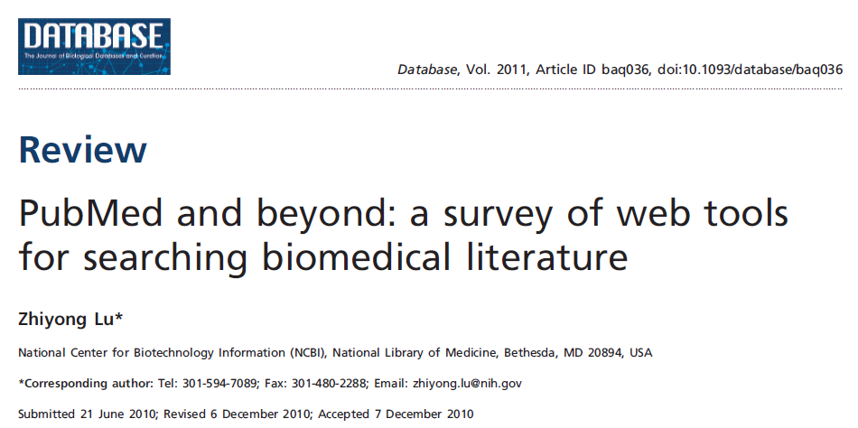
PubMed driven Web Tools
http://www.ncbi.nlm.nih.gov/CBBresearch/Lu/search/
http://www.hsls.pitt.edu/molbio

Slide 50
PubMed based Tools
http://www.ncbi.nlm.nih.gov/CBBresearch/Lu/search/
Lu et al. Database (Oxford). 2011; 2011: baq036
http://www.hsls.pitt.edu/molbio

Slide 51
Extract gene list from Literature
http://www.quertle.info/
http://www.hsls.pitt.edu/molbio

Slide 52
Questions for Quertle/Quetzal
What genes cause Asthma?
What cell lines are used in diabetes research?
Which cell types are known to express EGFR?
What animals are used in studies for diabetes?
Which protein kinases activate TP53?
http://www.hsls.pitt.edu/molbio

Slide 53
A short video on Quertle
Resources
Quertle: www.quertle.info
Link to the video tutorial:
http://media.hsls.pitt.edu/media/molbiovideos/quertle-ac0212.swf
http://www.hsls.pitt.edu/molbio

Slide 54
Literature to gene list & more
PALM-IST
http://www.hpppi.iicb.res.in/ctm/palmist_server.html
http://www.hsls.pitt.edu/molbio

Slide 55
Search Engine for finding Disease Causing Genes

Slide 56
Search Engine Just for Human Genetics
CDC HuGENavigator : http://hugenavigator.net/
http://www.hsls.pitt.edu/molbio

Slide 57
Find human genes reported to be associated with Asthma
Find human SNPs reported to be associated with Asthma
Resources
HugeNavigator: http://hugenavigator.net/HuGENavigator/home.do
Link to the video tutorial:
http://media.hsls.pitt.edu/media/clres2705/asthma.swf
http://www.hsls.pitt.edu/molbio

Slide 58
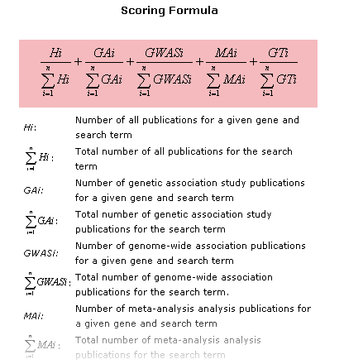
Search Engine Just for Human Genetics
http://www.hsls.pitt.edu/molbio

Slide 59
Search Engine Just for Human Genetics
CDC HuGENavigator : http://hugenavigator.net/
http://www.hsls.pitt.edu/molbio

Slide 60
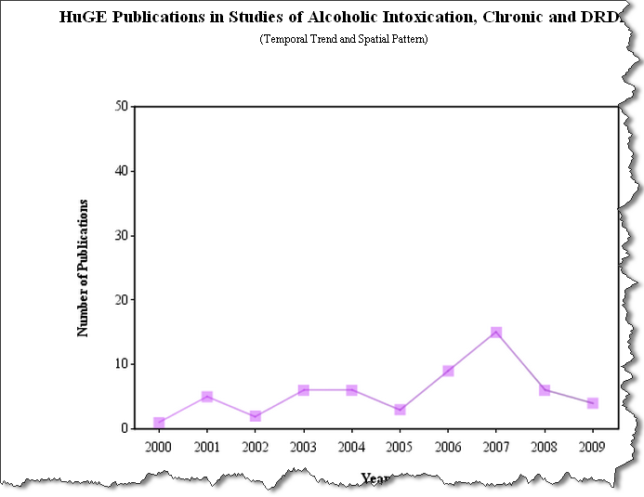
Search Engine Just for Human Genetics
http://hugenavigator.net/HuGENavigator/huGEPedia.do
http://www.hsls.pitt.edu/molbio

Slide 61
Search Engine Just for Human Genetics
CDC HuGENavigator : http://hugenavigator.net/
http://www.hsls.pitt.edu/molbio

Slide 62
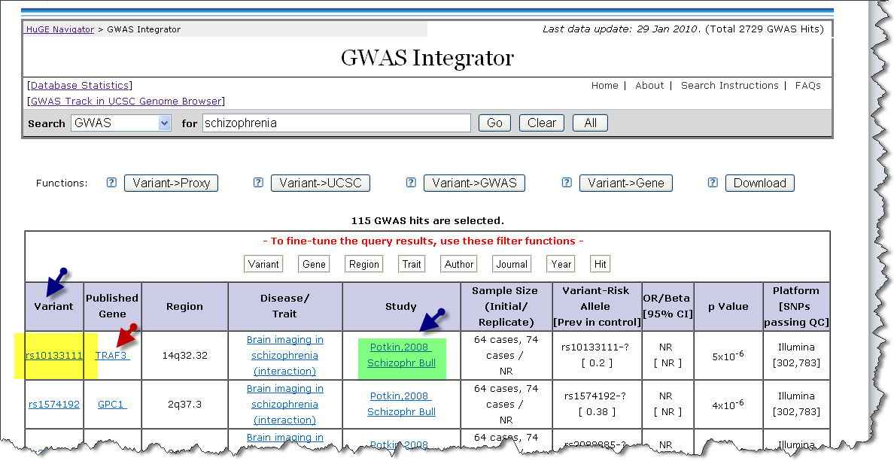
Find Disease Causing SNPs
http://hugenavigator.net/HuGENavigator/gWAHitStartPage.do
What SNPs are associated
with “Schizophrenia”?
http://www.hsls.pitt.edu/molbio

Slide 63
Software for Finding Similar Texts in Published Literature

Slide 64
Text-based Similarity Search Tools
Search Box:
http://www.hsls.pitt.edu/molbio

Slide 65
Text Similarity Search Tools
eTBLAST
http://etest.vbi.vt.edu/etblast3/
http://www.hsls.pitt.edu/molbio

Slide 66
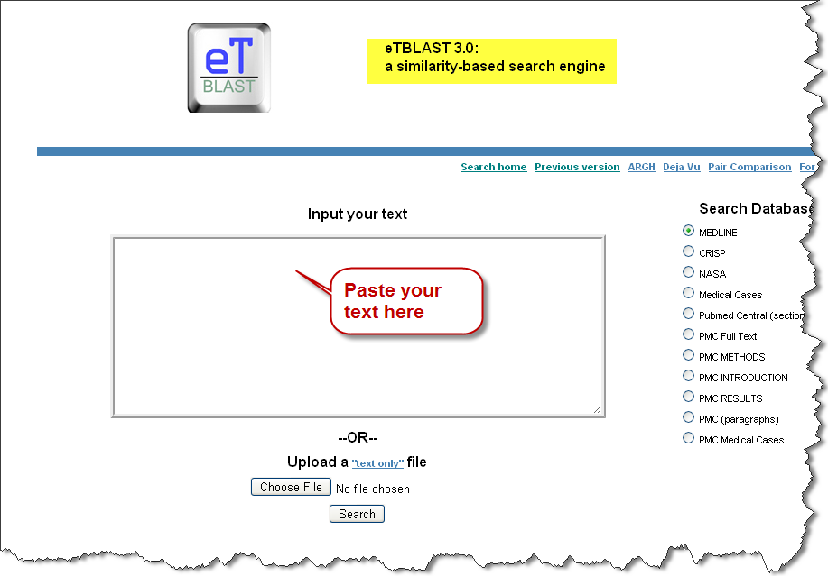
Text Similarity Search Tools
eTBLAST
http://www.hsls.pitt.edu/molbio

Slide 67
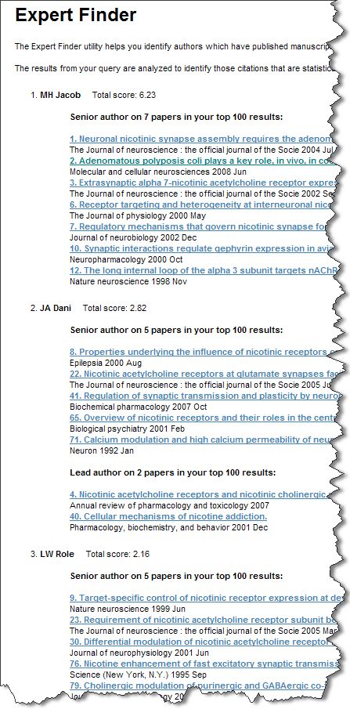
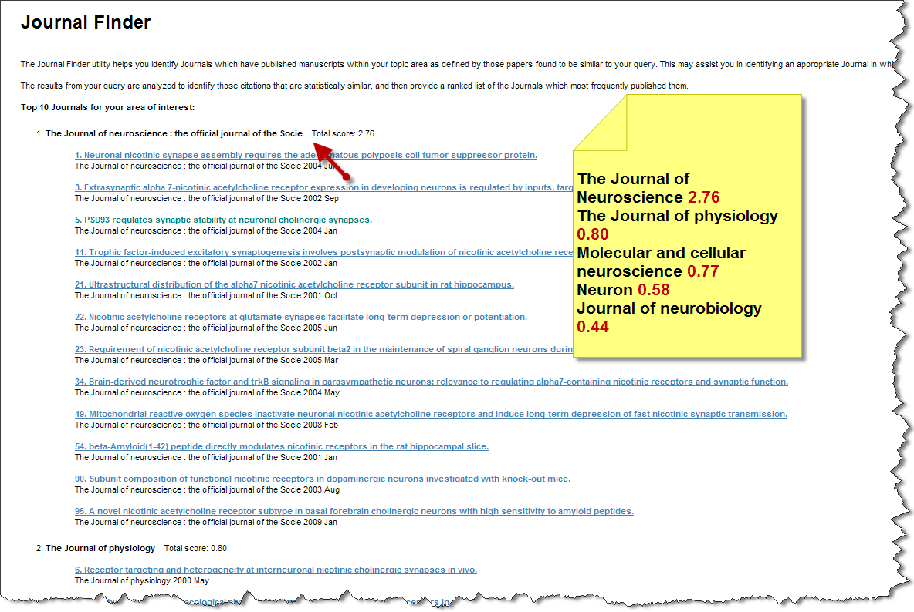
Text Similarity Search Tools
http://www.hsls.pitt.edu/molbio

Slide 68
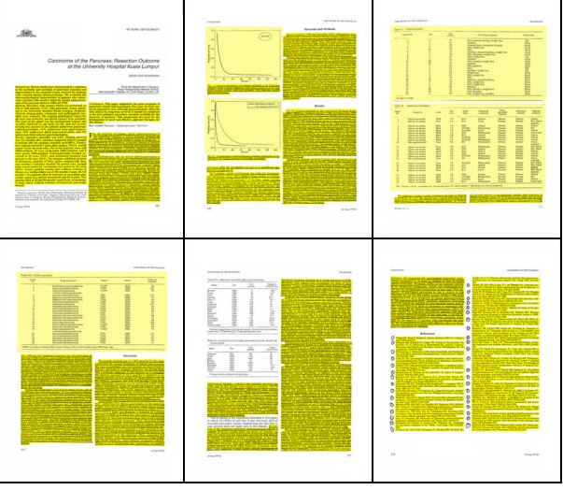
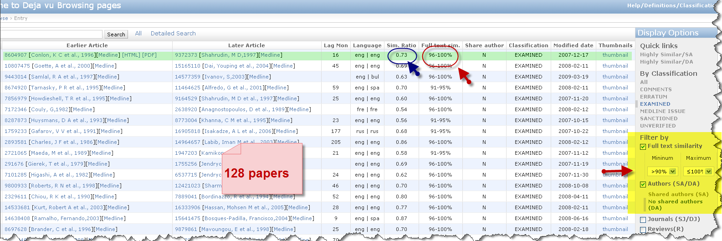
Déjà Vu: a Database of Highly Similar Citations
http://dejavu.vbi.vt.edu/dejavu/duplicate/
http://www.hsls.pitt.edu/molbio

Slide 69
Journal Author Name Estimator
http://www.biosemantics.org/jane/
http://www.hsls.pitt.edu/molbio

Slide 70
Search Engine for Bioinformatics Resources

Slide 71
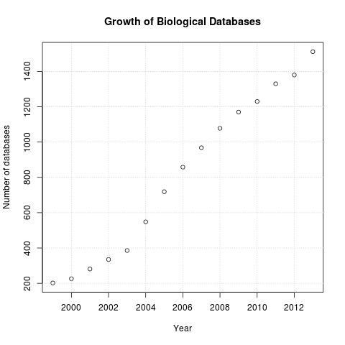
Molecular Databases
Nucleic Acids Research : Annual databases Issue
NAR: Annual Web Server Issue
Oxford Journal : Bioinformatics
BioMedCentral: BMC Bioinformatics
http://www.hsls.pitt.edu/molbio

Slide 72
Search for bioinformatics Resources
Locate online tools that predict phosphorylation sites
in a protein sequence.
Resources
Search.HSLS.MolBio : http://www.hsls.pitt.edu/molbio
Link to the video tutorial:
http://media.hsls.pitt.edu/media/Search%20Bioinfo%20Resoursec.swf
http://www.hsls.pitt.edu/molbio

Slide 73
Life Sciences Search Engine
http://www.hsls.pitt.edu/obrc/
http://www.hsls.pitt.edu/molbio

Slide 74
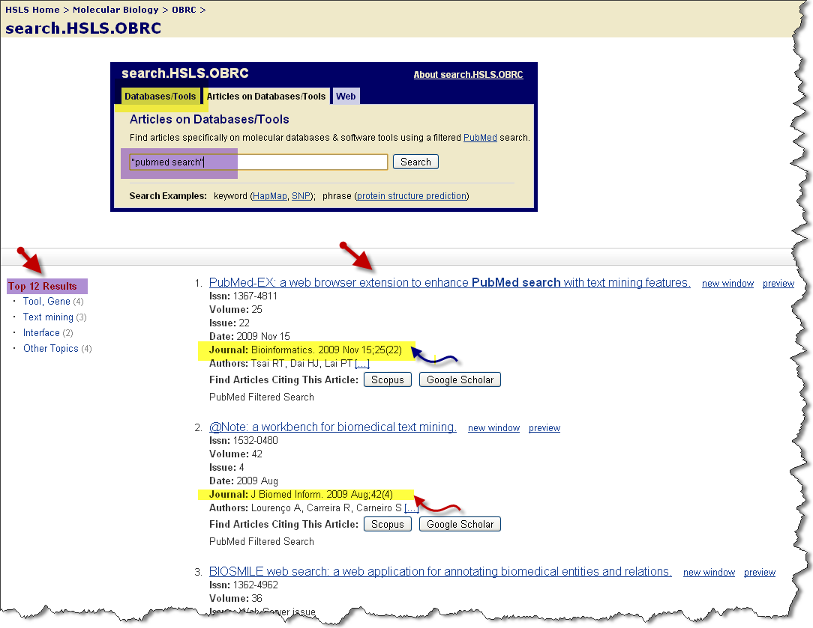
Life Sciences Search Engine
http://www.hsls.pitt.edu/molbio

Slide 75
HSLS OBRC
http://www.hsls.pitt.edu/molbio

Slide 76
Molecular Databases Catalog
HSLS OBRC
2457 links to databases and software
~3000
hits/day
http://www.hsls.pitt.edu/molbio

Slide 77
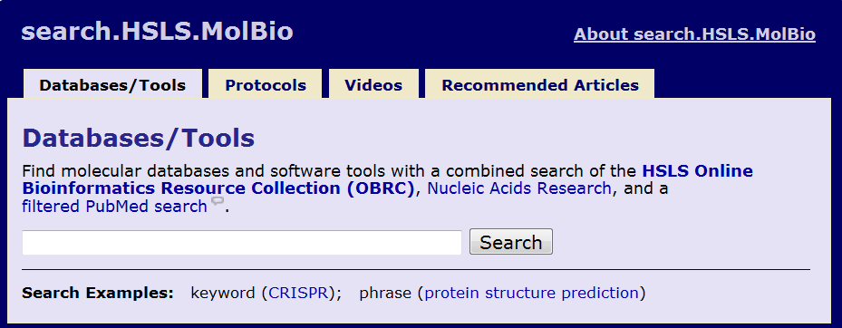
Search.HSLS.MolBio
http://www.hsls.pitt.edu/molbio/
Search term: “phosphorylation”
http://www.hsls.pitt.edu/molbio

Slide 78
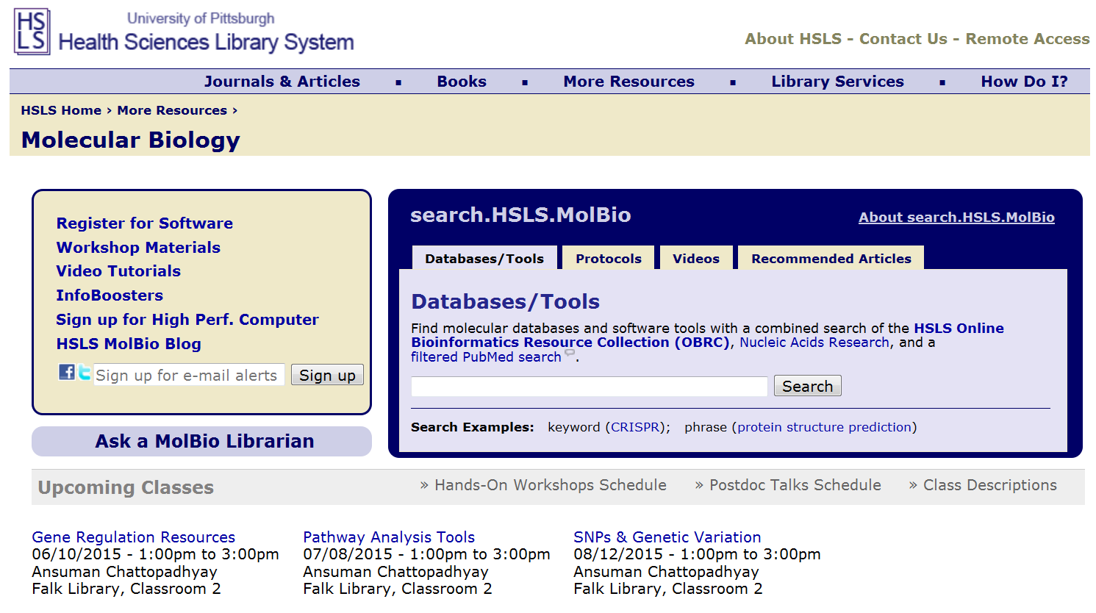
HSLS MolBio
http://www.hsls.pitt.edu/molbio/
http://www.hsls.pitt.edu/molbio

Slide 79
HSLS Molecular Biology Information Service
Workshops
Website
Software Licensing
Bioinformatics Consultations
http://www.hsls.pitt.edu/molbio

Slide 80
Thank you! Any questions?
Carrie Iwema Ansuman Chattopadhyay
iwema@pitt.edu ansuman@pitt.edu
412-383-6887 412-648-1297
http://www.hsls.pitt.edu/molbio

