Slide 1
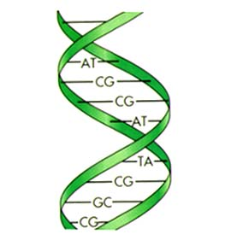
Medical Genetics 2nd February 2010
Carrie Iwema, PhD, MLS
Information Specialist in Molecular Biology
Health Sciences Library System
University of Pittsburgh
http://www.hsls.pitt.edu/guides/genetics

Slide 2
QUESTION:
?...how to locate the relevant genetic information about a particular disorder…?
www.hsls.pitt.edu/guides/genetics

Slide 3
Useful (free) Online Resources (1):
search.HSLS.MolBio
Molecular databases & tools search engine, U.Pitt
NCBI Entrez Gene
Searchable database of genes
Online Mendelian Inheritance in Man (OMIM)
Compendium of human genes and genetic phenotypes
GeneTests
Medical genetics information resource
GARD
Molecular Genetic and Rare Disease Information Center
Genetic Tools
Genetics through a primary care lens
www.hsls.pitt.edu/guides/genetics

Slide 4
Useful (free) Online Resources (2):
BioMed Central Databases
Catalog of biomedical databases
Genetic Association Database
Archive of human genetic association studies
Database of Genomic Variants
Curated catalog of structural variants in human genome
dbGAP
Database of Genotypes & Phenotypes
Gene Gateway
Collection of guides/tutorials on the Human Genome Project
Your Genes Your Health
A multimedia guide to genetic disorders
www.hsls.pitt.edu/guides/genetics

Slide 5
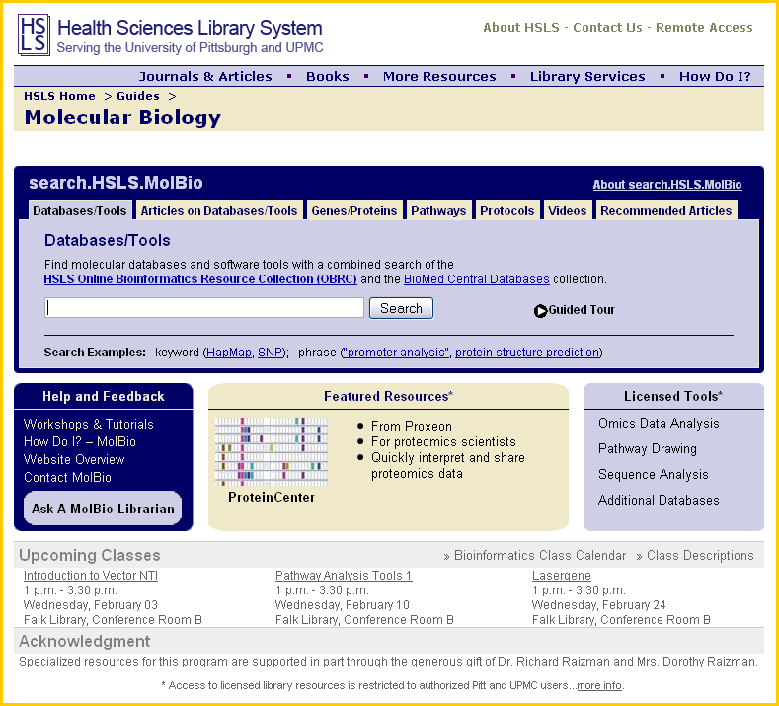
HSLS Molecular Biology Info Service
www.hsls.pitt.edu/guides/genetics

Slide 6
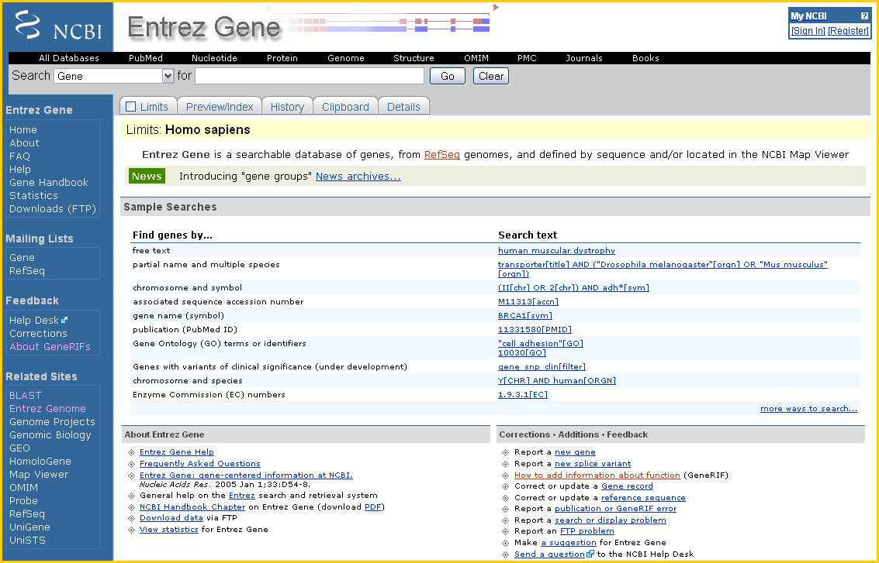
NCBI Entrez Gene
www.hsls.pitt.edu/guides/genetics

Slide 7
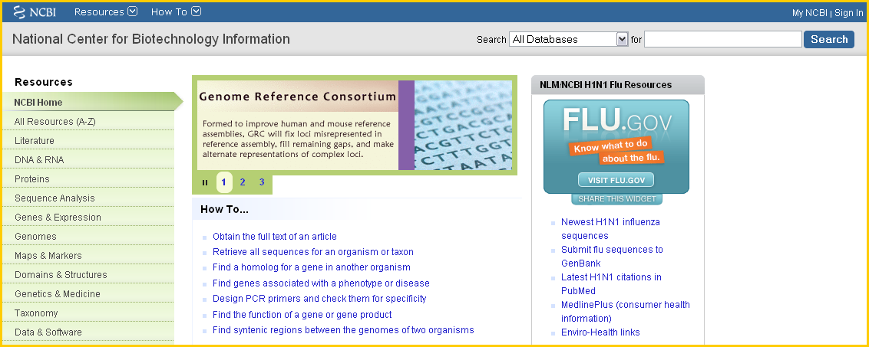
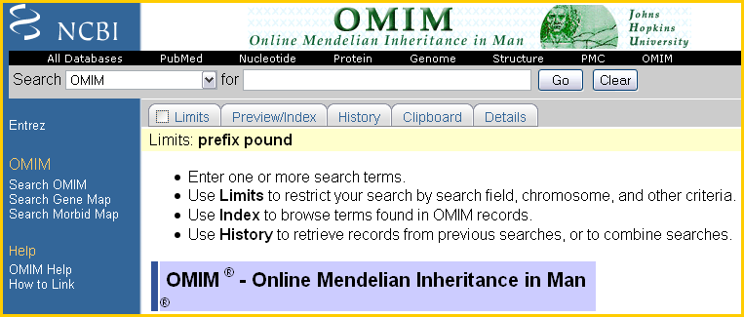
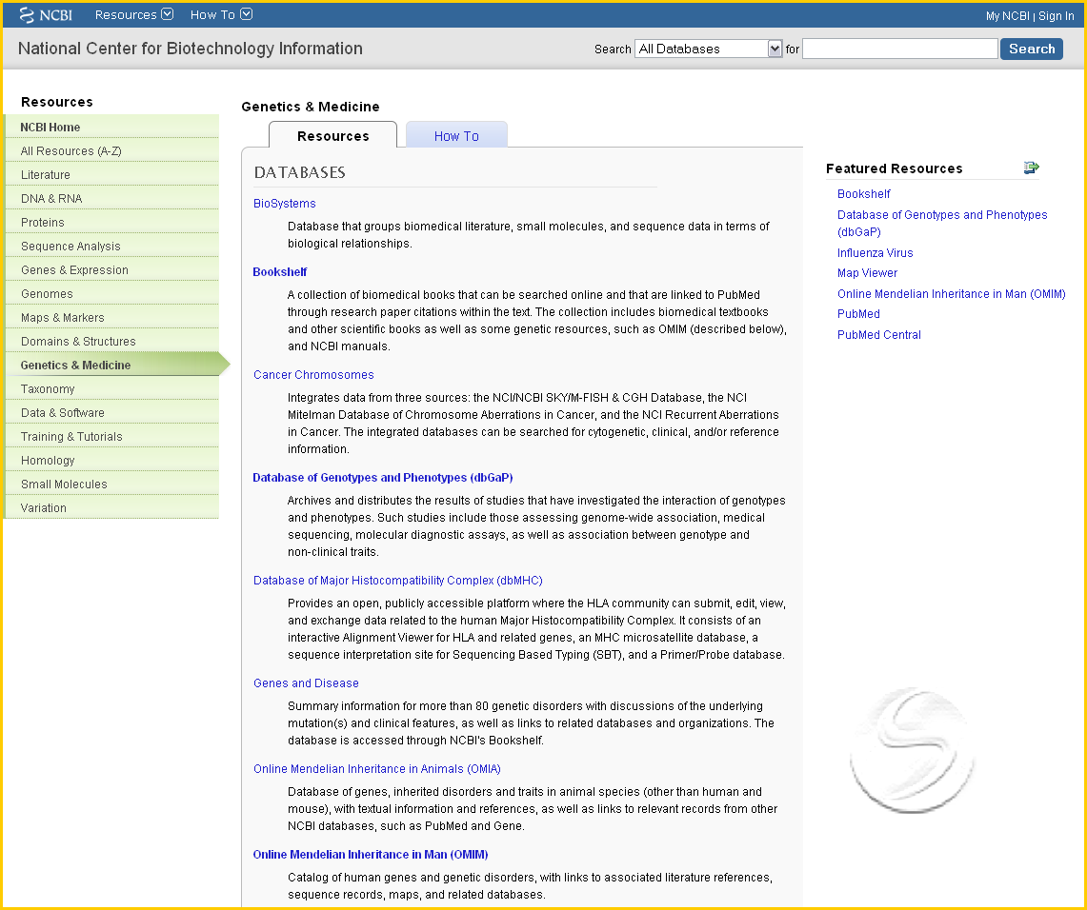
NCBI—OMIM
www.hsls.pitt.edu/guides/genetics

Slide 8
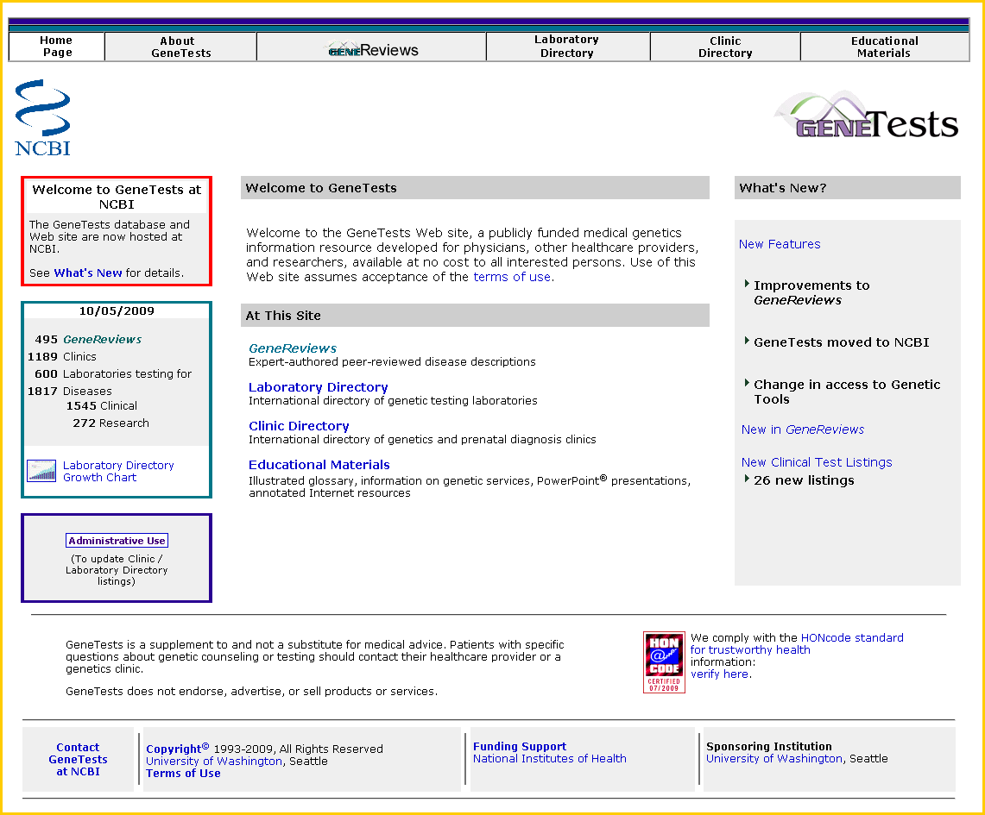
GeneTests & GeneReviews
www.hsls.pitt.edu/guides/genetics

Slide 9
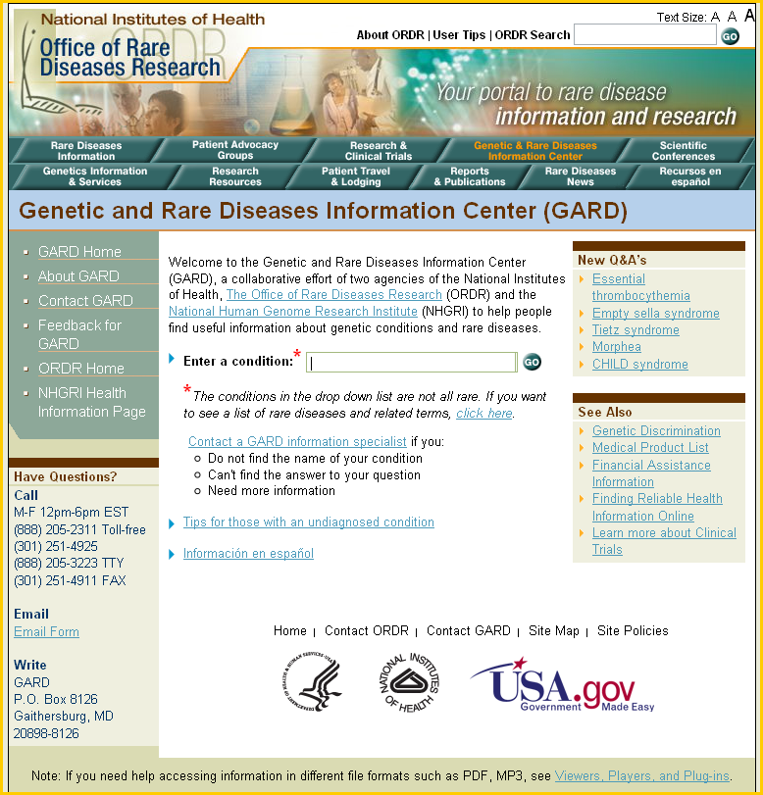
Genetic and Rare Diseases Information Center
www.hsls.pitt.edu/guides/genetics

Slide 10
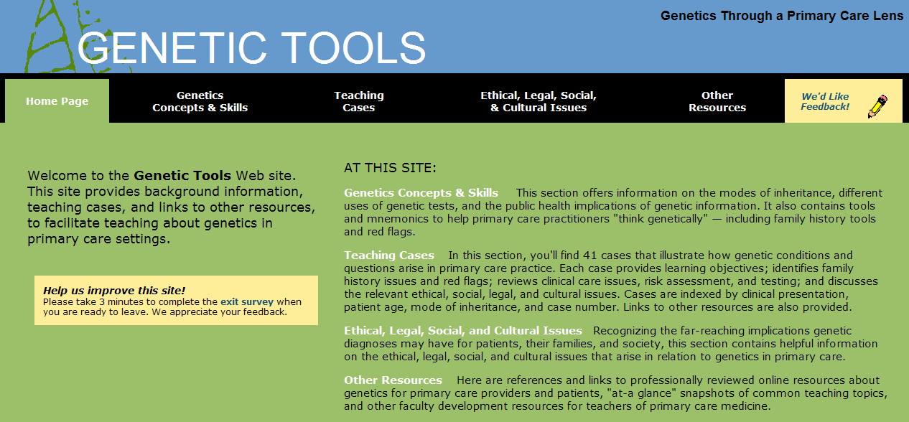
Genetic Tools
www.hsls.pitt.edu/guides/genetics

Slide 11
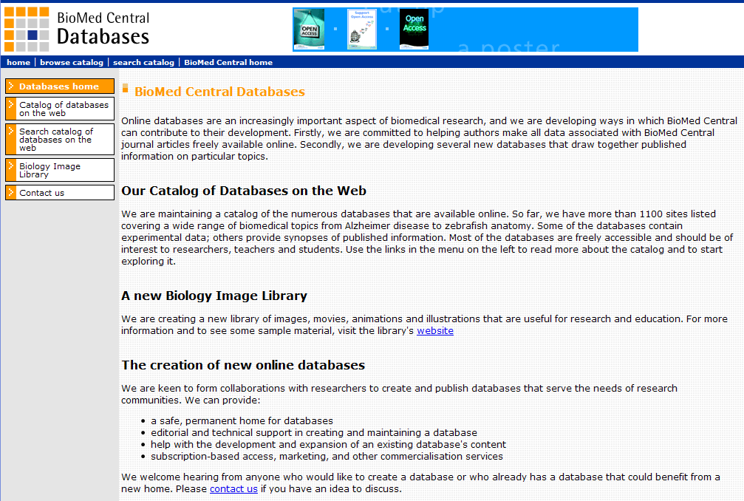
BioMed Central Databases
www.hsls.pitt.edu/guides/genetics

Slide 12
Genetic Association Database
www.hsls.pitt.edu/guides/genetics

Slide 13
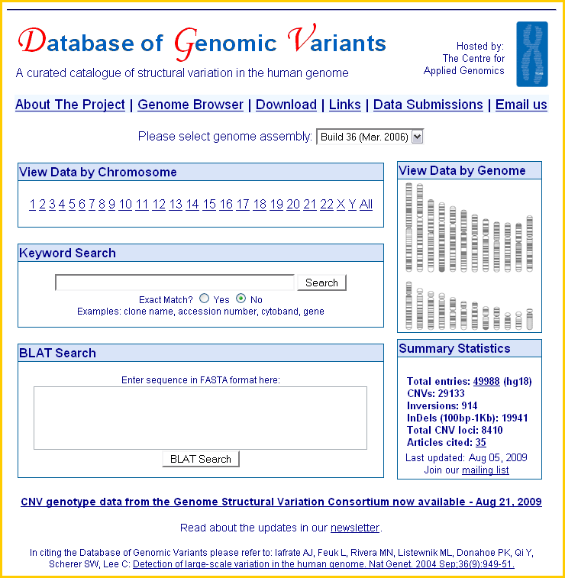
Database of Genomic Variants
www.hsls.pitt.edu/guides/genetics

Slide 14
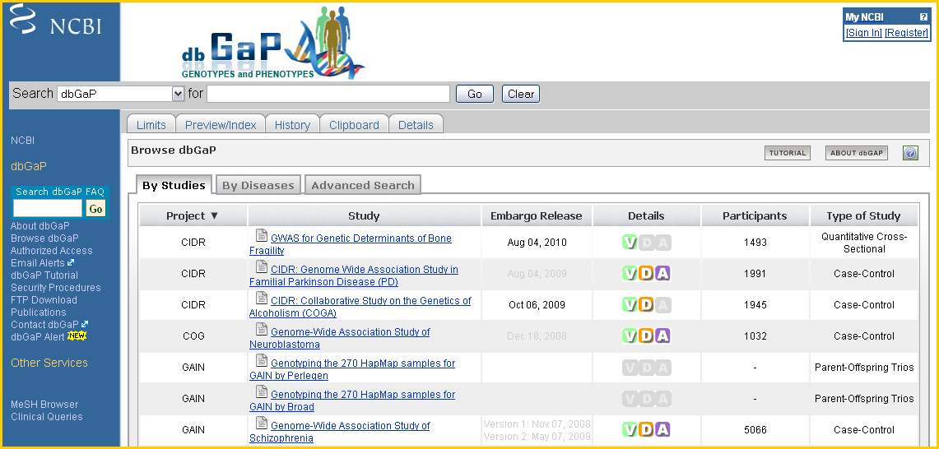
dbGAP
www.hsls.pitt.edu/guides/genetics

Slide 15
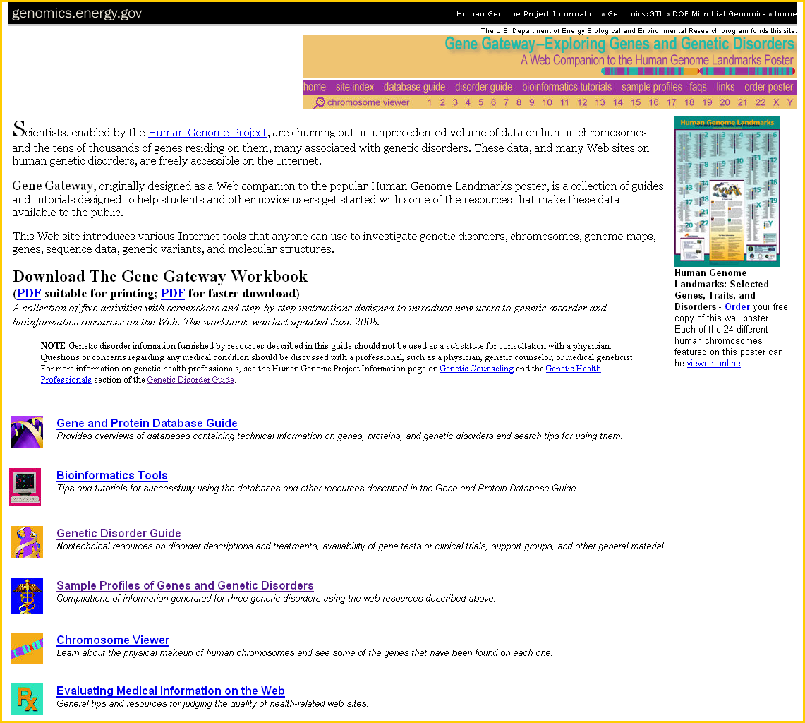
Gene Gateway
www.hsls.pitt.edu/guides/genetics

Slide 16
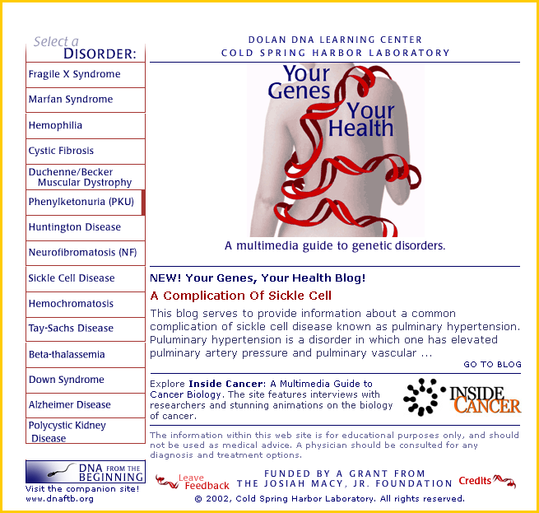
Your Gene Your Health
www.hsls.pitt.edu/guides/genetics

Slide 17
Pharmacogenetics Resources:
PharmGED
Pharmacogenetic effect database
PharmGKB
Pharmacogenetics & pharmacogenomics knowledge base
www.hsls.pitt.edu/guides/genetics

Slide 18
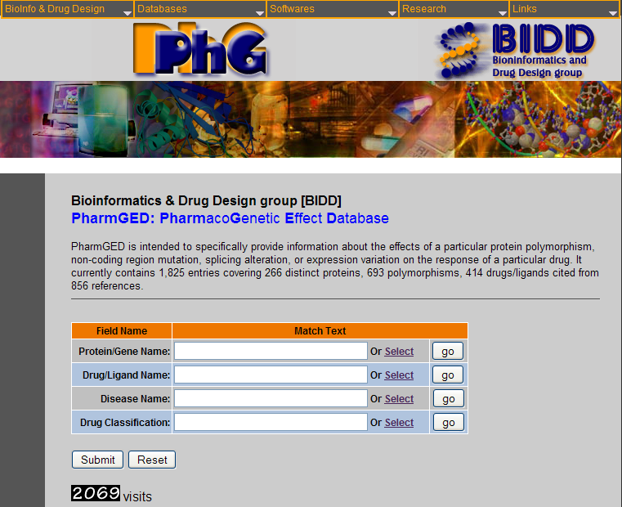
PharmGED
www.hsls.pitt.edu/guides/genetics

Slide 19
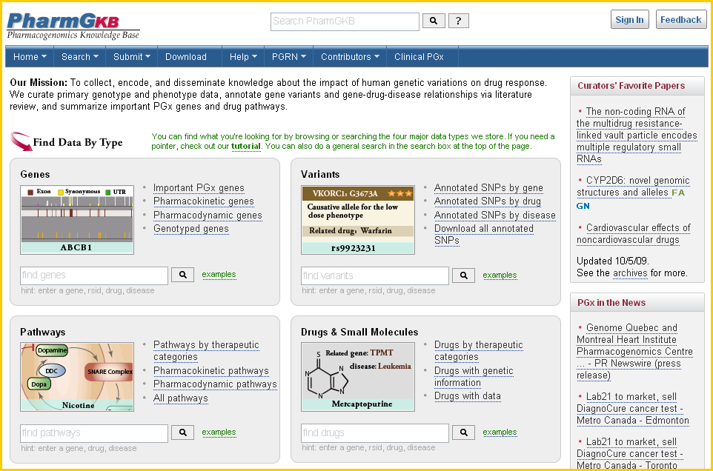
PharmGKB
www.hsls.pitt.edu/guides/genetics

Slide 20
Genetics Education Groups:
NCHPEG
National Coalition for Health Professional Education in Genetics
Genetic Alliance
Genetics community advocacy organization
National Human Genome Research Institute
Information about genetics and genomes, rare diseases, patient care and more
www.hsls.pitt.edu/guides/genetics

Slide 21
NCHPEG
www.hsls.pitt.edu/guides/genetics

Slide 22
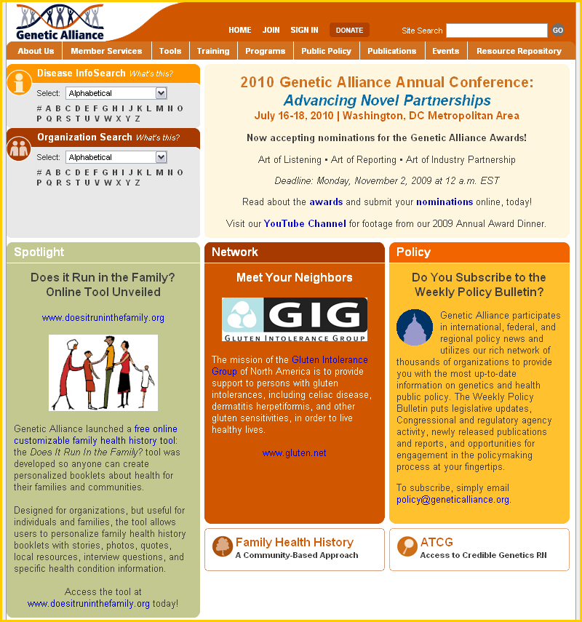
Genetic Alliance
www.hsls.pitt.edu/guides/genetics

Slide 23
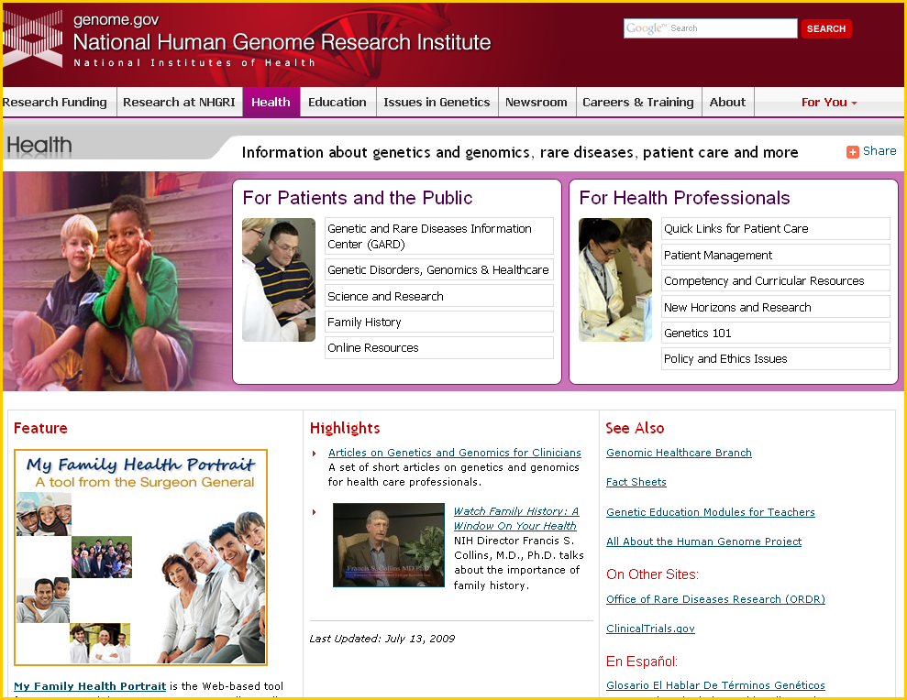
National Human Genome Research Institute
www.hsls.pitt.edu/guides/genetics

Slide 24
Thank you! Any questions?
Carrie Iwema Ansuman Chattopadhyay
iwema@pitt.edu ansuman@pitt.edu
412-383-6887 412-648-1297
http://www.hsls.pitt.edu/guides/genetics

