Slide 1
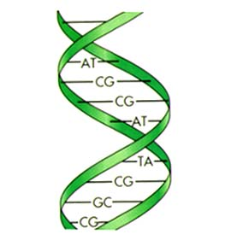
Regulation of Gene Expression
Ansuman Chattopadhyay, PhD
Assistant Director
Molecular Biology Information Services
Health Sciences Library System
University of Pittsburgh
ansuman@pitt.edu

Slide 2
Topics
1. Retrieve generic promoter sequences (1000 bp 5’and 200 bp 3’ from TSS) UCSC Genome Browser
2. Browse through the epigenetic biochemical markers
Histone modifications, DNA methylation etc.,
ENCODE, UCSC GB, Ensembl Reg Build, GeneHancer
3. Determine transcription factor occupancy - Match
4. Search for ChIP-seq/ATAC-seq etc., data from GEO –
Cistrome Data Browser
5. search for gene expression data from GEO
Correlation Engine
http://www.hsls.pitt.edu/guides/genetics

Slide 3
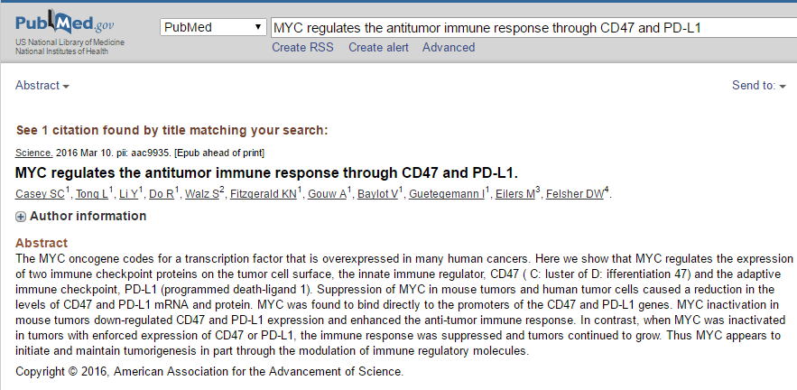
26966191
http://science.sciencemag.org/content/early/2016/03/09/science.aac9935.long
http://www.hsls.pitt.edu/guides/genetics

Slide 4
Myc,CD47 and CD274
http://www.hsls.pitt.edu/guides/genetics

Slide 5
Identify Myc-binding sites present in the promoter sequences of CD47 and PD-L1
Retrieve the promoter sequence of CD47 and PD-L1 genes
http://www.hsls.pitt.edu/guides/genetics

Slide 6
An excellent movie on transcription
http://vcell.ndsu.edu/animations/transcription/index.htm
http://www.hsls.pitt.edu/guides/genetics

Slide 7
A movie on regulated transcription
http://vcell.ndsu.edu/animations/regulatedtranscription/index.htm

Slide 8
Promoter, Enhancer and Silencer
Source: http://www.cbs.dtu.dk/dtucourse/cookbooks/dave/Lekt03bkg.html
http://www.hsls.pitt.edu/guides/genetics

Slide 9
More Movies @ HSLS MolBio Videos
https://hsls.pitt.edu/molbio/videos
http://www.hsls.pitt.edu/guides/genetics

Slide 10
Retrieve promoter sequence for a gene
http://www.hsls.pitt.edu/guides/genetics

Slide 11
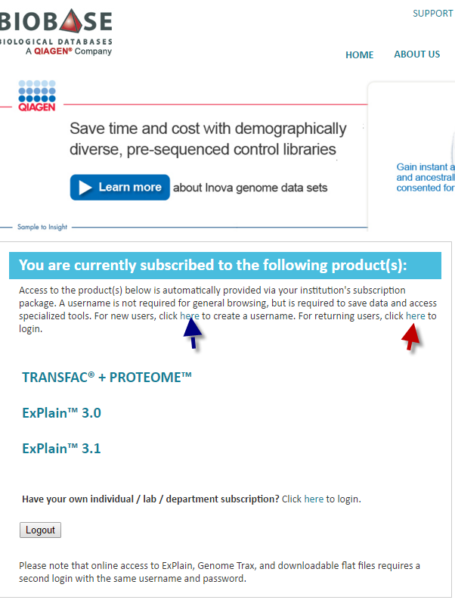
UCSC Genome Browser
GeneExplain - Biobase
http://www.hsls.pitt.edu/guides/genetics

Slide 12
Promoter Sequence
http://www.hsls.pitt.edu/guides/genetics

Slide 13
Find sequence information for a gene
-genomic -promoter - intron-exon coordinates
-mRNA -protein
Resources
UCSC Genome Browser: http://genome.ucsc.edu/
NCBI Entrez Gene: http://www.ncbi.nlm.nih.gov/gene
Link to the video tutorial:
http://media.hsls.pitt.edu/media/clres2705/sequence.swf
http://media.hsls.pitt.edu/media/clres2705/sequence_2.swf
http://www.hsls.pitt.edu/molbio

Slide 14
Fetching Promoters
http://www.hsls.pitt.edu/molbio/videos/play?v=37
http://www.hsls.pitt.edu/guides/genetics

Slide 15
BIOBASE TransPro
http://www.hsls.pitt.edu/guides/genetics

Slide 16
Promoter Sequence
http://www.hsls.pitt.edu/guides/genetics

Slide 17
Retrieve Promoter Sequence

Slide 18
Epigenetic mechanisms
Source: NCBI
http://www.ncbi.nlm.nih.gov/books/NBK45788/#epi_sci_bkgrd.About_Epigenetics
http://www.hsls.pitt.edu/guides/genetics

Slide 19
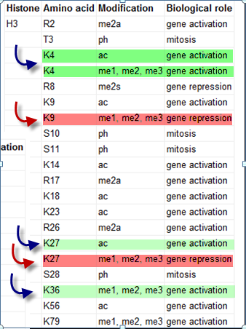
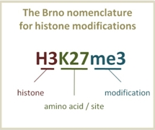
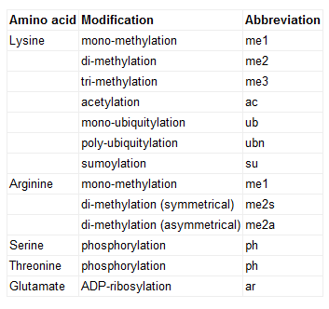
Histone Modifications
http://goo.gl/GQ9V8
http://www.hsls.pitt.edu/guides/genetics

Slide 20
Epigenome and
Encyclopedia of DNA Elements Project
http://www.hsls.pitt.edu/guides/genetics

Slide 21
Encode Project
http://www.genome.gov/10005107

Slide 22
Chromatin Immuno-Precititation-Seq (ChIP-Seq)
http://www.hsls.pitt.edu/guides/genetics

Slide 23
Epigenetic Markers
Landmark Paper:
http://www.nature.com/ng/journal/v39/n3/full/ng1966.html

Slide 24
Encode Cell Types
http://genome.ucsc.edu/ENCODE/cellTypes.html
http://www.hsls.pitt.edu/guides/genetics

Slide 25
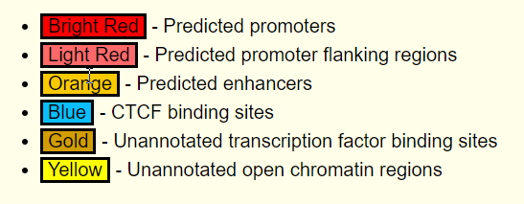
Epigenetics Marks in Promoter Sequence

Slide 26
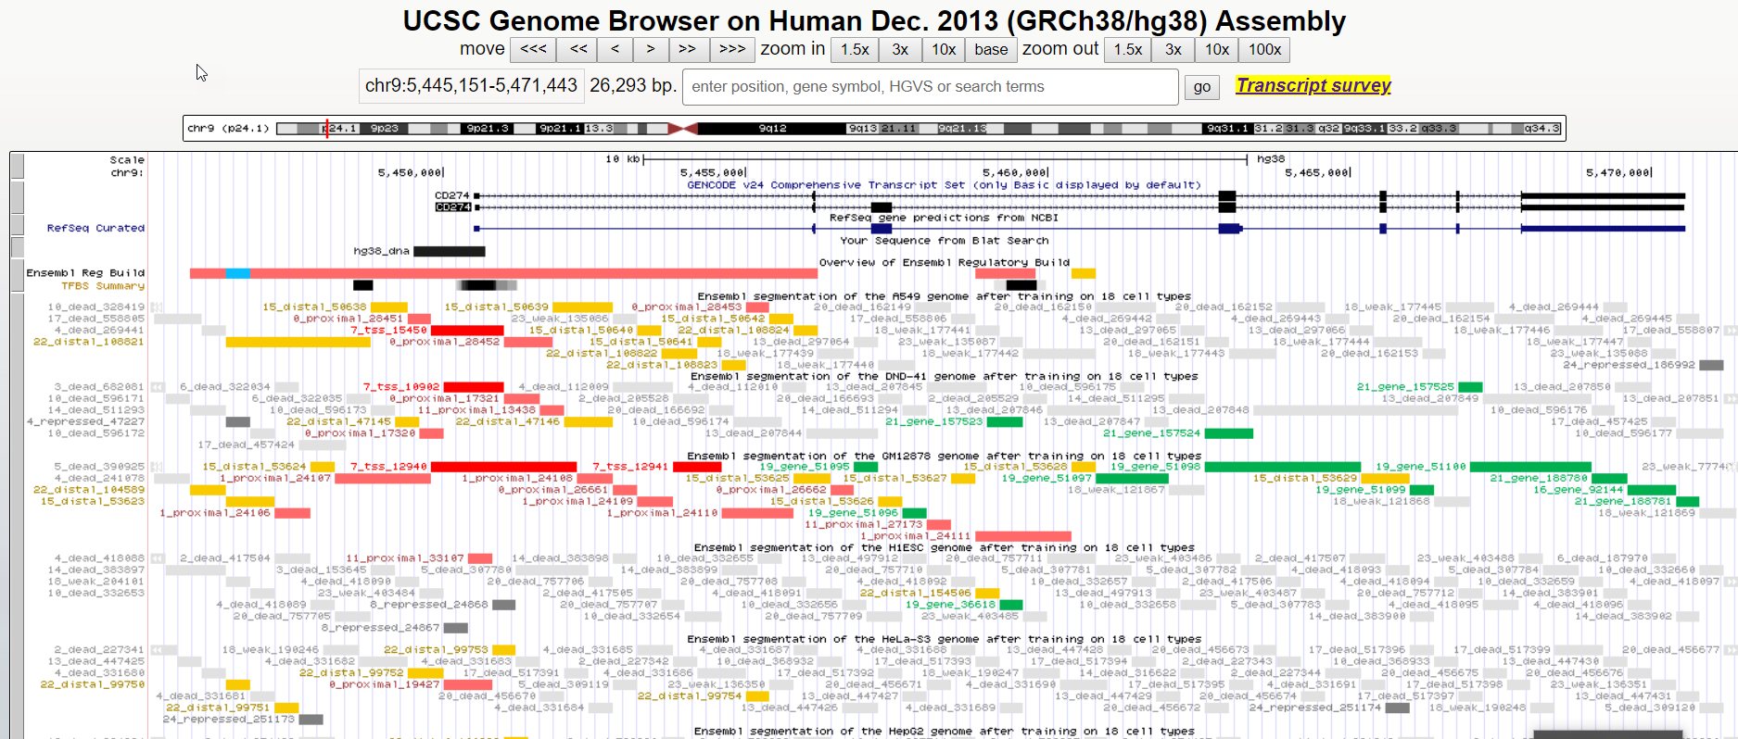
Track Hub – Ensembl Reg Build

Slide 27
Track Hub – Ensembl Reg Build
Transcription Factors

Slide 28
Hands-On: Find Promoter Sequence
Retrieve promoter sequence for :
Human : BCL2, EGFR
C. elegans : let-23
Drosophila: son of sevenless
Yeast: fus3
Tips:
Go to UCSC genome browser
Search by gene name
Click on UCSC genes/Wormbase genes/Flybase genes
Click on Genomic sequence
http://www.hsls.pitt.edu/guides/genetics

Slide 29
GeneHancer Elite Regulatory Elements

Slide 30
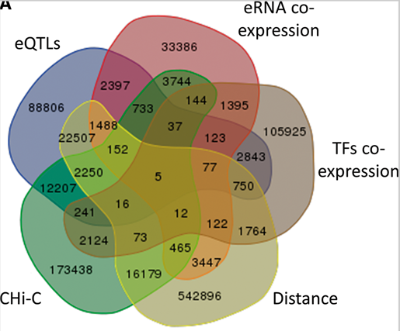
GeneHancer Elite Regulatory Elements

Slide 31
GeneHancer Double Elite Regulatory Elements

Slide 32
Hands-On Exercise
1. Retrieve the promoter Sequence for Human CD 274

Slide 33
Search for Myc in GeneExplain Database
https://portal.genexplain.com/cgi-bin/portal/login.cgi

Slide 34
Information on Myc in GeneExplain

Slide 35
Find Transcription Factor occupancy in
CD 47 promoter sequence using GeneExplain Match program

Slide 36
Transfac Pro
http://www.hsls.pitt.edu/guides/genetics

Slide 37
Transcription Factor binding sites
Jonathan M. Keith (ed.), Bioinformatics, Volume II: Structure, Function and Applications, vol. 453, © 2008 Humana Press,
http://www.hsls.pitt.edu/guides/genetics

Slide 38
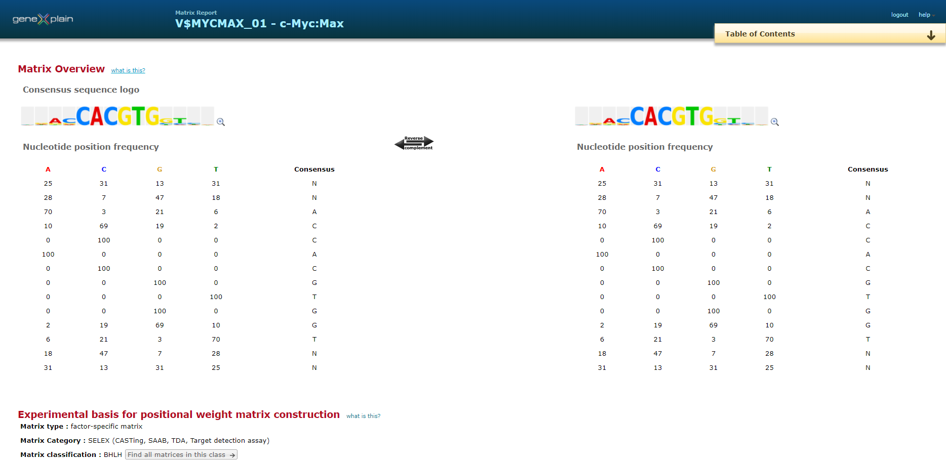
Transcription Factor Binding Matrix

Slide 39
Search for TF Binding Sites

Slide 40
BioBase Match
http://www.hsls.pitt.edu/guides/genetics

Slide 41
Biobase Match Search
http://www.hsls.pitt.edu/guides/genetics

Slide 42
Search for TF Binding Sites

Slide 43
Predicted TF Binding sites on CD 274 Promoter

Slide 44
Check the presence of Myc binding site(s) in CD47 and CD274 promoter sequences
Tutorial : Ho to create a TF binding profile –
https://portal.genexplain.com/archive/videos/Profile_creation_new_2014.mp4

Slide 45
Create a Profile for TF Myc
http://www.hsls.pitt.edu/guides/genetics

Slide 46
Predicted Myc Binding Sites on CD 47
http://www.hsls.pitt.edu/guides/genetics

Slide 47
Predicted Myc Binding Sites on CD47 Promoter Sequence
http://www.hsls.pitt.edu/guides/genetics

Slide 48
Hands-On Exercise
Locate Myc binding site(s) in CD274 promoter Sequence

Slide 49
Browse NCBI GEO hosted ChIP-Seq Dataset

Slide 50
Cistrome Project

Slide 51
http://cistrome.org/db/#/

Slide 52
Search NCBI GEO datasets for Myc binding peaks in CD47 and CD274 promoters using Cistrome Browser

Slide 53
Cistrome Data Browser

Slide 54
Search for Factor: Myc and Source: lung

Slide 56
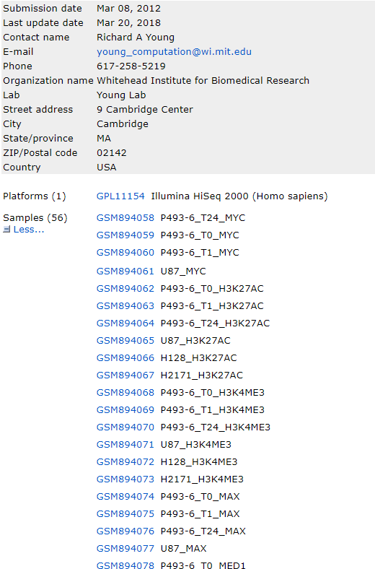
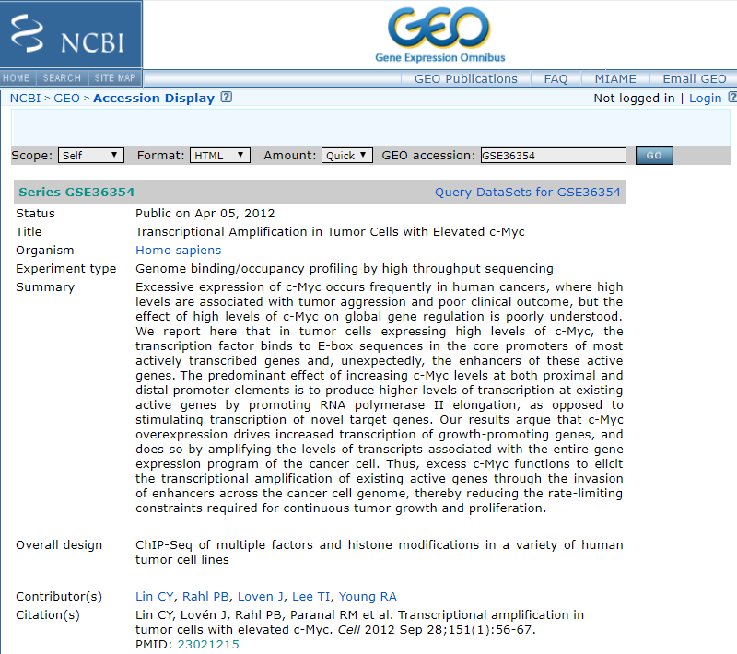

Slide 57
GEO ChIP_seq QC report

Slide 58
Myc-peaks from GEO datasets in CD47 promoter

Slide 59
Myc-peaks from GEO datasets in CD47 promoter

Slide 60
Transcriptomics
Browse GEO RNA-seq/microarray data set and identify Myc regulated genes
Illumina Correlation Engine

Slide 61
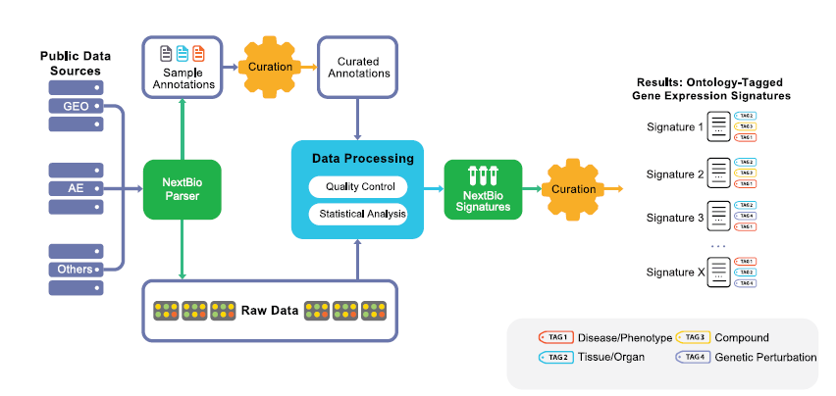
NextBio
http://www.hsls.pitt.edu/molbio

Slide 62
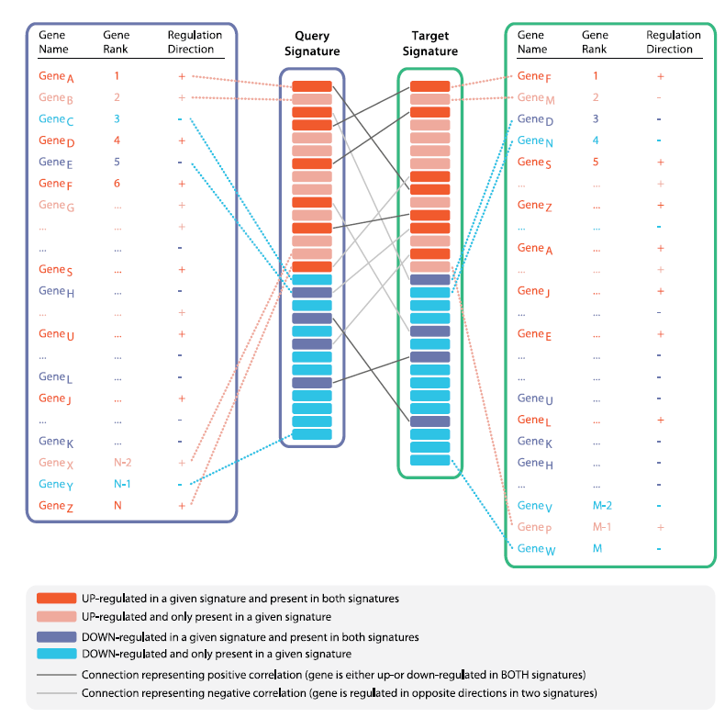
NextBio
http://www.hsls.pitt.edu/molbio

Slide 63
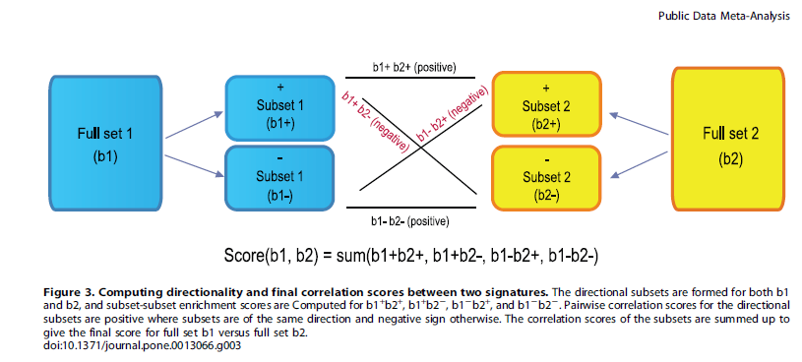
NextBio
http://www.hsls.pitt.edu/molbio

Slide 64
Illumina NextBio
http://www.hsls.pitt.edu/guides/genetics

Slide 65
Thank You !

