Slide 1
ChIP-Seq Analysis – Using Partek Flow
July 24, 2019
Ansuman Chattopadhyay, PhD
Health sciences library system
University of pittsburgh
ansuman@pitt.edu
Sri Chaparala, MS
Health Sciences Library System
University of Pittsburgh
chapa28@pitt.edu

Slide 2
Topics
Transcription Factor ChIP-Seq
Histone ChIP-Seq
ATAC-Seq

Slide 3
Workshop Page
https://hsls.libguides.com/MolBioWorkshops/ChIPseq

Slide 4
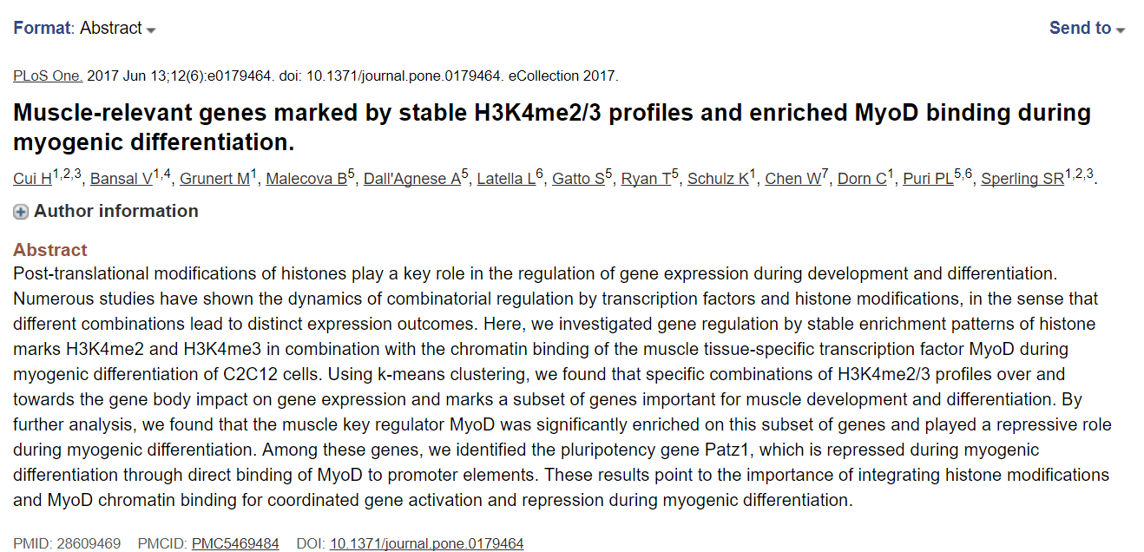
Transcription Factor and Histone ChIP-Seq

Slide 5
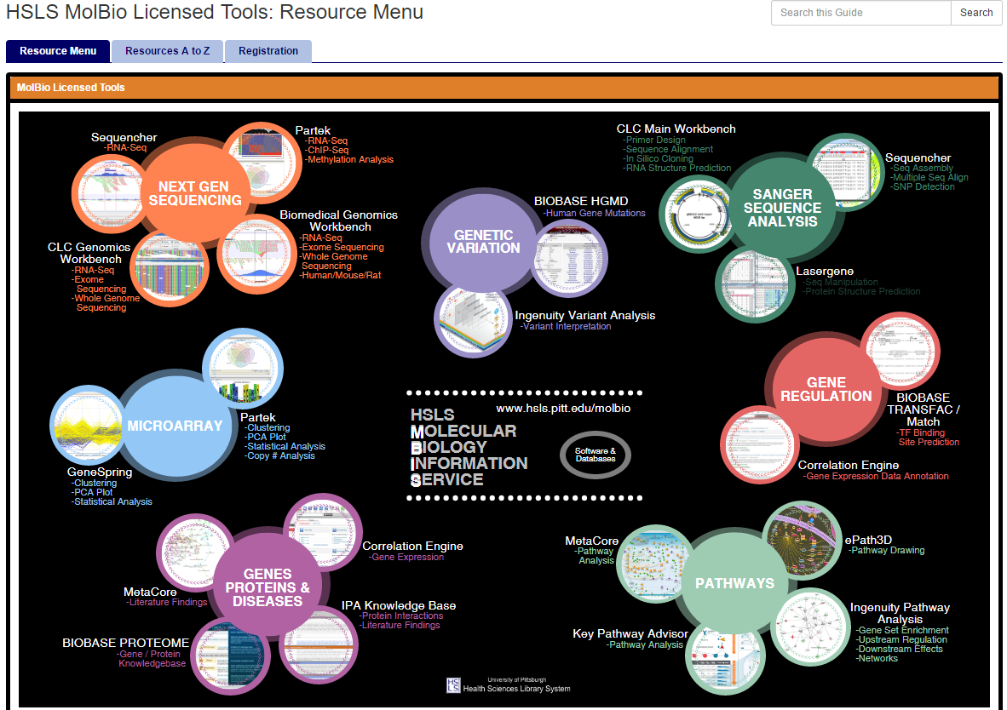
Software @ HSLS MolBio
http://hsls.libguides.com/molbio/licensedtools/resources

Slide 6
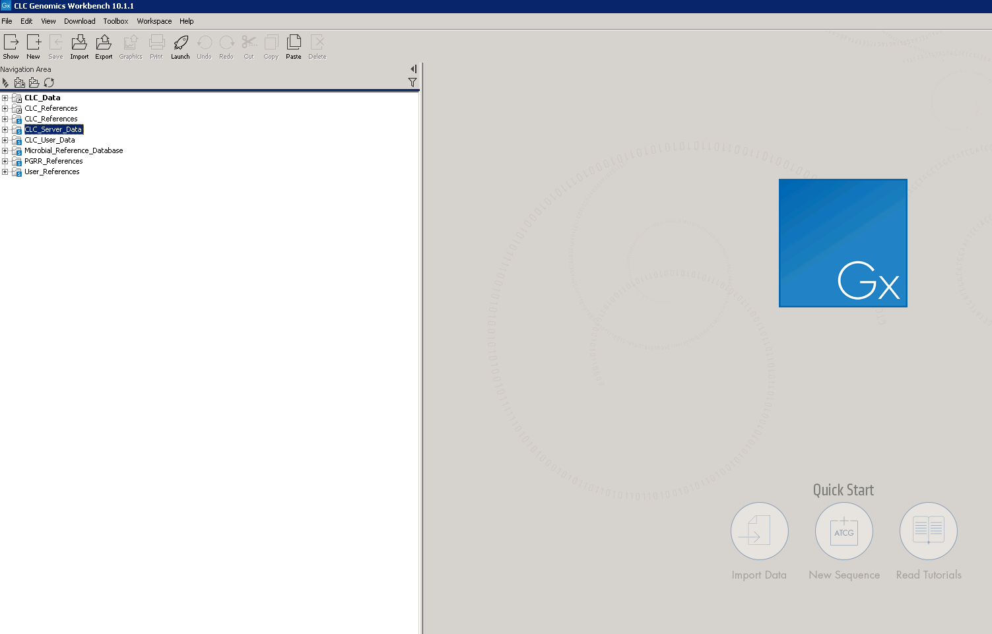
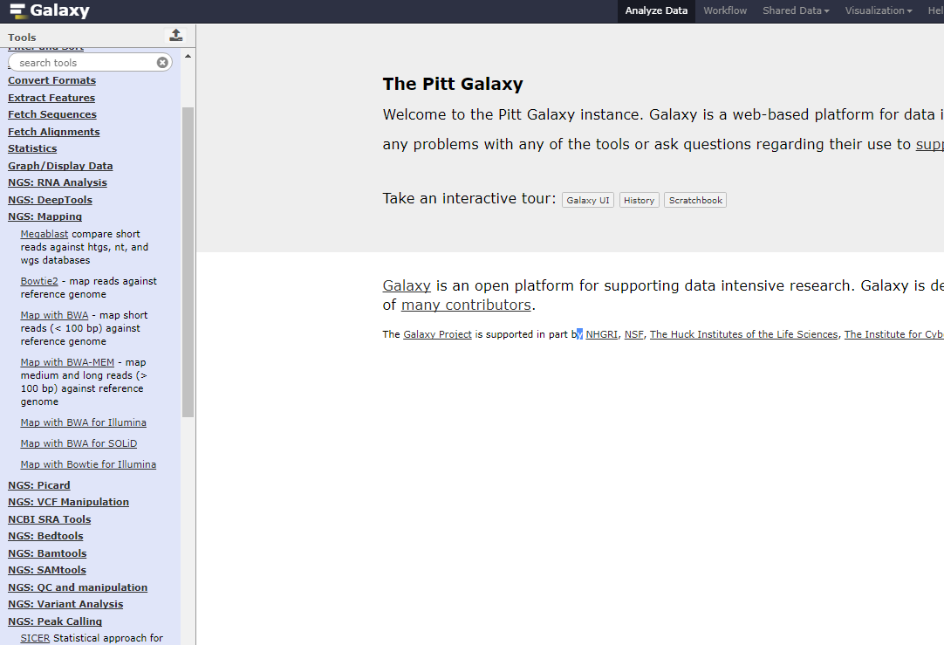
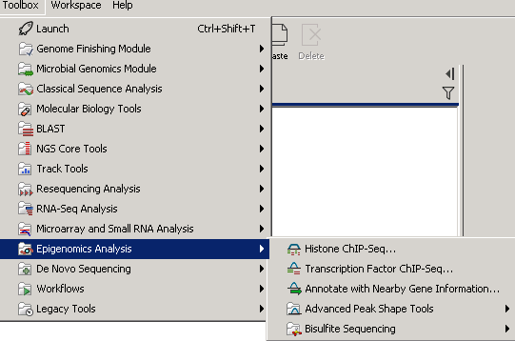
Graphical User Interface based software
Galaxy : http://galaxy.crc.pitt.edu:8080/
CLC Genomics Workbench

Slide 7
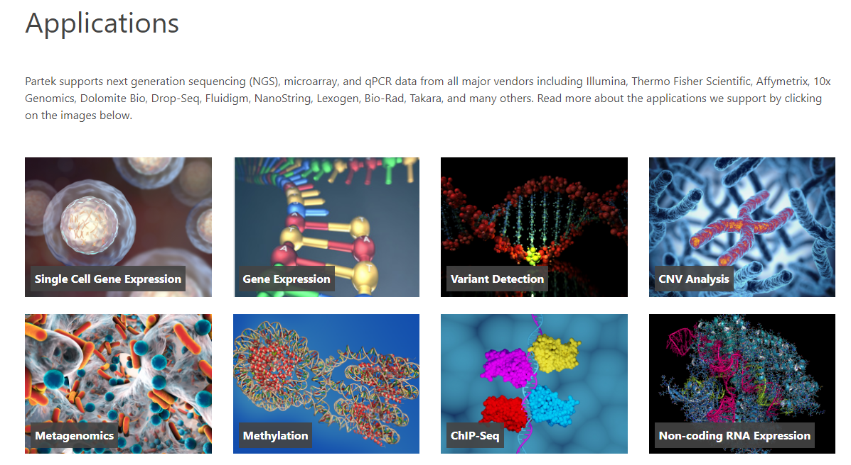
Partek Flow software
http://www.partek.com/partek-flow/

Slide 8
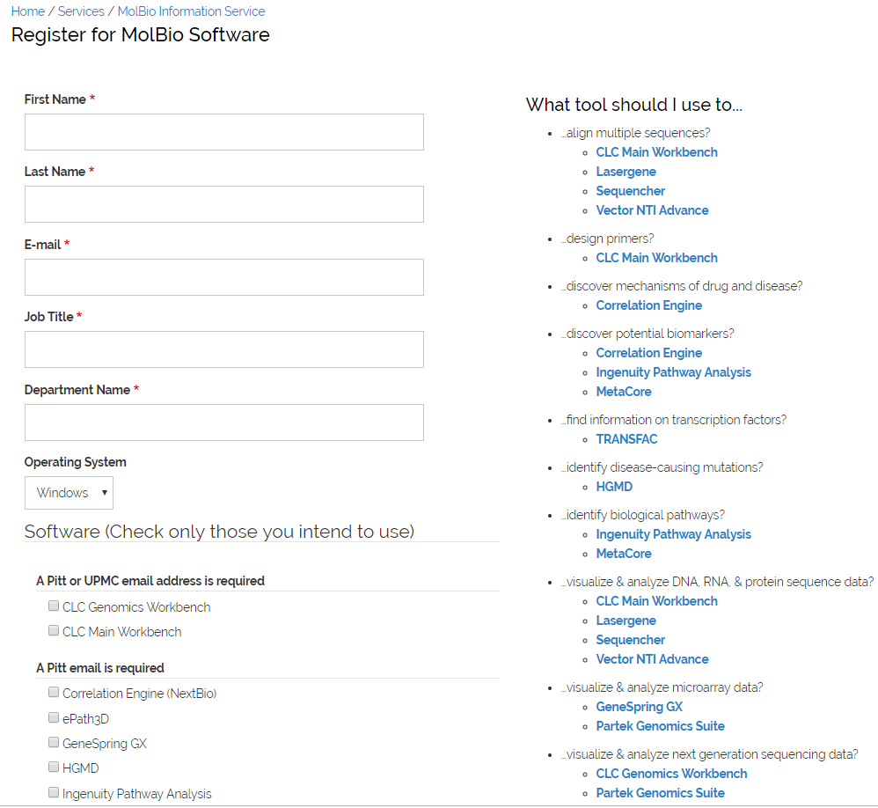
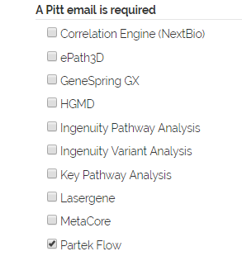
Software registration@ HSLS MolBio
https://hsls.pitt.edu/molbio/software_registration

Slide 9
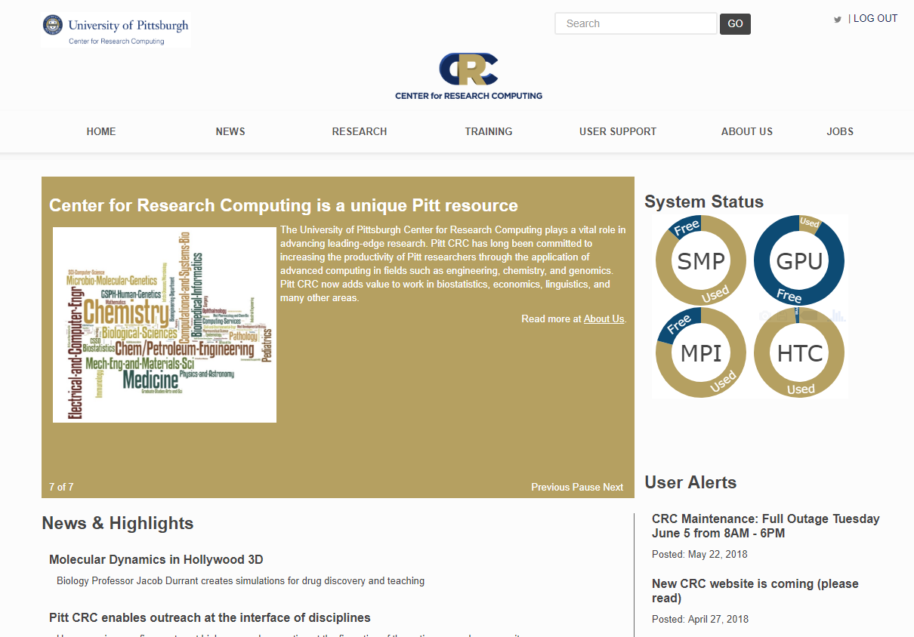
Center for Research computing (CRC)
https://crc.pitt.edu/

Slide 10
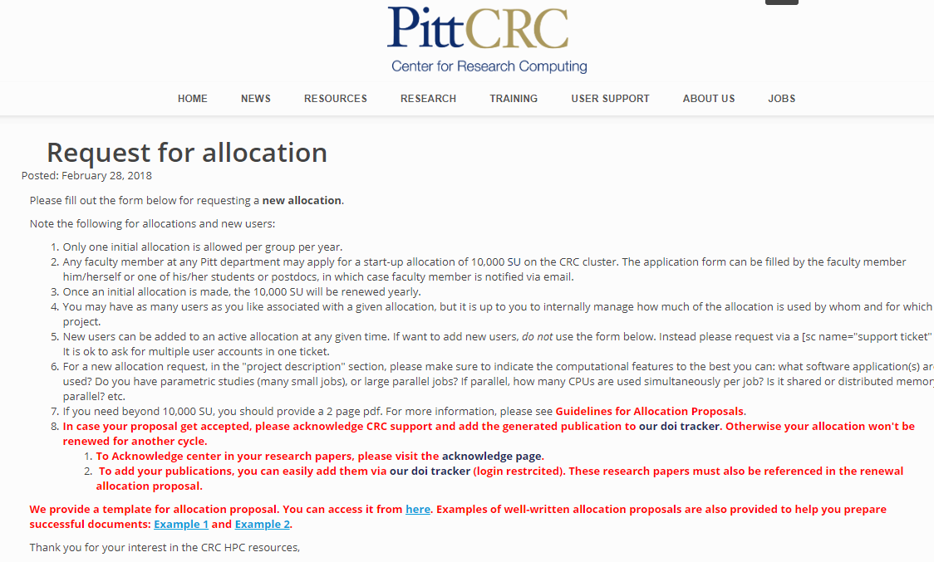
Request access to CRC
https://crc.pitt.edu/apply

Slide 11
You need Secure Remote Access via Pulse to run CLCGx from off campus locations / Pitt Wireless

Slide 12
Partek flow software access

Slide 13
Partek Flow at Pitt http://partek.crc.pitt.edu/
Access from outside
Pitt Network --
Use Pulse Secure

Slide 14
Partek Flow Software Basics

Slide 15
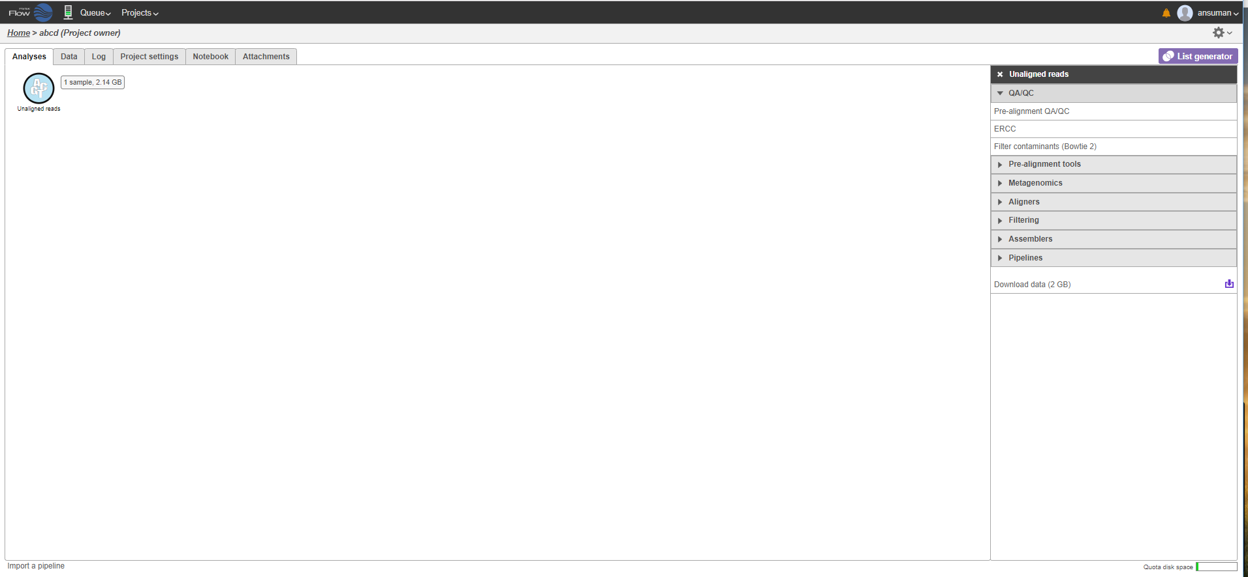
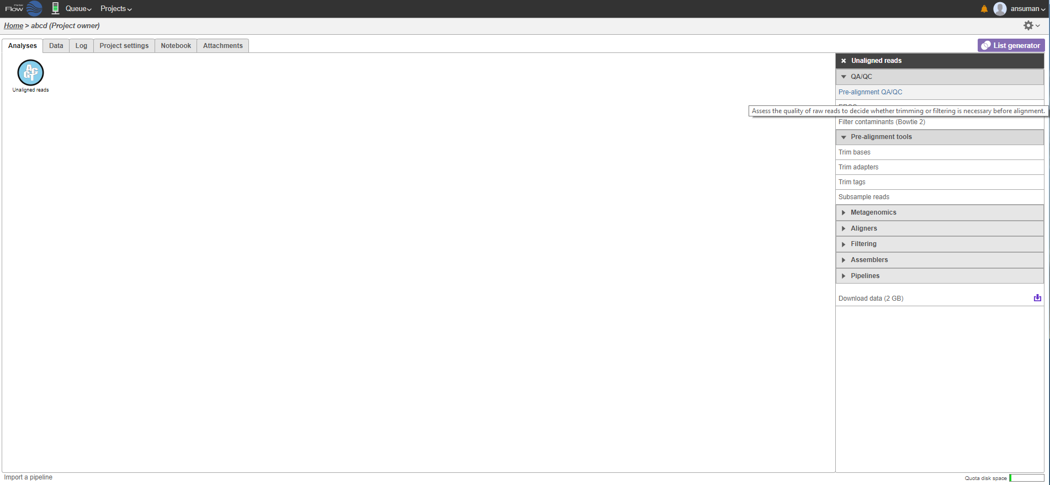
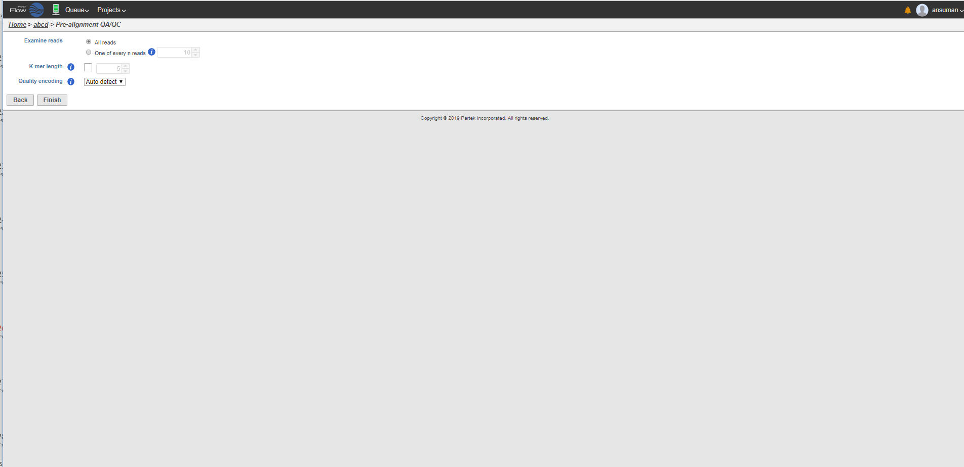
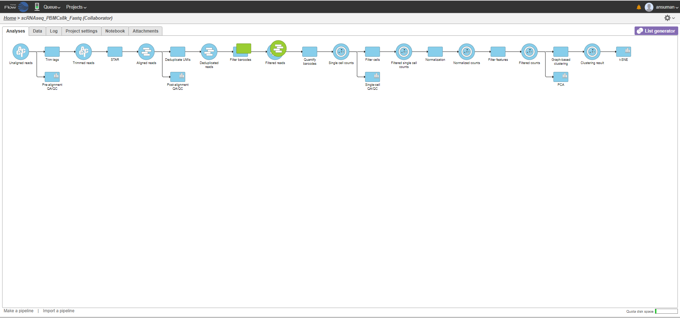
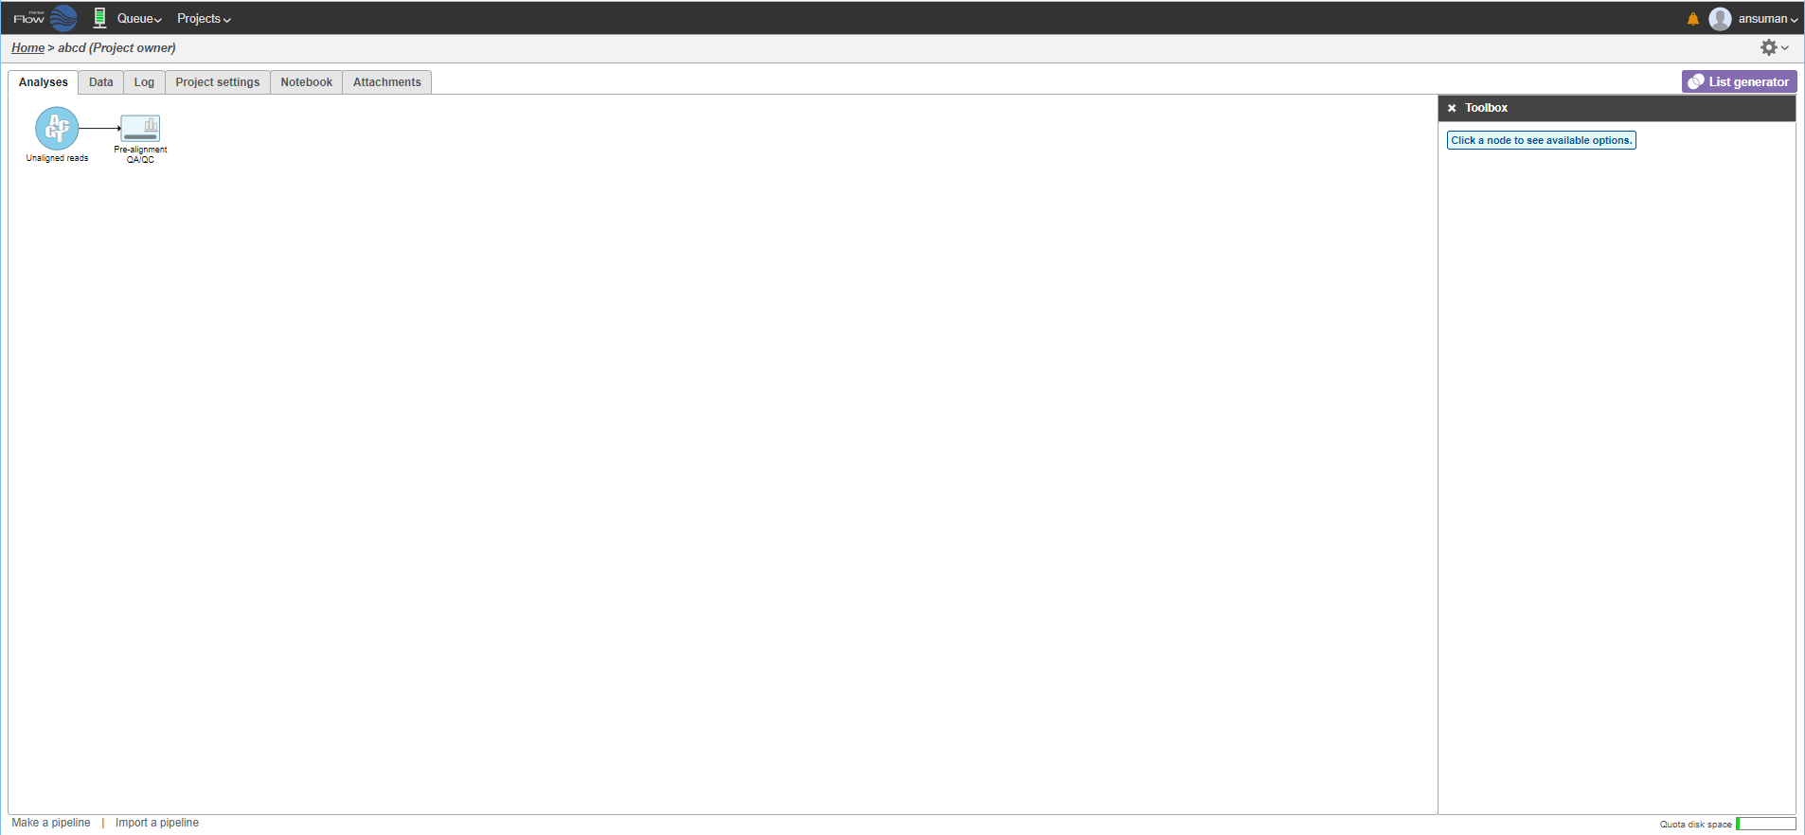
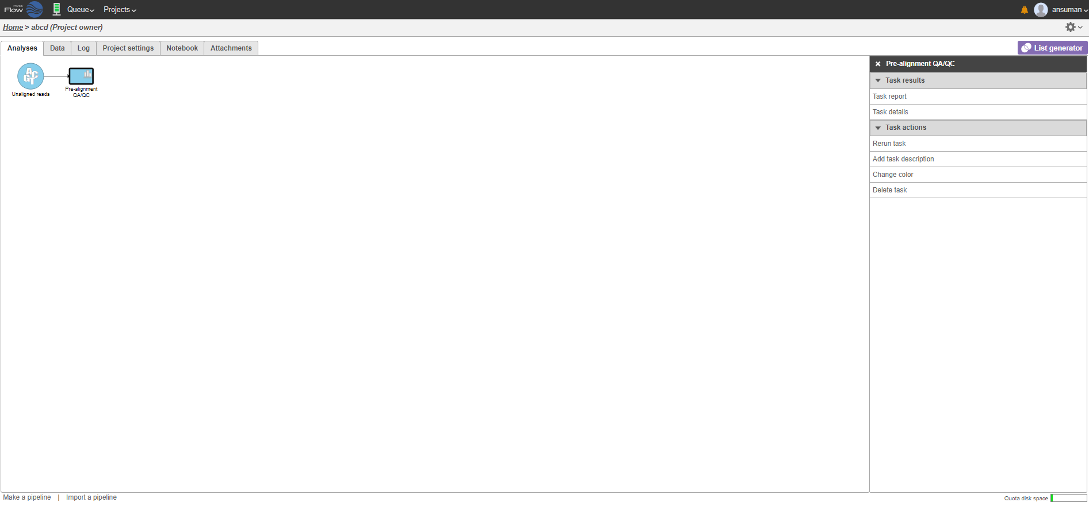
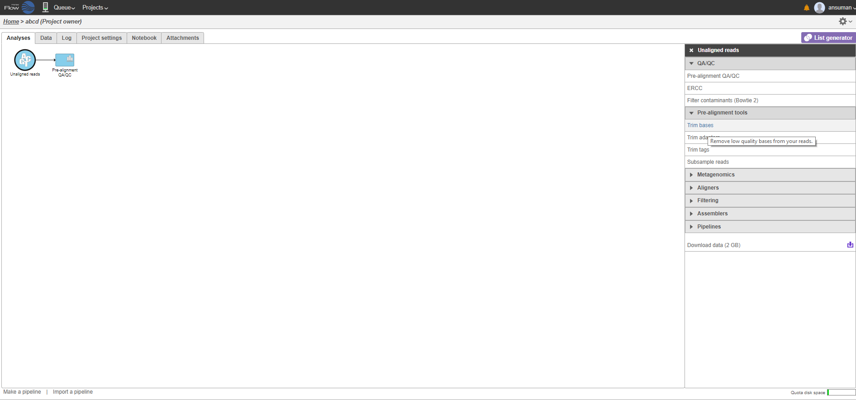
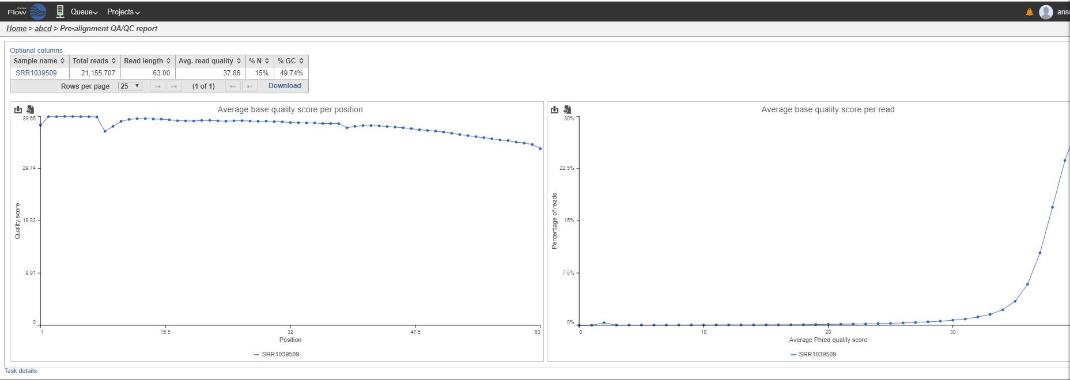
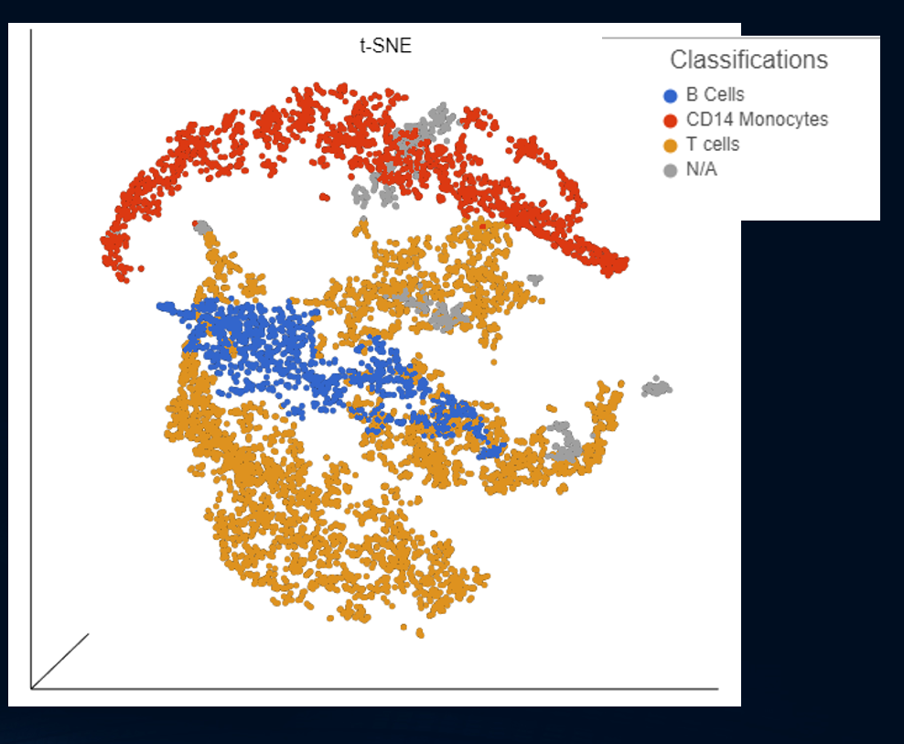
Partek Flow basics
FASTQ Reads
Circular node : Data
Rectangle: Task

Slide 16
Introduction to ChIP-Seq Experiments
https://hbctraining.github.io/Intro-to-ChIPseq/lectures/Introduction%20to%20ChIP-seq%202019.pdf

Slide 17
HSPH Bioinformatics Core
Shannan Ho Sui

Slide 19
HSPH Bioinformatics Core
Shannan Ho Sui

Slide 20
HSPH Bioinformatics Core
Shannan Ho Sui

Slide 21
HSPH Bioinformatics Core
Shannan Ho Sui

Slide 22
HSPH Bioinformatics Core
Shannan Ho Sui

Slide 23
HSPH Bioinformatics Core
Shannan Ho Sui

Slide 24
HSPH Bioinformatics Core
Shannan Ho Sui

Slide 25
HSPH Bioinformatics Core
Shannan Ho Sui

Slide 26
HSPH Bioinformatics Core
Shannan Ho Sui

Slide 27
HSPH Bioinformatics Core
Shannan Ho Sui

Slide 28
Histone ChIP-Seq
Li etal., Cell 2007.01.015

Slide 30
HSPH Bioinformatics Core
Shannan Ho Sui

Slide 31
ChIP-Seq Workflow

Slide 32
TF ChIP-Seq Workflow
http://education.knoweng.org/sequenceng/index.html#

Slide 33
Taken from Introduction to ChIP-Seq by HPC Tutorial by HBC Training

Slide 34
ChIP Seq work flow in Partek
Import reads
QA/QC
Align reads to Reference genome
Peak calling by MACS2
Annotate Peaks

Slide 35
Partek flow documentation
https://documentation.partek.com/display/FLOWDOC/Partek+Flow+Documentation

Slide 36
ChIpSeq webinar in Partek flow
http://www.partek.com/webinar/chip-seq-and-atac-seq-analysis-and-integration-with-gene-expression-data/
http://www.partek.com/webinar/chip-seq-and-atac-seq-analysis-and-integration-with-gene-expression-data/

Slide 37
Dataset
https://www.ncbi.nlm.nih.gov/geo/query/acc.cgi?acc=GSE63716

Slide 38
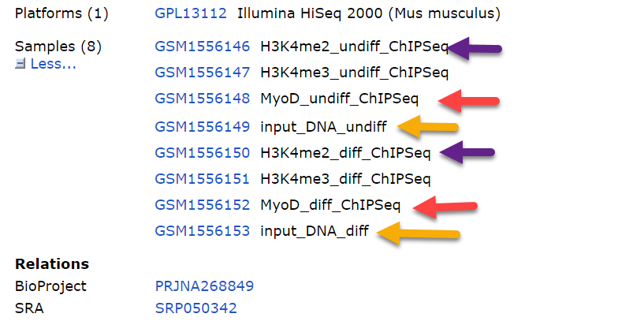
GEO Dataset
https://www.ncbi.nlm.nih.gov/geo/query/acc.cgi?acc=GSE63716

Slide 39
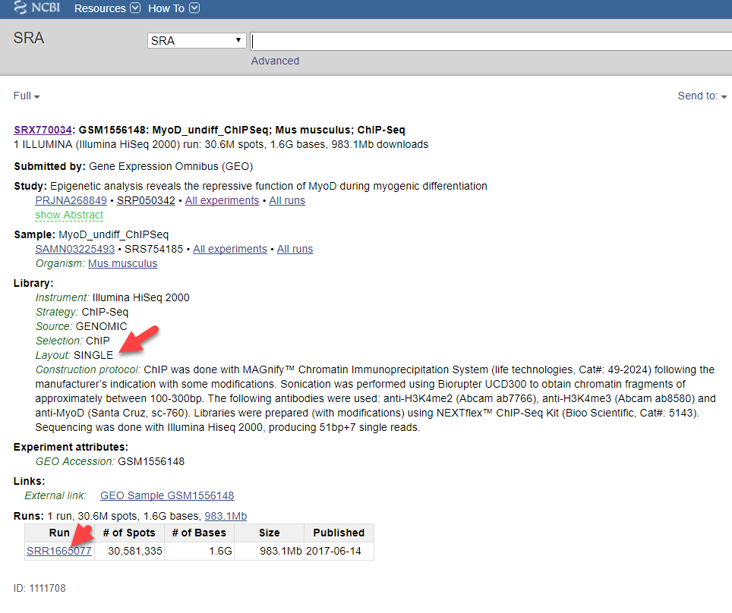
Download FASTQ Reads MyoD_Undiff_ChIp-Seq

Slide 40
ENA : Download FASTQ Reads MyoD_Undiff_ChIp-Seq

Slide 41
Txnfactor ChIPSeq pipeline in Partek flow

Slide 42
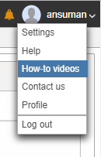

Slide 43
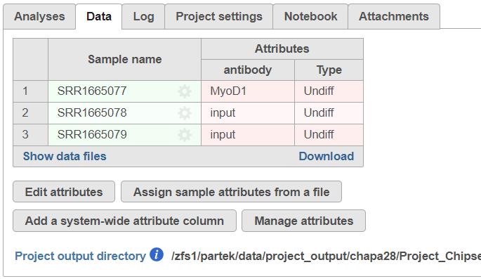
Import reads in Partek flow

Slide 44
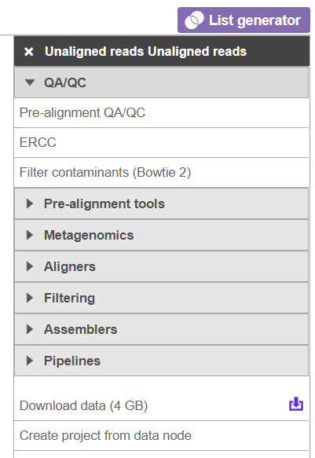
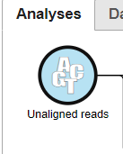
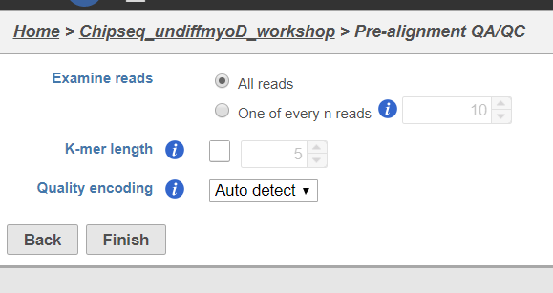
Pre-alignment QA/QC

Slide 45
QC report

Slide 46
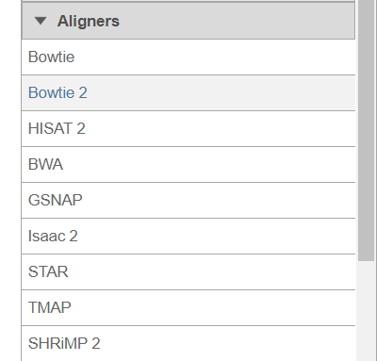
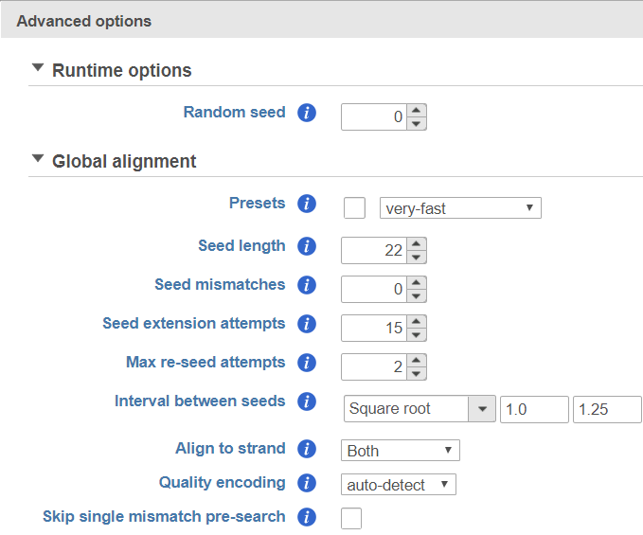
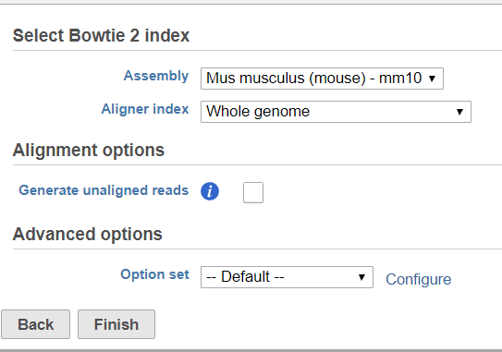
Read alignment with Bowtie 2

Slide 47
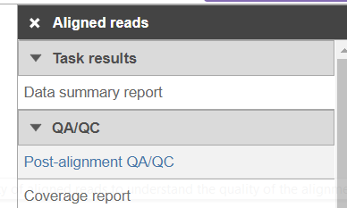
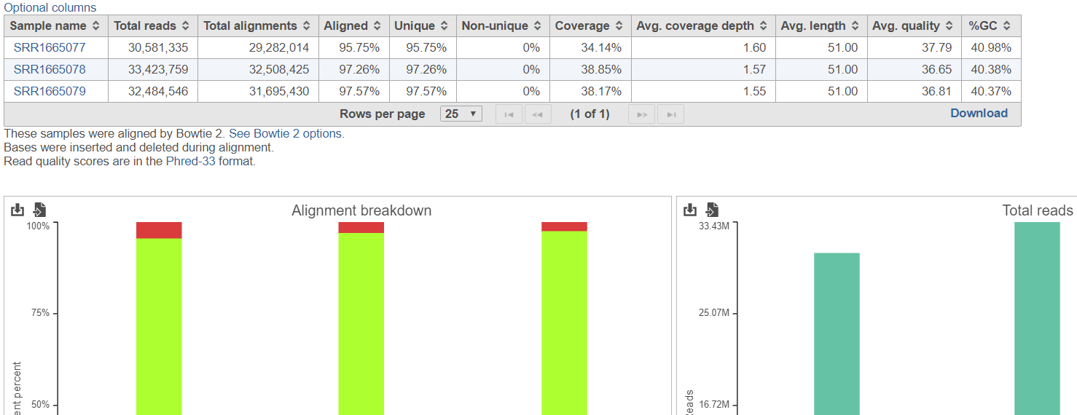
Post alignment QC

Slide 48
Peak Calling
Strino etal.,BMC Bioinformatics, June 2016

Slide 49
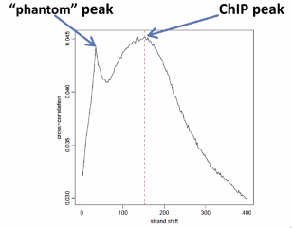
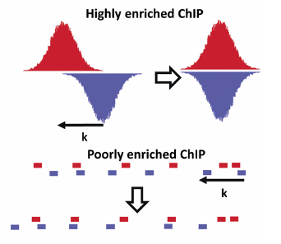
Peak Calling
Strino etal.,BMC Bioinformatics, June 2016
Landt etal.,Genome Research,2012

Slide 50
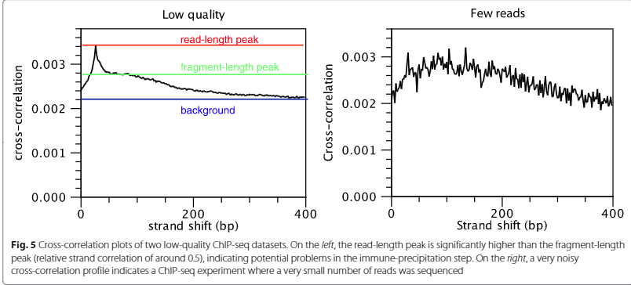
Peak Calling
Strino etal.,BMC Bioinformatics, June 2016

Slide 51
Peak Shape Score
The Peak Shape Score is standardised and follows a standard normal distribution, so a p-value for each genomic position can be calculated as
p-value=Φ(−Peak Shape Score of the peak centre), where Φ is the standard normal cumulative distribution function.
Score = genomic coverage * filter; *: cross-correlation operator
Score indicates how likely a genomic position is to be a center of a peak
Strino etal.,BMC Bioinformatics, June 2016

Slide 52
Peak Shape Filter
Strino etal.,BMC Bioinformatics, June 2016

Slide 53
Peak Detection
peaks are called by first identifying the genomic positions whose p-value is higher than the specified threshold and which do not have any higher value in a window around them.
The size of this window is determined by the filter as the longest distance between two positive values in the filter.
These maxima define the center of the peak, while the peak boundaries are identified by expanding from the center both left and right until either the score becomes 0 or the peak touches a window boundary
Strino etal.,BMC Bioinformatics, June 2016

Slide 54
Commonly Used Open-Source Tool
https://pypi.python.org/pypi/MACS2

Slide 55
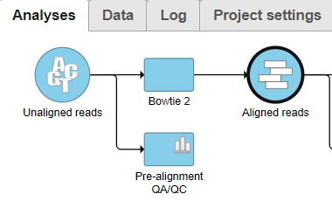
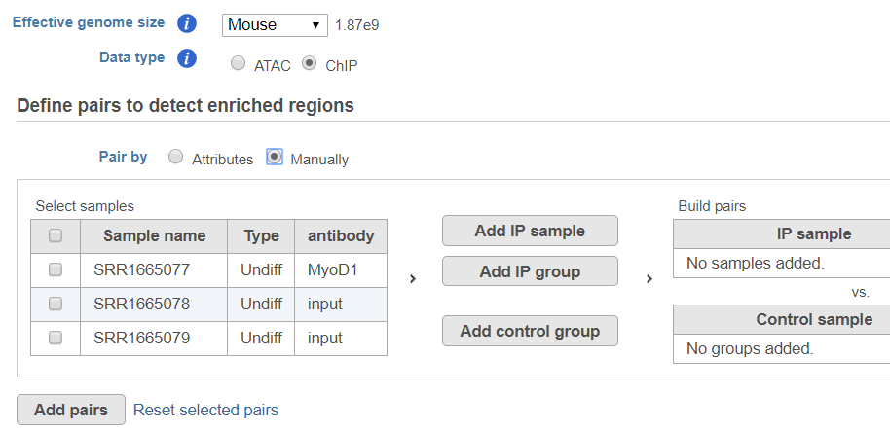
Txn factor Peak calling by MACS2

Slide 56
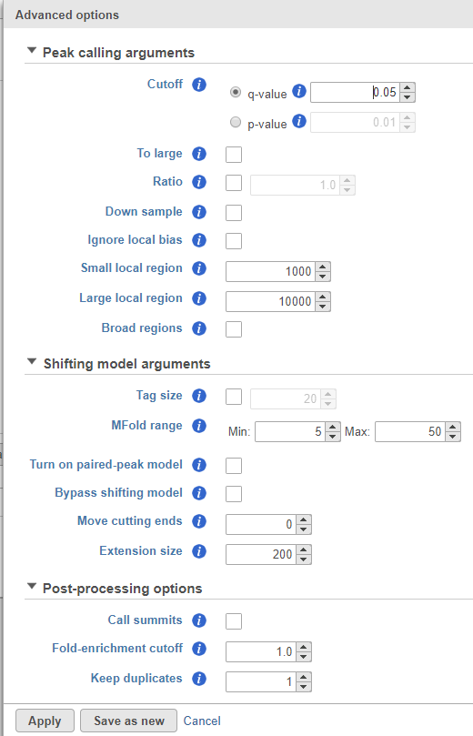
MACS2 for Txn factor ChIPSeq

Slide 57
Txnfactor ChIPSeq results in Partek flow

Slide 58
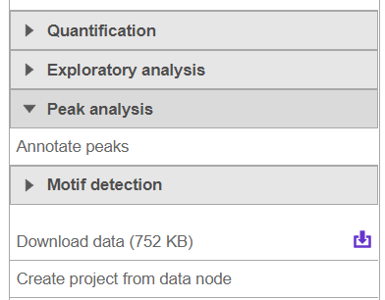
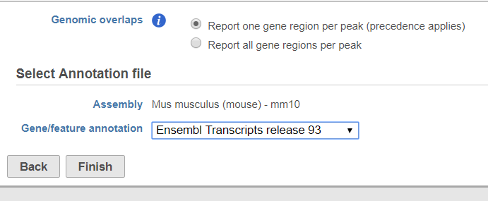
Peak Annotation

Slide 59
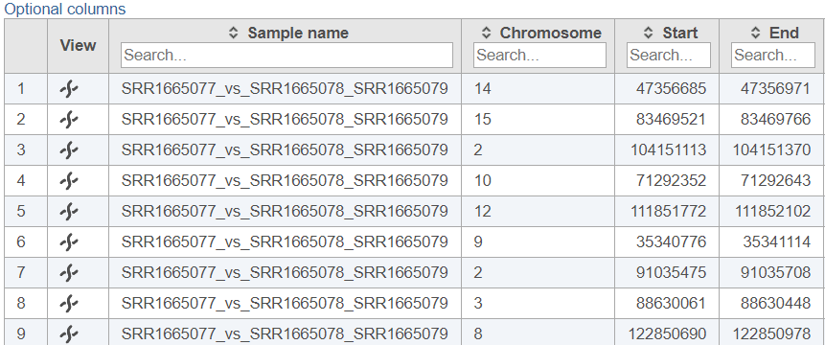
Peak Annotation results

Slide 60
Chromosome view for peak

Slide 61
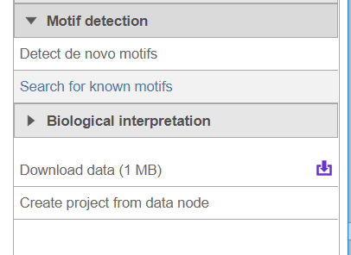
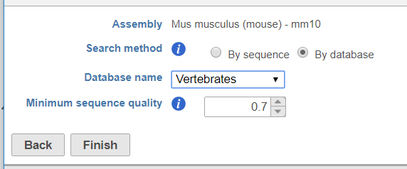
Motif detection

Slide 62
HSPH Bioinformatics Core
Shannan Ho Sui

Slide 63
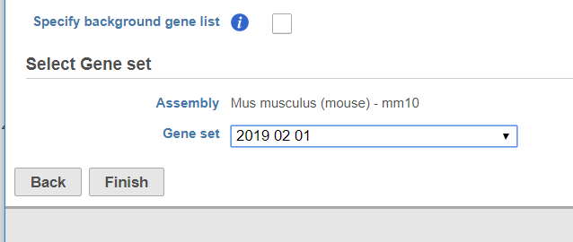
Gene set enrichment

Slide 64
Gene set enrichment results

Slide 65
Txnfactor ChIPSeq pipeline in Partek flow

Slide 66
Histone ChIP-Seq
Li etal., Cell 2007.01.015

Slide 67
Histone ChIP-Seq

Slide 68
Histone Modifications
Li etal., Cell 2007.01.015

Slide 69
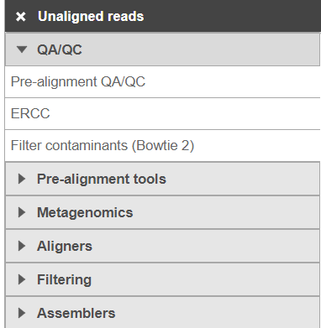
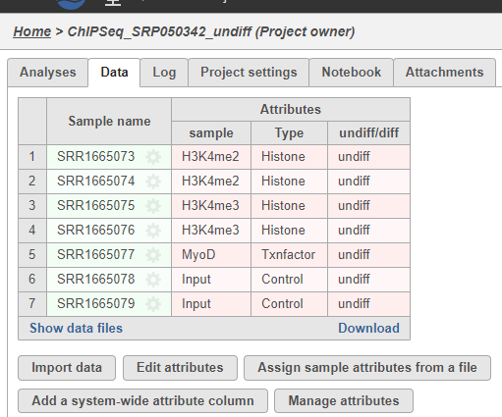
Histone Chipseq

Slide 70
Histone peak calling

Slide 71
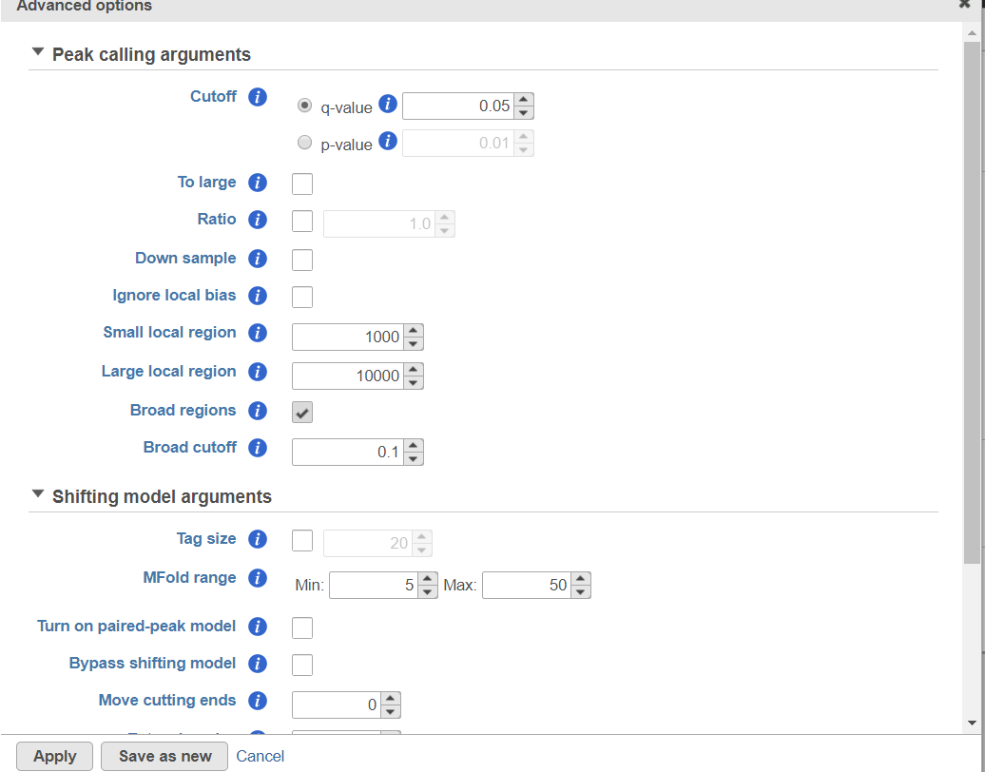
Histone peak calling cont…

Slide 72
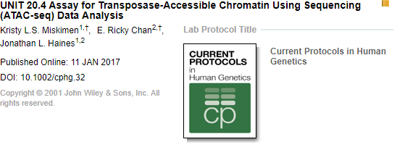
ATAC-Seq Data Analysis

Slide 73
ATAC Seq pipeline in Partek flow

Slide 74
Contact us for one-on-one Consultations
https://hsls.pitt.edu/ask-a-molbio-specialist

Slide 75
Thanks To….
HSLS
Sri Chaparala
Carrie Iwema
David Leung
Michael Sweezer
CLCBio
Shawn Prince
Center for Research Computing
Mu Fangping

