Slide 1
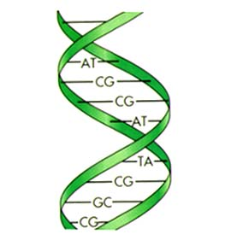
Mobile MolBio: Apps for Scientists 24th February 2011 Lunch w/a Librarian
Carrie L Iwema, PhD, MLS
Molecular Biology Information Specialist
Health Sciences Library System
University of Pittsburgh
iwema@pitt.edu
http://www.hsls.pitt.edu/molbio

Slide 2
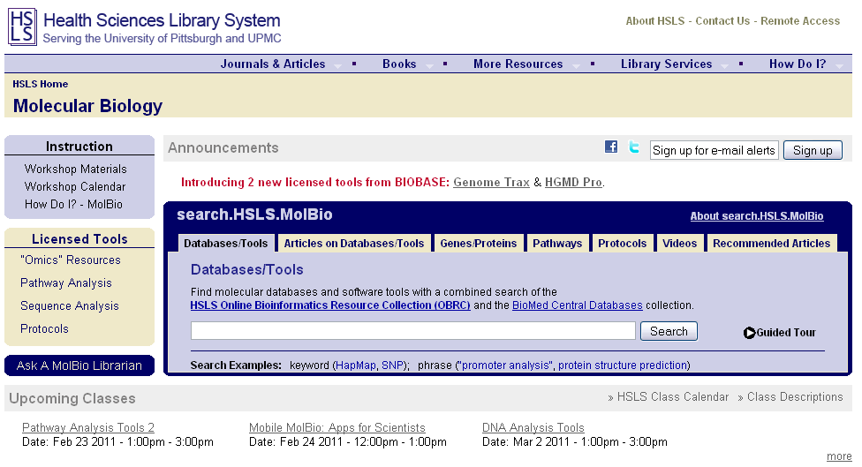
HSLS MolBio
http://www.hsls.pitt.edu/molbio

Slide 3
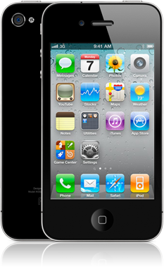
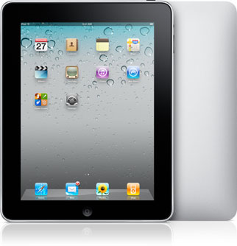
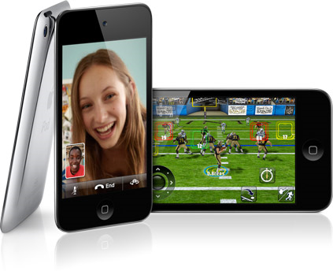
iDevices
iPad
iPhone
iPod touch
http://www.hsls.pitt.edu/molbio

Slide 4
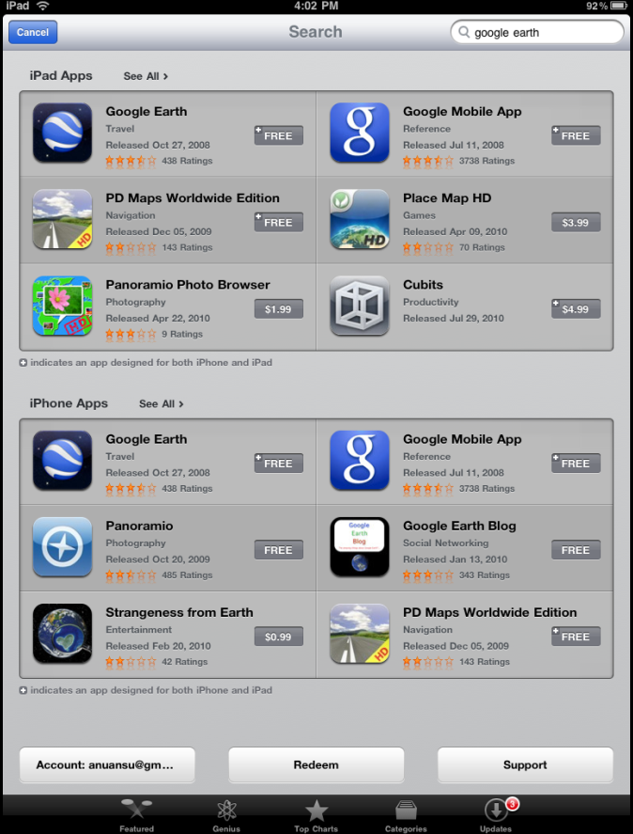
“…there’s an app for that”
http://www.hsls.pitt.edu/molbio

Slide 5
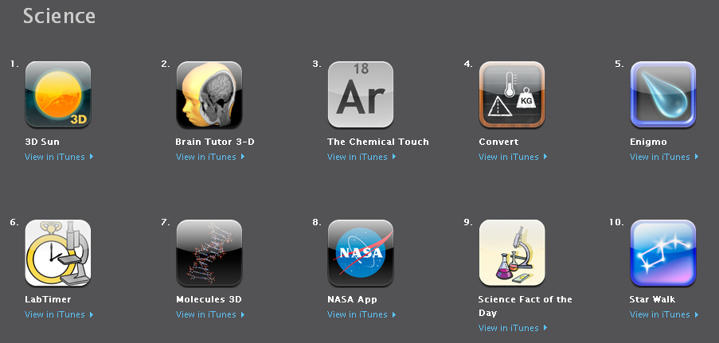
Science Apps
http://www.hsls.pitt.edu/molbio

Slide 6
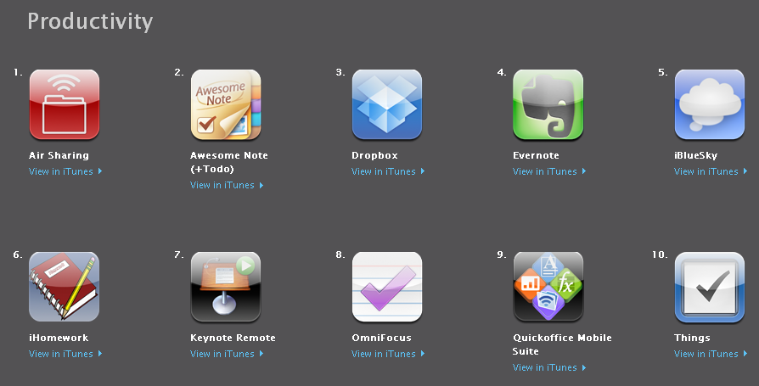
Productivity Apps
http://www.hsls.pitt.edu/molbio

Slide 7
Topics
Literature Informatics
Bioinformatics
Research Lab Productivity
http://www.hsls.pitt.edu/molbio

Slide 8
Apps for
Literature Informatics
http://www.hsls.pitt.edu/molbio

Slide 9
Literature Informatics Apps
PubMed on Tap
JournalRss
Mendeley lite
PLoS Reader
SciVerse
http://www.hsls.pitt.edu/molbio

Slide 10
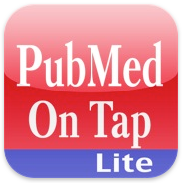
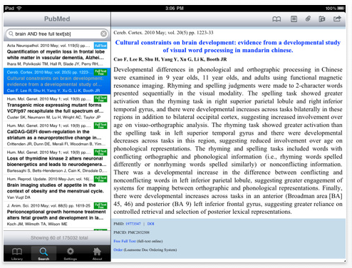
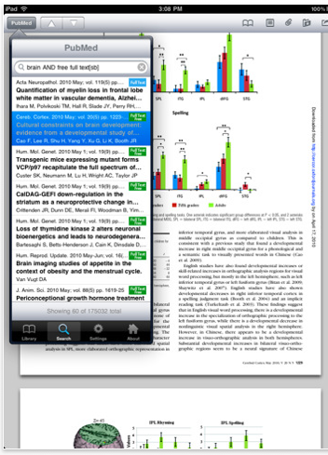
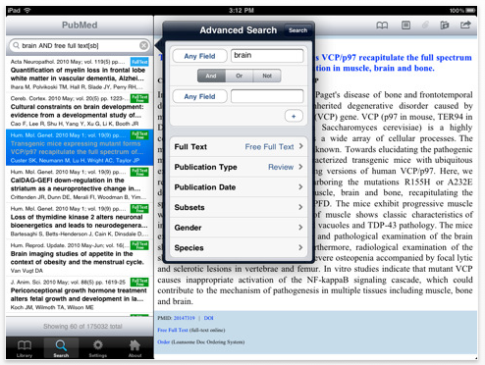
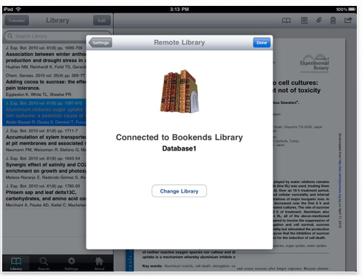
PubMed on Tap: iPad/iPhone/iPod touch
http://www.hsls.pitt.edu/molbio

Slide 11
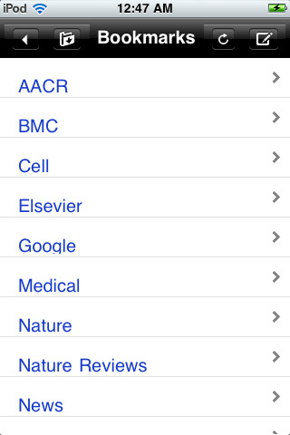
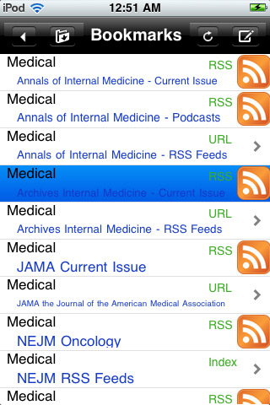
JournalRSS: iPhone/iPod touch
http://www.hsls.pitt.edu/molbio

Slide 12
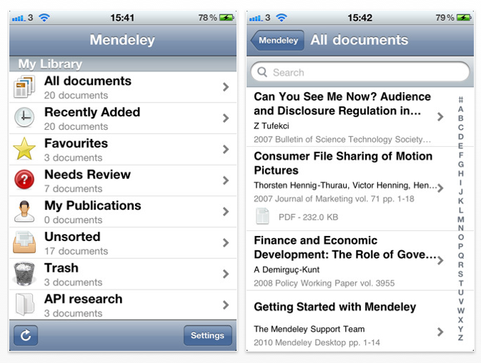
Mendeley Lite: iPad/iPhone/iPod touch
http://www.hsls.pitt.edu/molbio

Slide 13
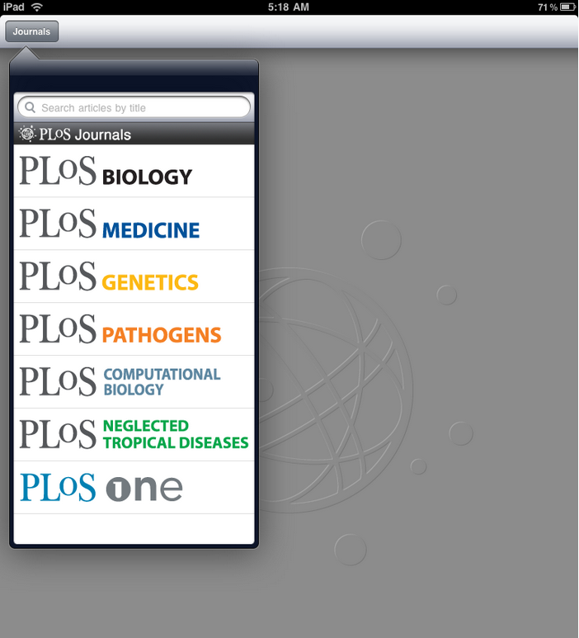
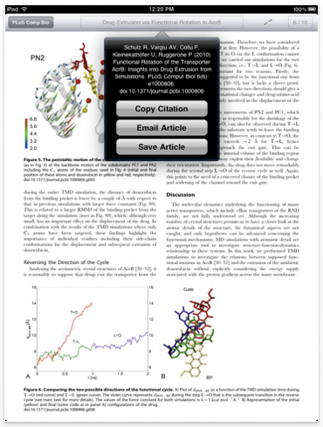
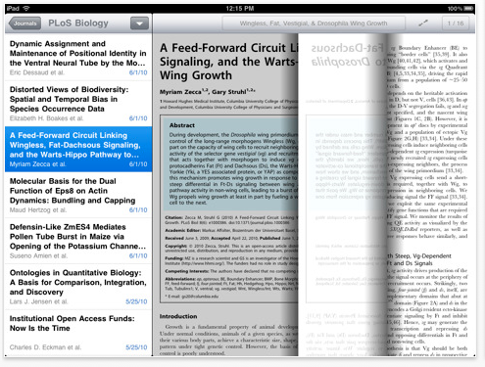
PloS Reader: iPad
http://www.hsls.pitt.edu/molbio

Slide 14
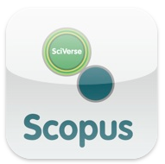
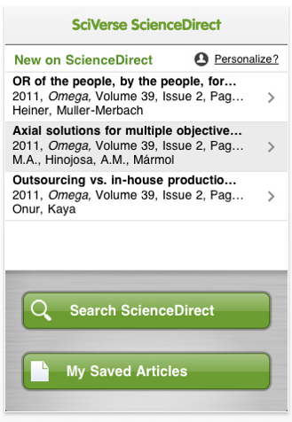
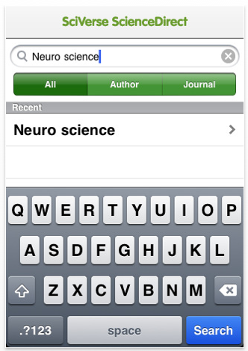
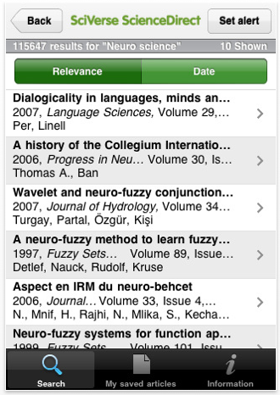
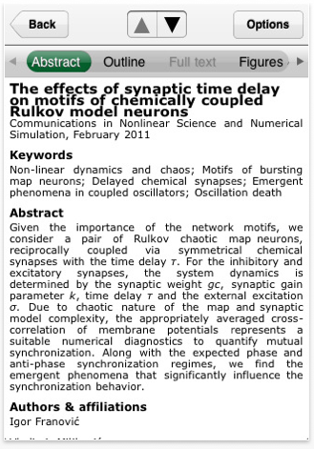
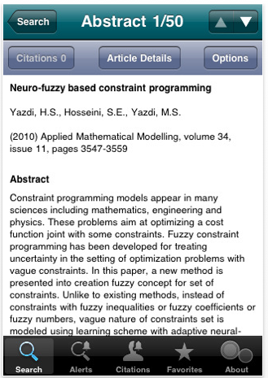
SciVerse: iPhone/iPod touch
http://www.hsls.pitt.edu/molbio

Slide 15
Apps for
Bioinformatics
http://www.hsls.pitt.edu/molbio

Slide 16
Bioinformatics Apps
GeneIndex
BioGene
BioGPS
genomePad
Molecules
iPathways
http://www.hsls.pitt.edu/molbio

Slide 17
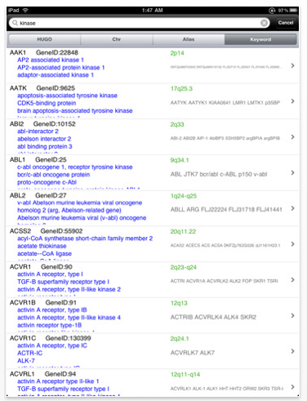
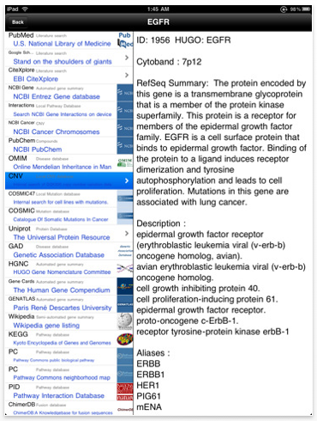
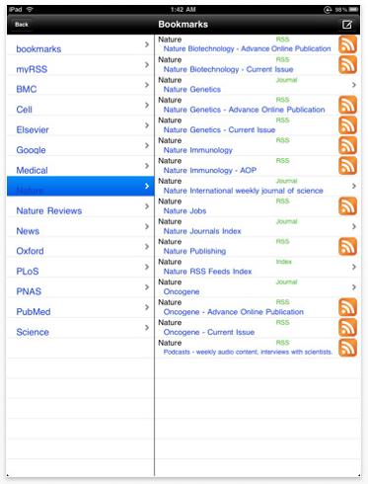
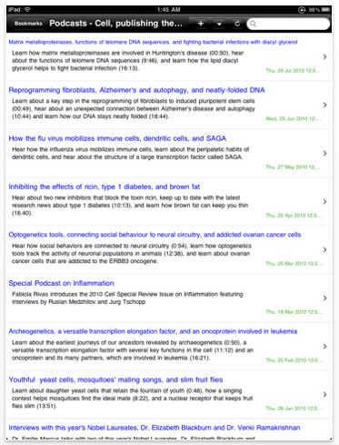
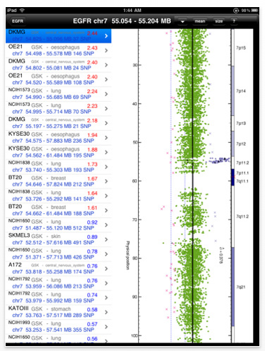
GeneIndex: iPad/iPhone/iPod touch
http://www.hsls.pitt.edu/molbio

Slide 18
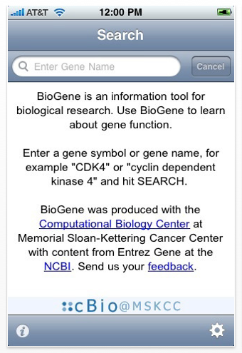
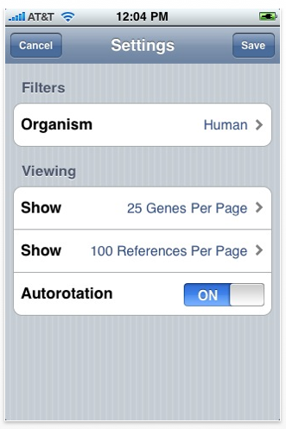
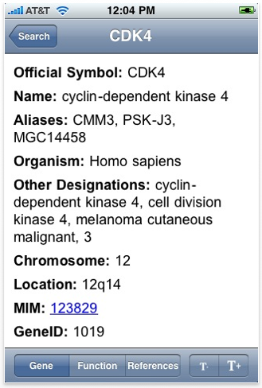
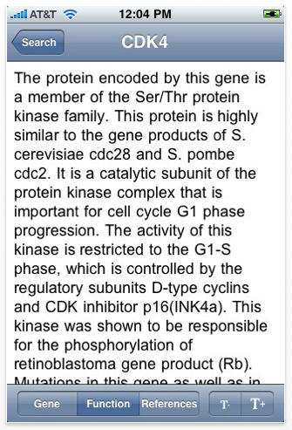
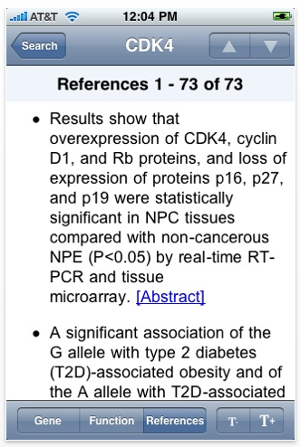
BioGene: iPhone/iPod touch
http://www.hsls.pitt.edu/molbio

Slide 19
BioGPS: iPhone/iPod touch
http://www.hsls.pitt.edu/molbio

Slide 20
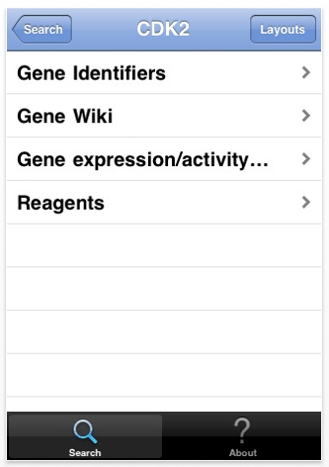
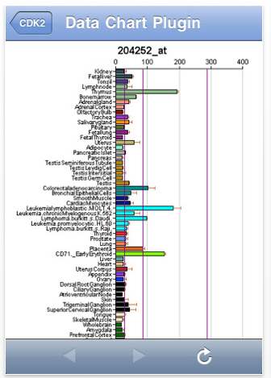
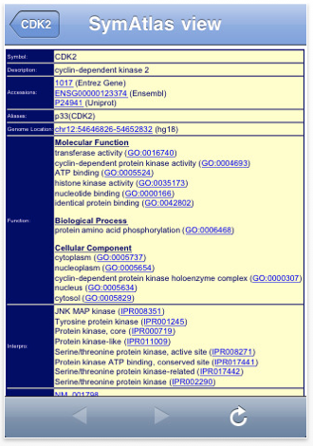
BioGPS
http://www.hsls.pitt.edu/molbio

Slide 21
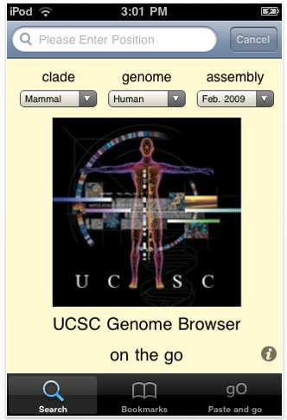
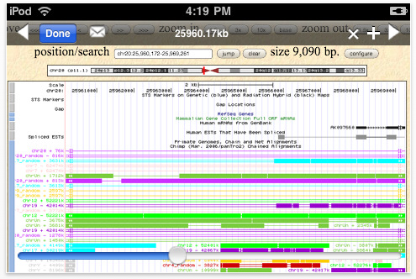
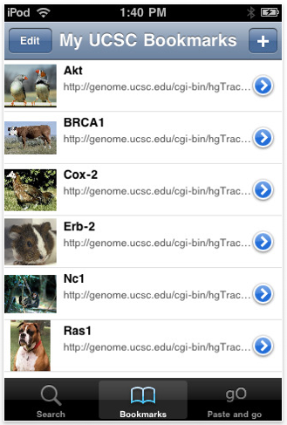
genomePad: iPhone/iPod touch
http://www.hsls.pitt.edu/molbio

Slide 22
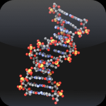
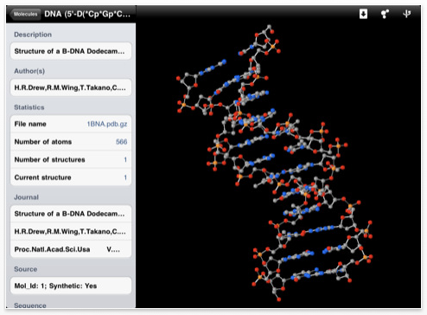
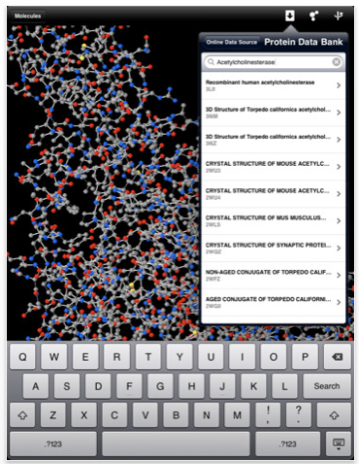
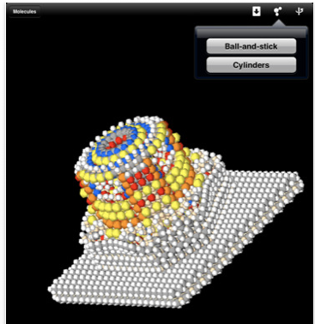
Molecules: iPad/iPhone/iPod touch
http://www.hsls.pitt.edu/molbio

Slide 23
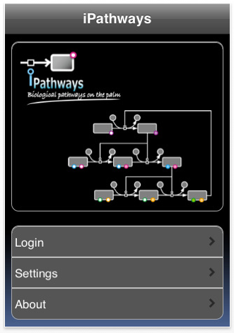
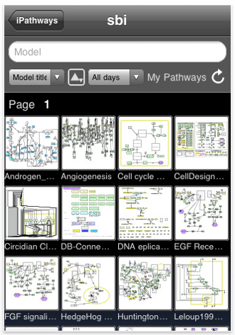
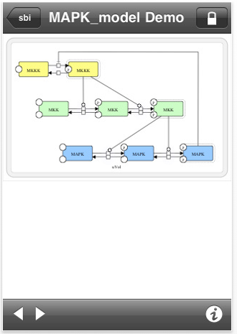
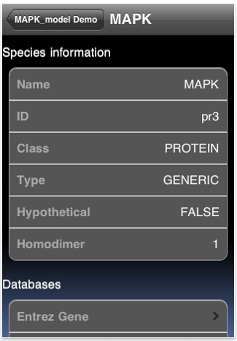
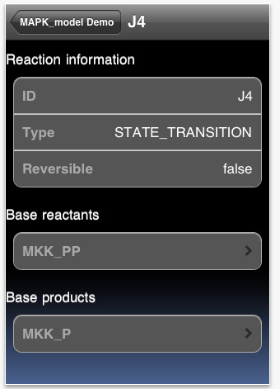
iPathways: iPad/iPhone/iPod touch
http://www.hsls.pitt.edu/molbio

Slide 24
Apps for
Research Lab Productivity
http://www.hsls.pitt.edu/molbio

Slide 25
Research Lab Productivity
Promega
Bio-Rad Real-Time PCR
NEB Tools
Gene Link: BioTools
Genetic Code
Protocolpedia
LabTimer
DropBox
Evernote
http://www.hsls.pitt.edu/molbio

Slide 26
Promega: iPad/iPhone/iPod touch
http://www.hsls.pitt.edu/molbio

Slide 27
Bio-Rad RT-PCR: iPhone/iPod touch
http://www.hsls.pitt.edu/molbio

Slide 28
NEB Tools: iPhone/iPod touch
http://www.hsls.pitt.edu/molbio

Slide 29
Gene Link BioTools: iPhone/iPod touch
http://www.hsls.pitt.edu/molbio

Slide 30
Genetic Code: iPhone/iPod touch
http://www.hsls.pitt.edu/molbio

Slide 31
Protocolpedia: iPhone/iPod touch
http://www.hsls.pitt.edu/molbio

Slide 32
LabTimer: iPad/iPhone/iPod touch
http://www.hsls.pitt.edu/molbio

Slide 33
DropBox: iPad/iPhone/iPod touch
http://www.hsls.pitt.edu/molbio

Slide 34
Evernote: iPad/iPhone/iPod touch
http://www.hsls.pitt.edu/molbio

Slide 35
Thank you! Any questions?
Carrie L Iwema, PhD, MLS
iwema@pitt.edu
http://www.hsls.pitt.edu/molbio

