Slide 1
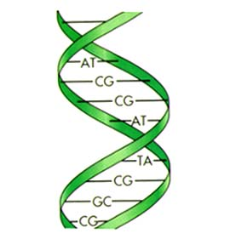
Making Sense of the ENCODE Project (ENCyclopedia Of DNA Elements) Data
Ansuman Chattopadhyay, PhD
Head, Molecular Biology Information Services
Health Sciences Library System
University of Pittsburgh
ansuman@pitt.edu

Slide 2
Topics
Introduction
Gene Regulation
Epigenetics
ENCODE Project
Plus and minuses
UCSC Encode Browser
Noteworthy Tools
Regulome db,
NCBI Epigenome
Genboree

Slide 3
Topics
retrieve promoter sequences
determine transcription factor occupancy
browse through the epigenetic biochemical markers
Histone modifications, DNA methylation etc.,
-predict the location of enhancers, silencers and promoters

Slide 4
INTRODUCTION

Slide 5
Genomic achievements since the Human Genome Project
http://www.hsls.pitt.edu/guides/genetics

Slide 6
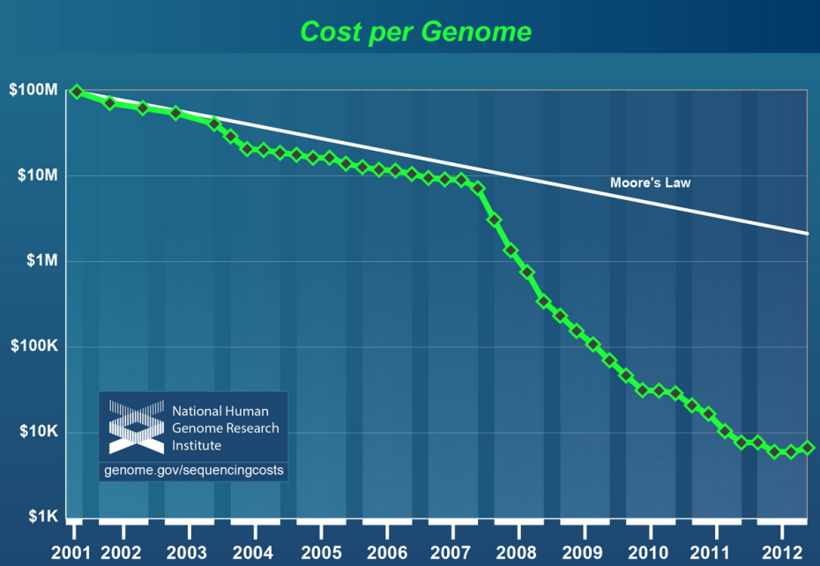
DNA Sequencing Cost
http://www.hsls.pitt.edu/molbio

Slide 7
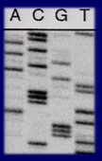
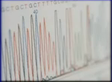
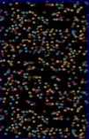
Progress in Genomics
1990 2003 2013
Time
Technology
6-8 year 3-4 months 2-3 days
Time
1B 10-50 M 4-6 K
Cost
Source: Eric Green; HGP10 Symposium

Slide 8
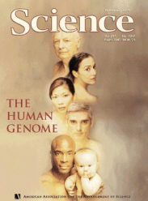
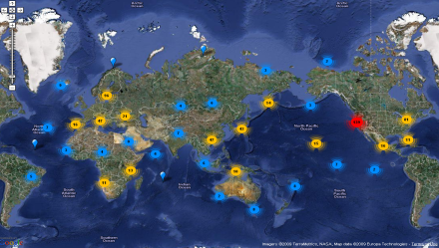
Genome Biology : Time Line
RNA
Bacteriophage
MS2
Human Genome
Draft Seq
Diploid Genome seq of
an Individual Human
Yeast
Drosophila
1976
1996
2001
2002
2007
1995
1998
2003
2008
2011
Haemophilus
Influenza
C. elegans
Published Complete
Human Ref Genome
Published Complete
Genomes: 1863 organisms
Jim Watson
Genome
http://www.hsls.pitt.edu/molbio

Slide 9
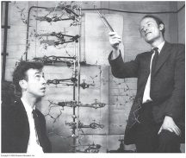
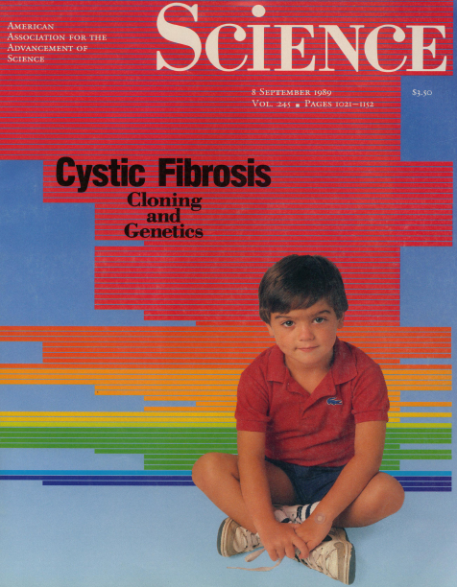
Big DATA Biology
Multi Gene –
System Wide –
High throughput
Multi Institution
Single Gene
Single Protein
Single lab
Small Science
Big Science

Slide 10
ENCODE

Slide 11
Epigenome and
Encyclopedia of DNA Elements Project

Slide 12
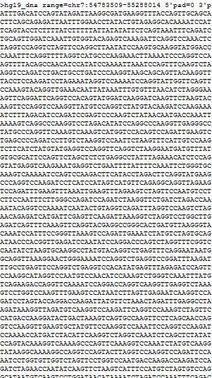
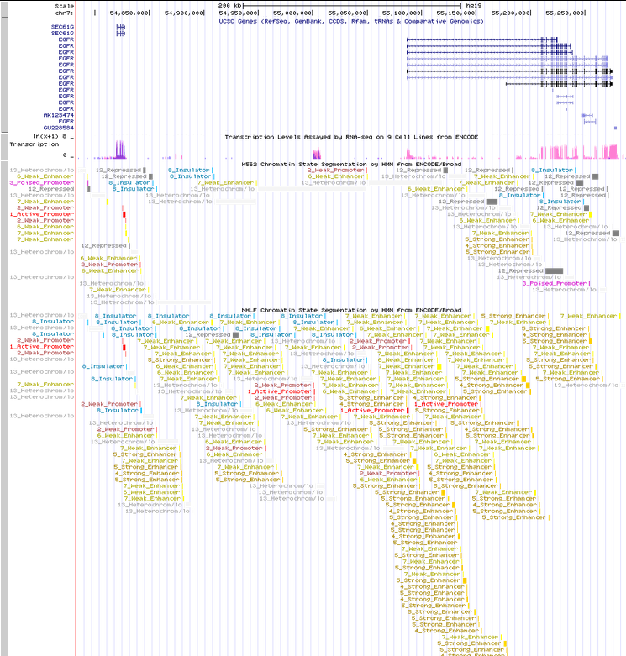

Slide 13
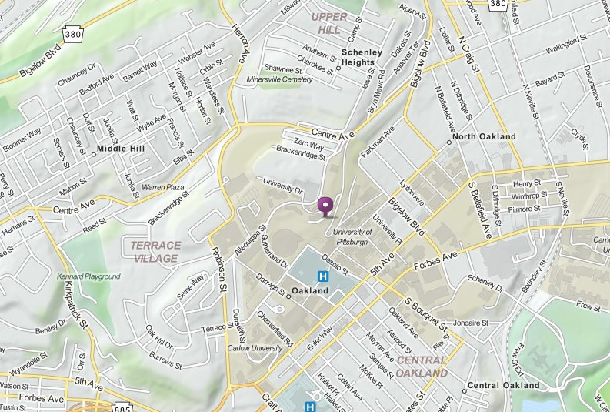
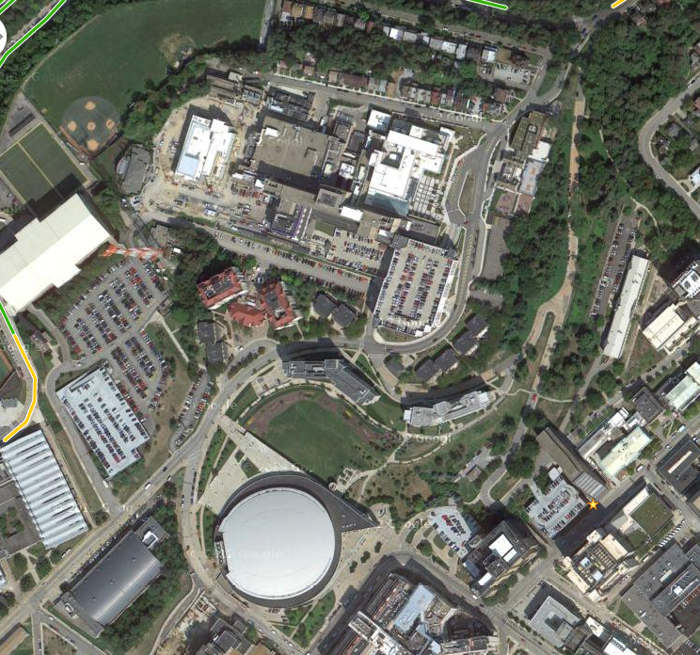
ENCODE

Slide 14
An excellent movie on transcription
http://vcell.ndsu.edu/animations/transcription/index.htm
http://www.hsls.pitt.edu/guides/genetics

Slide 15
Promoter, Enhancer and Silencer
Source: http://www.cbs.dtu.dk/dtucourse/cookbooks/dave/Lekt03bkg.html
http://www.hsls.pitt.edu/guides/genetics

Slide 16
Retrieve promoter sequence for a gene

Slide 17
UCSC Genome Browser
http://genome.ucsc.edu/cgi-bin/hgGateway

Slide 18
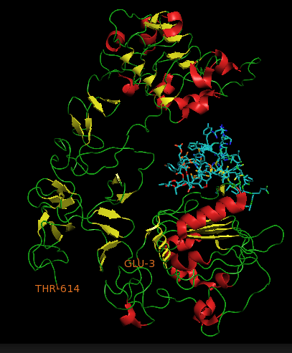
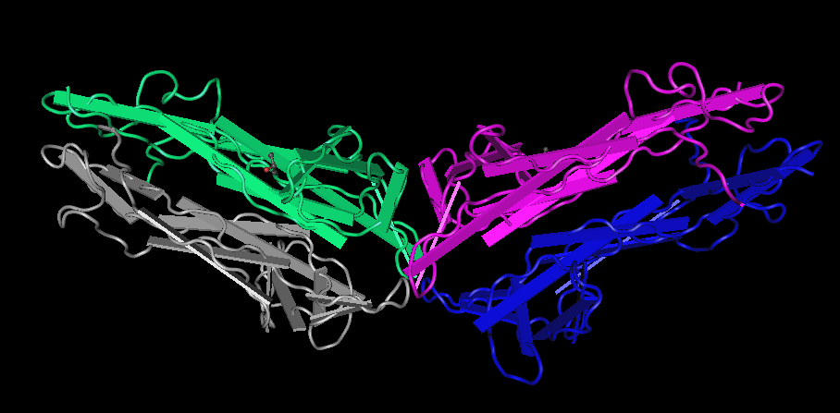
Gene of Interest
EGFR BDNF

Slide 19
BIOBASE TransPro
http://www.hsls.pitt.edu/guides/genetics

Slide 20
Promoter Sequence
Generic Promoter Seq
UCSC Genome Browser
Human Curated Promoter Seq
Biobase TransPro
CSH TRED
Eukaryotic Promoter Database (EPD)
Epigenome Data
http://www.hsls.pitt.edu/guides/genetics

Slide 21
Find sequence information for a gene
-genomic -promoter - intron-exon coordinates
-mRNA -protein
Resources
UCSC Genome Browser: http://genome.ucsc.edu/
NCBI Entrez Gene: http://www.ncbi.nlm.nih.gov/gene
Link to the video tutorial:
http://media.hsls.pitt.edu/media/clres2705/sequence.swf
http://media.hsls.pitt.edu/media/clres2705/sequence_2.swf
http://www.hsls.pitt.edu/molbio

Slide 22
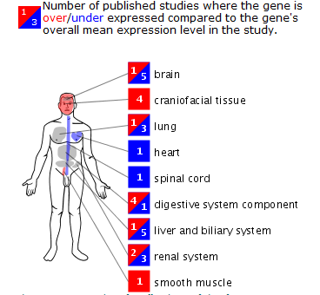
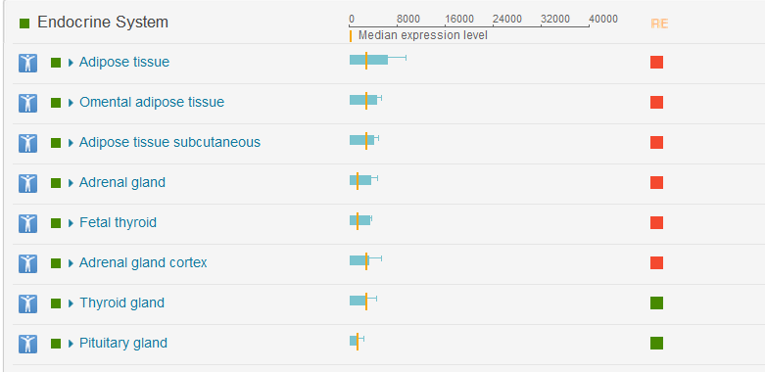
Spatiotemporal gene expression
EGFR
TP53

Slide 23
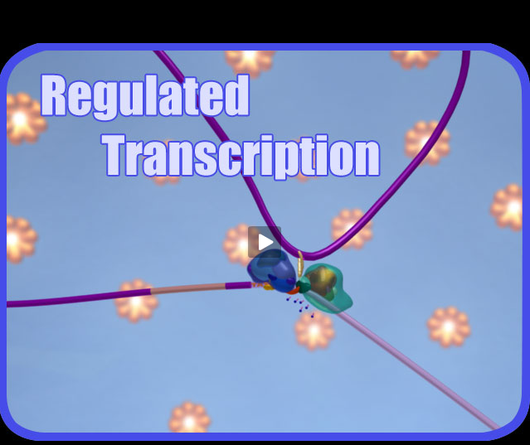
A movie on regulated transcription
http://vcell.ndsu.edu/animations/regulatedtranscription/index.htm

Slide 24
Epigenetic mechanisms
Source: NCBI
http://www.ncbi.nlm.nih.gov/books/NBK45788/#epi_sci_bkgrd.About_Epigenetics

Slide 25
Chromatin Immuno-Precititation-Seq (ChIP-Seq)

Slide 26
Epigenetic Markers
Landmark Paper:
http://www.nature.com/ng/journal/v39/n3/full/ng1966.html

Slide 27
NCBI-Epigenomics
http://www.ncbi.nlm.nih.gov/epigenomics

Slide 28
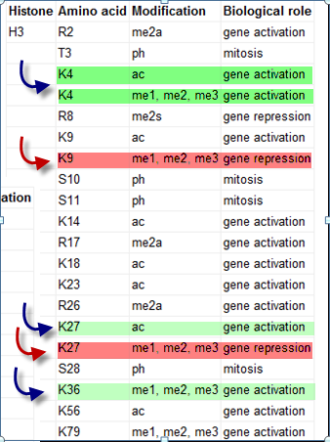
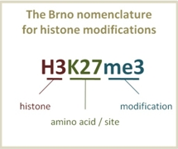
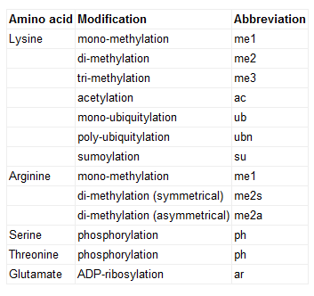
Histone Modifications
http://goo.gl/GQ9V8
http://www.hsls.pitt.edu/guides/genetics

Slide 29
Encode Project
http://www.genome.gov/10005107

Slide 30
http://www.nature.com/encode/#/threads
http://www.nature.com/encode/#/threads

Slide 31
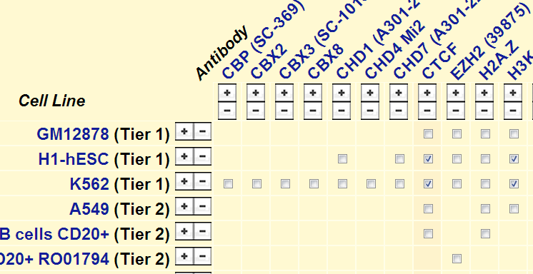
ENCODE DATA
30 papers
1640 data sets - a matrix of Assay Vs Cell Types
74.7% of the genome is transcribed,
56.1% is associated with modifed histones
15.2% is found in open-chromatin areas
8.5% binds transcription factors
4.6% consists of methylated CpG dinucleotides

Slide 32
ENCODE Project
http://www.plosbiology.org/article/info:doi/10.1371/journal.pbio.1001046

Slide 33
Encode Cell Types
http://genome.ucsc.edu/ENCODE/cellTypes.html

Slide 34
UCSC ENCODE BROWSER

Slide 35
Sec61g and EGFR
human chr7:54,801,956-55,305,954
http://goo.gl/QVsvN

Slide 36
EGFR and Sec61g
http://www.hsls.pitt.edu/guides/genetics

Slide 37
EGFR and Sec61g
Role of the Sec61 translocon in EGF receptor trafficking to the nucleus and gene expression.
Liao HJ, Carpenter G.
Mol Biol Cell. 2007 Mar;18(3):1064-72. Epub 2007 Jan 10.
http://www.hsls.pitt.edu/guides/genetics

Slide 38
Sec61g and EGFR

Slide 39
Identify promoter, enhancer and silencer sequences by browsing the epigenomic markers generated by the ENCODE project
Resource
UCSC Genome Browser: http://genome.ucsc.edu/
Link to the video tutorial:
http://media.hsls.pitt.edu/media/molbiovideos/encode1-ac0212.swf
http://media.hsls.pitt.edu/media/molbiovideos/encode2-ac0212.swf
http://media.hsls.pitt.edu/media/molbiovideos/encode3-ac0212.swf
http://www.hsls.pitt.edu/molbio

Slide 40
Cell Lines
K562
NHLF

Slide 41
UCSC browser link-genes: http://goo.gl/QVsvN
Video Tutorials
Browse the region of human chromosome 7 part
1: http://media.hsls.pitt.edu/media/clres2705/ucsc_genes.swf
Browse the region of human chromosome 7 part 2: http://media.hsls.pitt.edu/media/clres2705/ucsc_snp.swf
NCBI Mapviewer: http://media.hsls.pitt.edu/media/clres2705/ncbimapviewer.swf
Place a mRNA or peptide sequence into the human genome: http://media.hsls.pitt.edu/media/clres2705/blat.swf

Slide 42
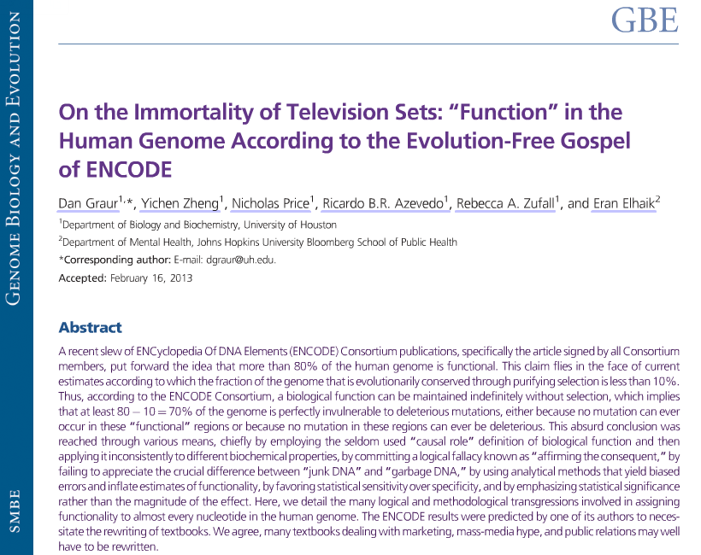
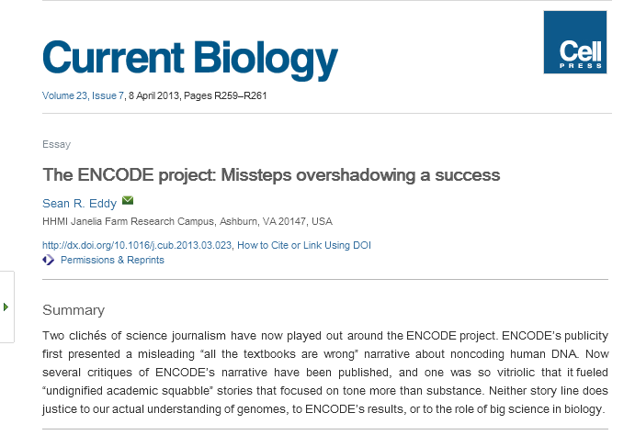
ENCODE Criticisms

Slide 43
ENCODE Summary
http://goo.gl/0IfZ9

Slide 44
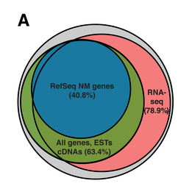
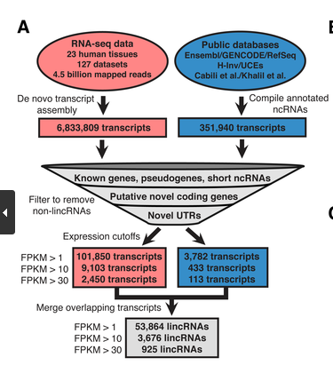
Latest Paper
http://goo.gl/3rJC7

Slide 45
Noteworthy Tools

Slide 46
Regulome, Haploreg and Genebore
http://goo.gl/jhBvS
http://goo.gl/oP5gj

Slide 47
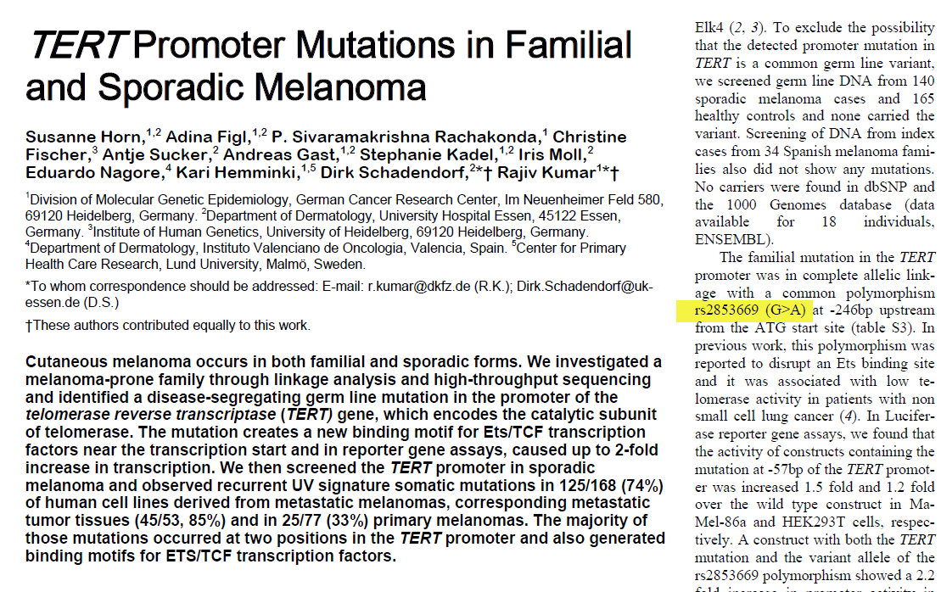
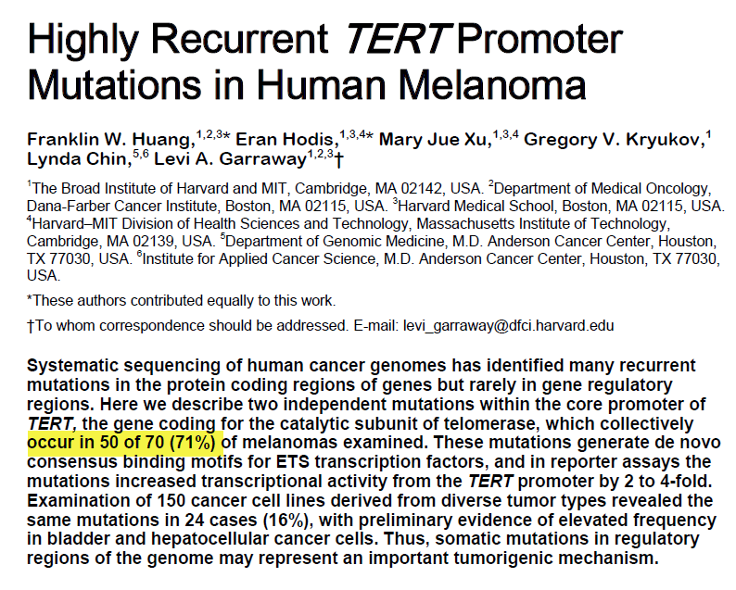
rs7216389
rs2853669

Slide 48
Regulome

Slide 50
HaploReg

Slide 51
ENCODE Tutorials
http://www.genome.gov/27553901

Slide 52
NCBI Roadmap Epigenomics Page

Slide 53
Thank you! Any questions?
Ansuman Chattopadhyay
ansuman@pitt.edu
412-648-1297
http://www.hsls.pitt.edu/guides/genetics

